Slide 1
Sustainability
A Course in Business Ethics
Module 16
John Hooker
Carnegie Mellon University
May 2022

Slide 2
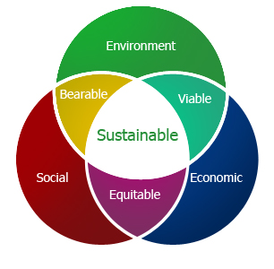
Theme
Three perspectives on sustainability:
  Environmental (energy, circular economy)
  Social (inclusion)
  Financial (stability)
2

Slide 3

Outline
Basic concepts
Ethical basis for sustainability
Environmental sustainability
Social sustainability
Financial sustainability
3

Slide 4
Basic Concepts

Slide 5

Basic Concepts
Sustainable Business
Triple Bottom Line
Sustainability doughnut
Greenwashing
5

Slide 6

Sustainable Business
What is it?
  Business that meets the needs of the present without compromising the ability of future generations to meet their needs.
    Brundtland definition (1987)
6

Slide 7
Sustainable Business
What is it?
  Business that contributes value while supporting the environmental, social, and economic systems that make value creation possible over the long run.
7

Slide 8
Sustainable Business
What is it?
  Business that manages for the Triple Bottom Line.
8

Slide 9
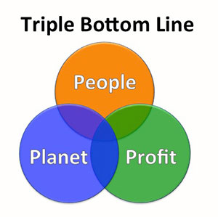
Triple Bottom Line
A “full cost” accounting approach
  People
    Social impact of the business
  Planet
    Environmental impact
  Profit
    Traditional measures
9

Slide 10

Triple Bottom Line
How to measure it?
  Global Reporting Initiative
    Used by 1000s of organizations in >100 countries for sustainability reporting
10

Slide 11
Sustainability doughnut
Combines social and environmental sustainability measures.
  Bars in the doughnut hole represent failure to meet social needs.
  Bars beyond the doughnut represent unsustainable
  pressure on the environment.
  Goal is to stay within the doughnut.
11

Slide 12
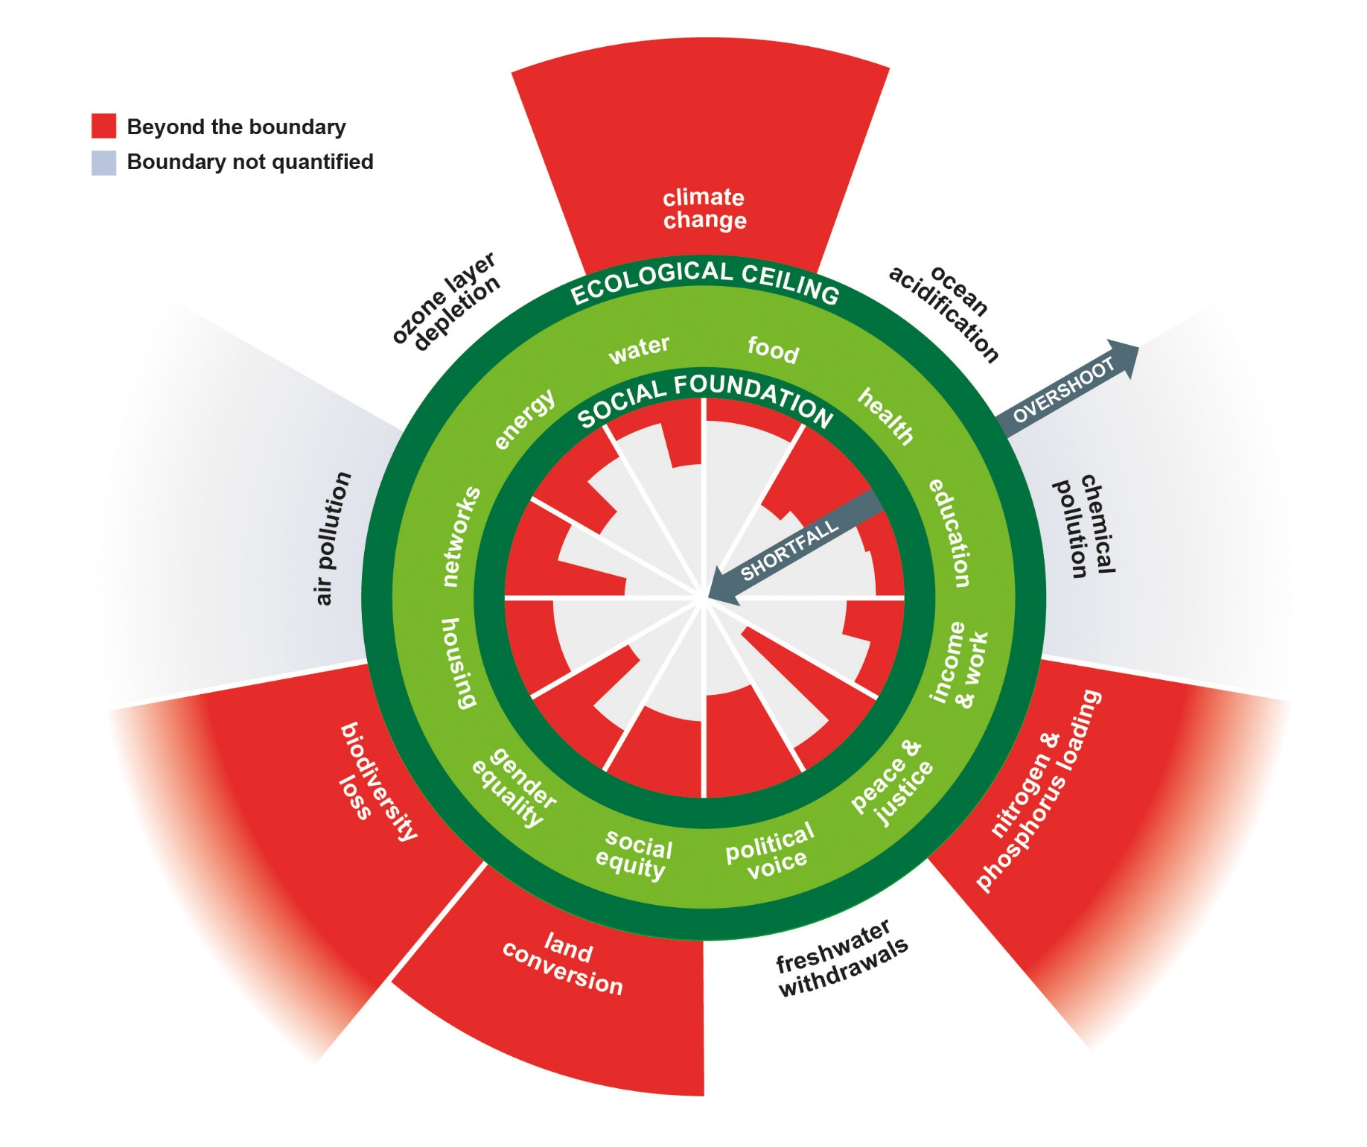
How to measure it?
12

Slide 13

Greenwashing
What is it?
  Greenwashing = spending more time and energy claiming to be green than being green.
13

Slide 14
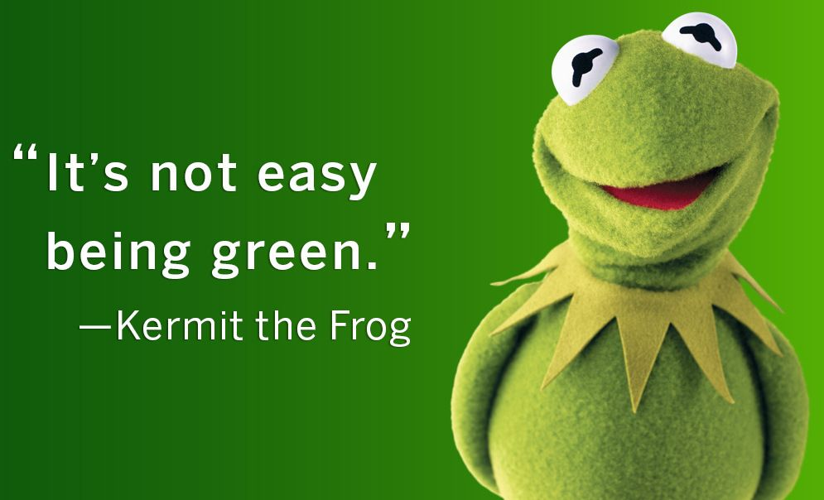
Greenwashing
Why does it exist?
  It’s often cheaper and easier to appear green
  than to be green.
    Public relations
    experts can
    manufacture an
    apparent concern
    for the environment.
14

Slide 15
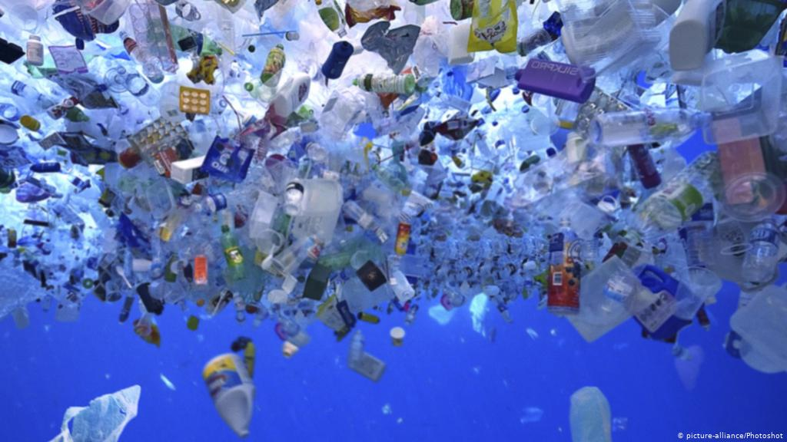
Greenwashing
Sophisticated greenwashing – plastics recycling
  Major issue since 1970s: plastics in the environment.
    Yet problem keeps getting worse.
    Oceans will
    contain more
    plastic than fish
    by 2050 (WEF).
    Plastic micro-
    particles
    everywhere.
Part of Great Pacific Garbage Patch
15

Slide 16
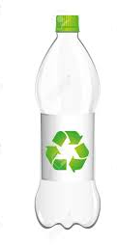

Greenwashing
Industry “solution”– plastics recycling
  It is the consumer’s responsibility to reduce plastics.
    Recycling logo creates impression that
    plastics are recycled.
    Even environmentalists initially bought
    into it.
16

Slide 17
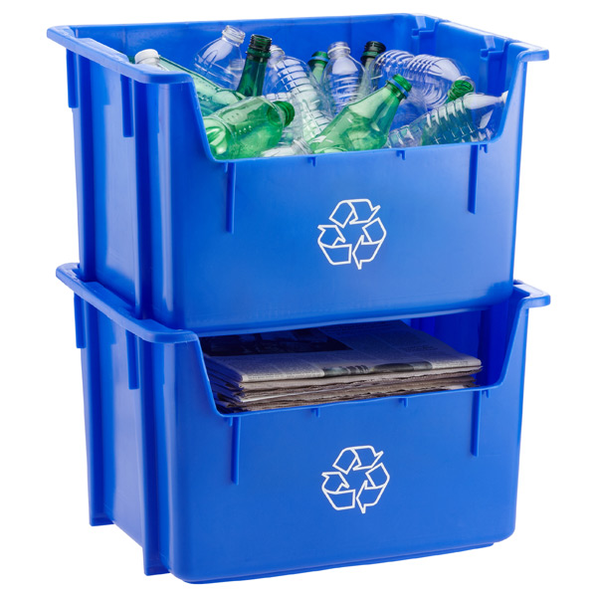
Greenwashing
Industry “solution”– plastics recycling
  One little problem – plastics recycling has never been economical.
    Not in 1970, not now.
    New plastics are cheaper than
    recycled plastics.
    The industry knows this.
    Only 9% of plastics have been
    recycled in U.S.
    Industry is “greenwashed” by
    shifting responsibility to consumer.
17

Slide 18
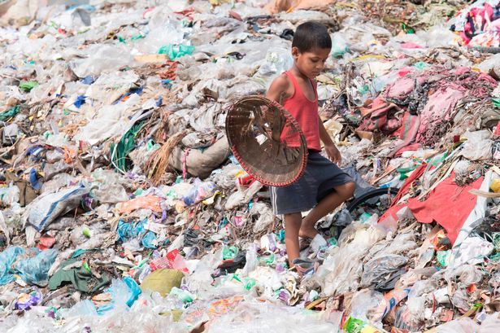
Greenwashing
Industry “solution”– plastics recycling
  What happens to “recycled” plastics?
    Much goes
    to Asia.
    Children
    pick out
    salable
    items from
    landfills.
    Much is
    dumped
    into the
    ocean.
18

Slide 19
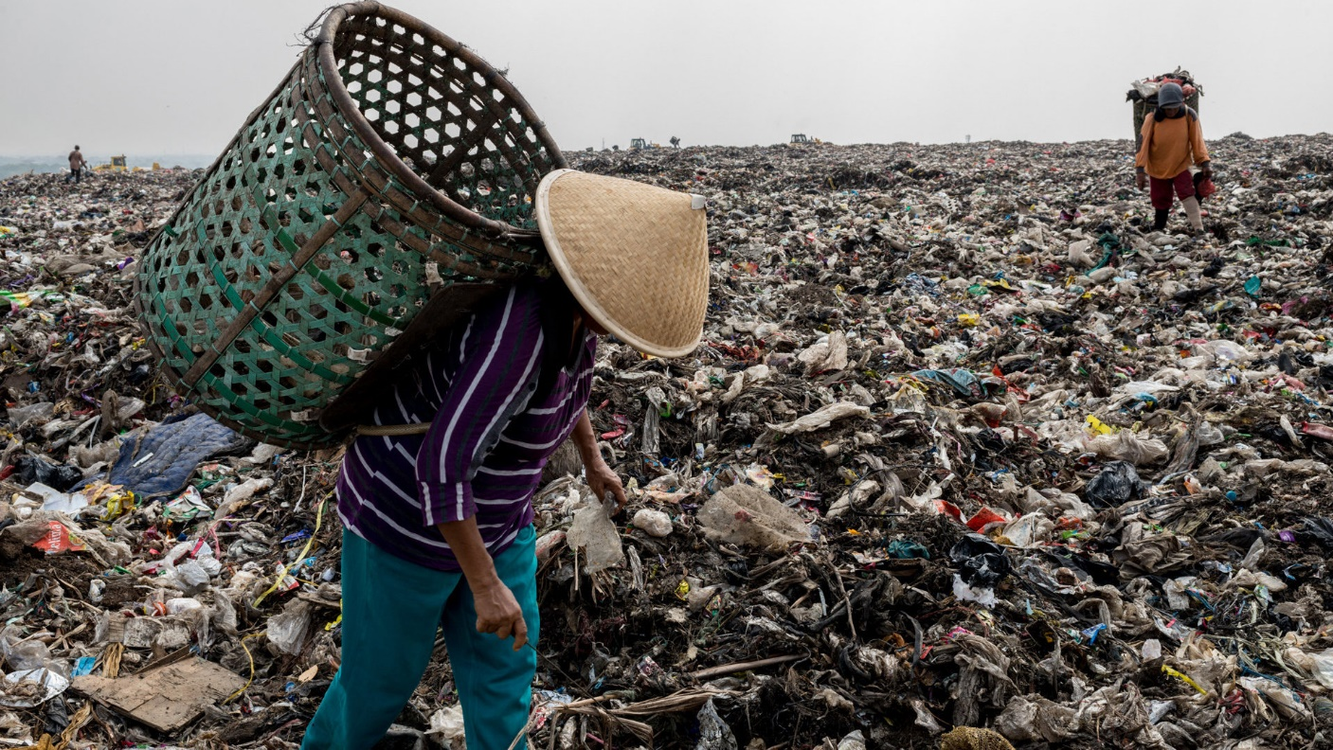
Greenwashing
Industry “solution”– plastics recycling
  What happens to “recycled” plastics?
    China put
    a stop to
    this in 2018.
    Waste now
    goes to
    Indonesia,
    etc.
19

Slide 20

Greenwashing
A more realistic approach – the Green Dot
  Began with German packaging law, 1991
    Manufacturers required to dispose and/or recycle
    all packaging material.
  German duales System takes care of this
  if packaging bears green dot.
    Green dot indicates that manufacturer has
    paid for disposal and/or recycling.
    Incentivizes manufacturers to minimize
    packaging material.
    Now expanded to EU (2008).
Green dot
(not a recycling logo)
20

Slide 21
Ethical Basis for Sustainability

Slide 22

Ethical Basis for Sustainability
Generalization Principle
Utilitarian Principle and discounting the future
22

Slide 23
Generalization Principle
Sustainability is another way of understanding
the generalization principle
  With a focus on the future
  Unsustainable business is not generalizable
    Undermines the environmental and social systems
    that make profitable business possible.
23

Slide 24
Utilitarian Principle
No reason to discount future returns when applying this principle.
  Why do we discount future returns when evaluating an investment?
    To compensate for risk that expected returns won’t materialize.
      Utilitarian calculation already does this.
    To reflect opportunity cost (money could have earned a return elsewhere).
      Utilitarian calculation already considers all the options.
    Because deferred gratification is less desirable.
      This is irrational if risk is already factored in.
24

Slide 25
Environmental sustainability

Slide 26

Sustainable Business
Umicore (circular economy)
AES Corporation (energy)
Lease vs buy
Car sharing
26

Slide 27

Umicore in Congo
A dark past in the mining industry …
  Historically involved in Belgian Congo.
    Perhaps the most exploitative European colony ever.
  Today, a €12 billion company known for recycling and sustainability.
    In 2013, ranked most sustainable company in the world by Corporate Knights.
27

Slide 28
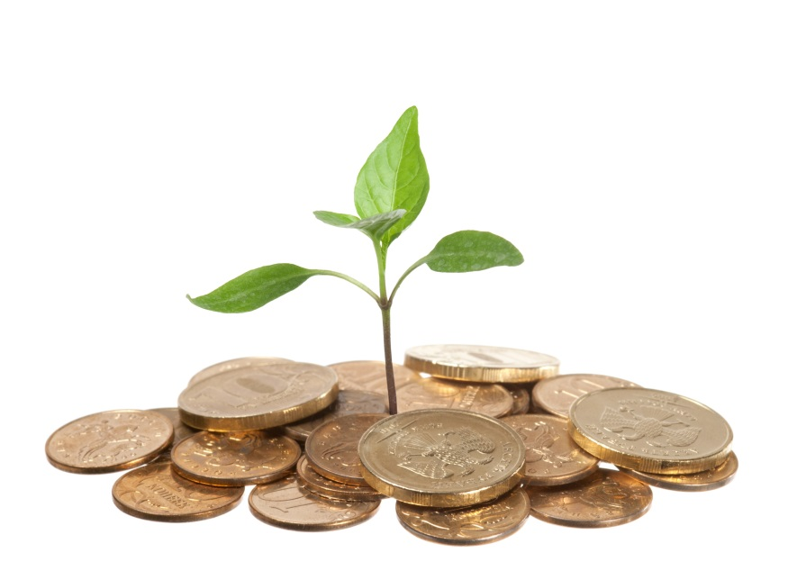
Umicore in Congo
Yet the company is asking how it can “monetize” its sustainability practices.
  That is, convert them to profits.
  Offers an important lesson in how we think about sustainability.
28

Slide 29
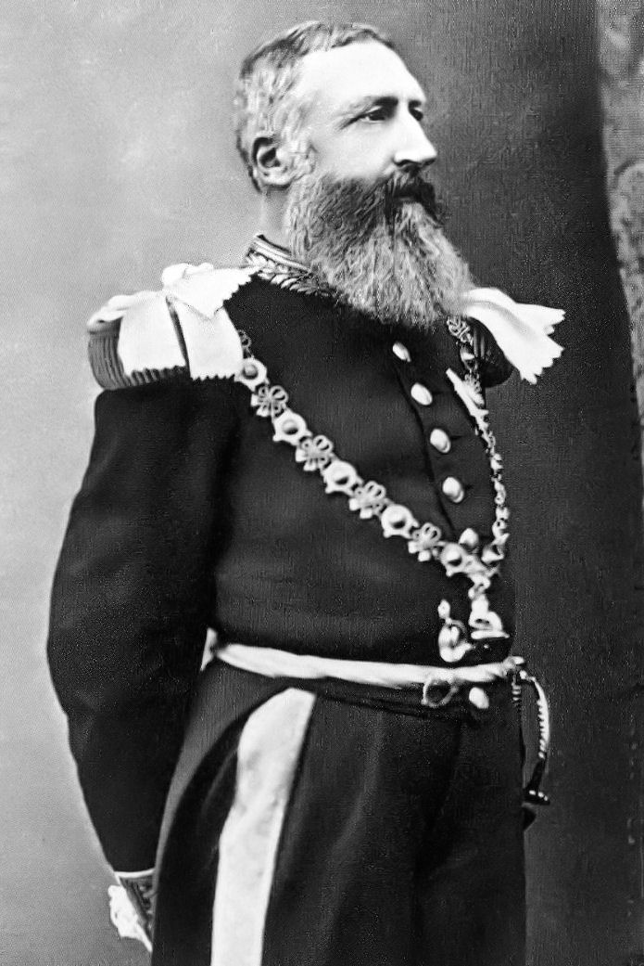
Umicore in Congo
Looking back…
  1885: Belgium’s King Leopold II
  seized personal control of
  Haut Katanga in central Africa.
    Later known as Belgian Congo.
    He wanted to exploit mineral
    resources.
  1906: Union Minière du Haut
  Katanga (UMHK)
    Formed to mine copper, tin cobalt,
    etc.
29

Slide 30

Umicore in Congo
Looking back…
  2001: Name change to Umicore
    Company growth has stalled
    Wants to shed negative image
    Becomes independent public company in 2004.
    Moves into recycling.
    Invests €174 million to clean up legacy sites.
30

Slide 31


Umicore in Congo
Looking back…
  2007: Signs on to sustainability agreements.
    Global Framework Agreement with major unions.
    Pledge to observe UN Declaration of Human Rights.
    Agrees to observe ILO’s core labor standards.
31

Slide 32
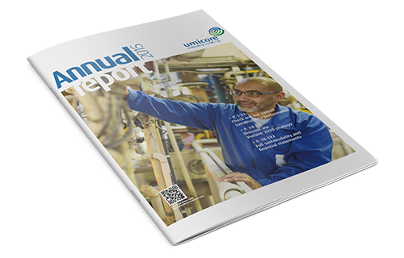
Umicore in Congo
Looking back…
  2007: New directions
    Develop recycling technology.
    Move into new products,
    like automotive catalysts
    and batteries.
    Restyle annual report to
    reassure shareholders company
    has a long-term strategy with focus
    on sustainability.
32

Slide 33
Umicore Worldwide
Example: Battery recycling
  Responding to rapid growth in demand for rechargeable batteries.
33

Slide 34
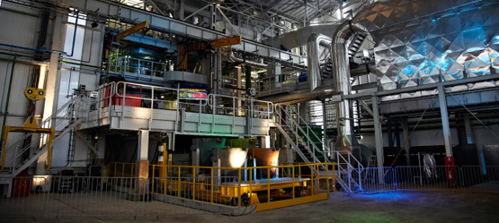
Umicore Worldwide
Example: Battery recycling
  2011: New recycling plant in Hoboken, Belgium.
  Major customer: Toyota
34

Slide 35


Umicore Worldwide
Recognition
  2013: Number one by Corporate Knights.
  Still, there were skeptics
35

Slide 36

Umicore Worldwide
Today…
  Operates in 34 countries. 11,000 employees
  R&D expenditure €196 million
  ROI comparable to industry average
36

Slide 37
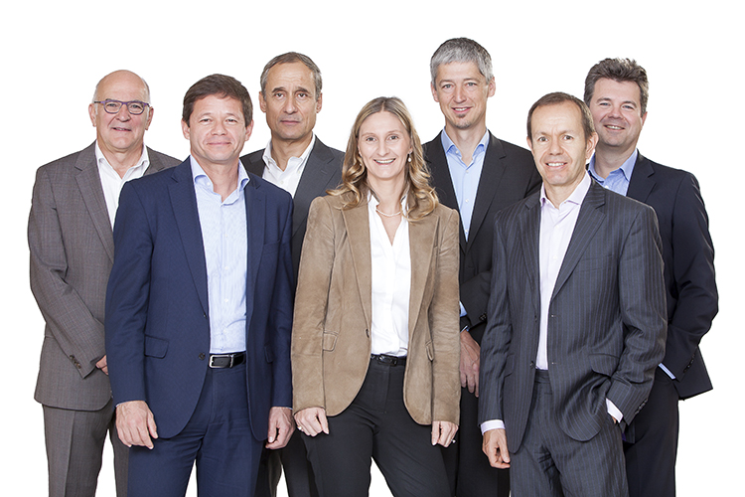
Umicore Worldwide
Still, Umicore executives want to monetize investment in sustainability
  Convince customers to pay premium price.
  Increase market share based on positive media exposure.
37

Slide 38
Umicore Worldwide
But Umicore has already benefited!
  Focus on restructuring for sustainability rescued a
  declining business.
    Modernized the business, aligned it with circular
    economy.
Feb 1
2000
Today
38

Slide 39
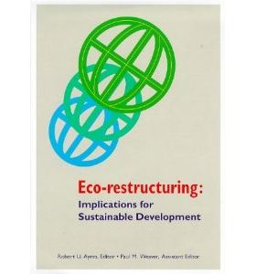
Umicore Worldwide
Lesson:
  A firm can benefit from restructuring for sustainability
    …simply because the
    fundamentals of the process
    receive more attention
  Particularly a firm in legacy
  industries.
39

Slide 40

AES Corporation
Environmentally responsible energy
production
  Attempted to
  make coal
  a sustainable
  fuel.
  Why? We are
  stuck with coal
  for now.

Slide 41
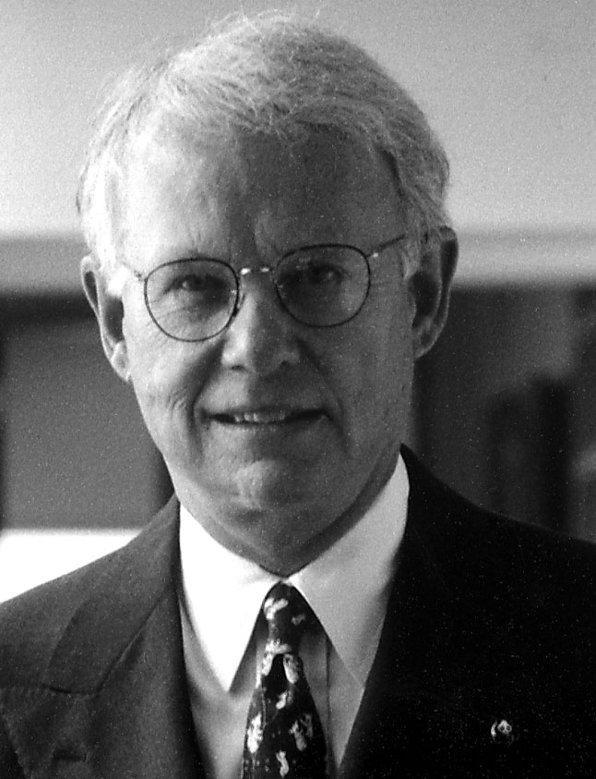
AES Corporation
Founded by Roger Sant and Dennis Bakke in 1981.
  Lifelong interest in energy conservation and environmental issues.
    Director of Energy Productivity Center at Carnegie Mellon
    University 1977-1981.
Roger Sant

Slide 42
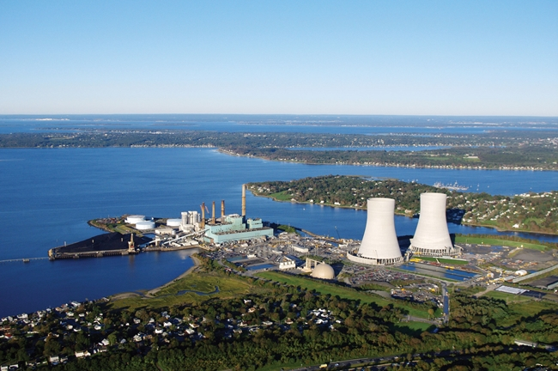
AES Corporation
Thames plant,
Connecticut (1987)
  Coal-fired
  cogeneration plant.
  Circulating fluidized
  bed boiler.
    Cleaner than all
    current standards.
    Captures 90% of
    sulfur, limiting acid
    rain. Minimizes
    nitrogen oxides.
  Problem: how to limit CO₂ emissions?

Slide 43

AES Corporation
Sant asked his staff for proposals on how to limit CO₂.
  Cost must not exceed 1% of $275 million project cost.
  Permanent disposal of CO₂.

Slide 44
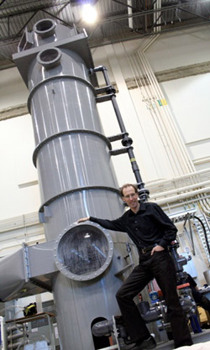
AES Corporation
Proposal 1: Scrub CO₂ from exhaust gases and sell it.
  Scrubbers incur about 1% of capital
  cost, but:
  Lower plant efficiency
  Limited demand for CO₂
    e.g. enhanced oil recovery
  CO₂ may eventually return to atmosphere.

Slide 45
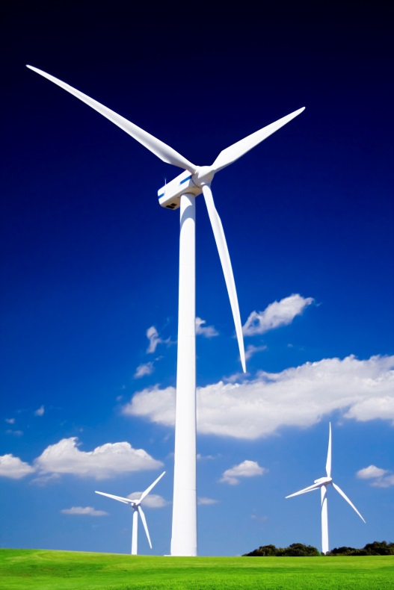
AES Corporation
Proposal 2: Abandon coal.
  Natural gas: 2/3 the CO₂ of coal.
    Fuel costs higher and unpredictable.
    Operating costs 15% higher; would
    lose contracts (this has changed)
  Garbage incineration: pollution hazard
  unknown.
  Wind: uneconomic at the time without
  tax incentives.
  Hydro: already exploited.

Slide 46
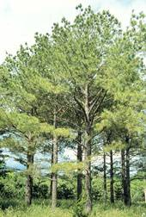
AES Corporation
Proposal 3: Reforestation. Selected.
  Carbon trapped in organic material.
  Need 2 sq. miles per megawatt.
  Guatemala project undertaken.
    385 sq. miles slash-and-burn land
    reforested.
    $2 million AES contribution
    leveraged by:
      $1.8 million from USAID.
      $1.2 million from Guatemala.
      $2.0 million from CARE.
      Labor from Peace Corps.

Slide 47

AES Corporation
Sustainable?
  Not really.
  Local resistance to tree planting.
  Plant generated far more CO₂ than trees absorbed.
  Not a global solution, too much CO₂.
  Mature forest absorbs little net CO₂.

Slide 48

AES Corporation
Sustainable?
  Not really.
  Local resistance to tree planting.
  Plant generated far more CO₂ than trees absorbed.
  Not a global solution, too much CO₂.
  Mature forest absorbs little net CO₂.
  In one way it turned out well…
    Positive international reaction helped
    AES expand globally in following years.

Slide 49
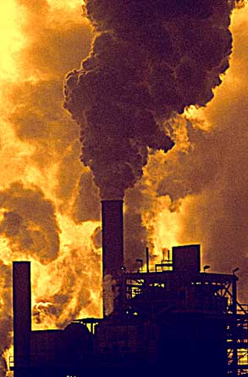
AES Corporation
Next: build efficient & clean power plants in developing world.
  Khazakhstan plant
    Bought 70% of country’s largest
    power plant in 1996.
    Antiquated, dirty Soviet plant
    operated at 20% capacity.
    AES invested $500 million to
    upgrade plant.

Slide 50
AES Corporation
Next: build efficient & clean power plants in developing world.
  Khazakhstan plant
    Bought 70% of country’s largest
    power plant in 1996.
    Antiquated, dirty Soviet plant
    operated at 20% capacity.
    AES invested $500 million to
    upgrade plant.

Slide 51
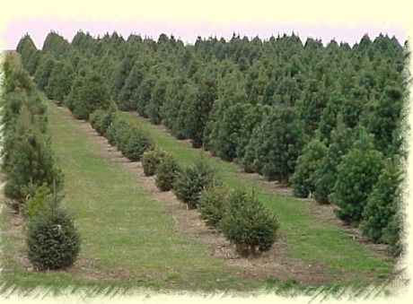
AES Corporation
  How did it work out?
    Kazakhstan buys all the power the plant can produce.
    The alternative is buying expensive, unreliable power from Russia.
  Develop infrastructure
    Build schools, etc.
    Plant trees locally.

Slide 52
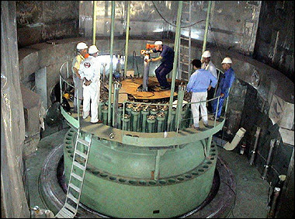
AES Corporation
Different kind of organization
  Socially conscious culture.
  Flat organization.
    At most 3 layers of
    management separate
    CEO from plant workers.
    Top executives spend
    a week each year working
    on plant floor.

Slide 53
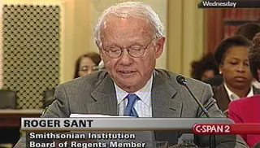

AES Corporation
AES today.
  8000 employees in 15 countries
  Partnered with Siemens to develop energy storage (2018)
  One of 130 World’s Most Ethical Companies for 7 years
  in a row (Ethisphere)

Slide 54
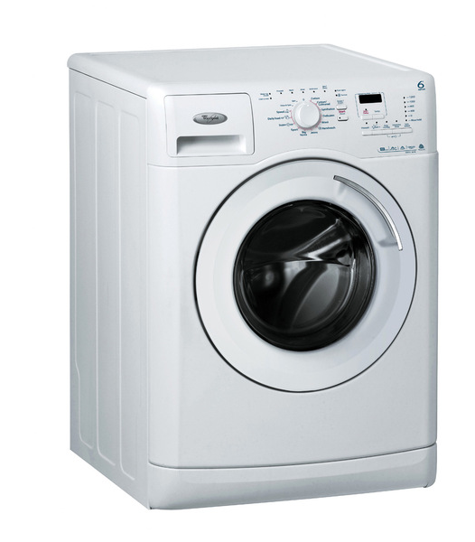
Lease vs Buy
An alternative to recycling in the circular economy.
Case study: Washing machines
  Wide range of models
    Low end: 2000 cycles
    High end: 10,000 cycles
Source: Ellen MacArthur Foundation, Towards the Circular Economy.
Analysis by McKinsey & Co.
54

Slide 55
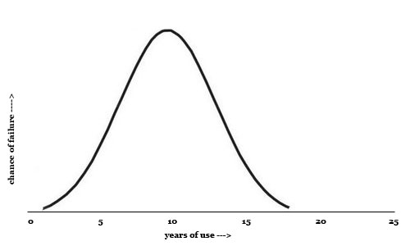
Lease vs Buy
  Households have incentive to purchase low-end machines
    About 250 cycles per year
    Warranty period 1-2 years
    Typical lifetime less than
    10 years
    Lifetime usage about 2000
    cycles
55

Slide 56
Lease vs Buy
Why lease?
  Cost advantage for consumer
    High-end machines: US$ 0.12 per cycle
    Low-end machines: US$ 0.27 per cycle
    Lease a high-end machine
    Avoid up-front capital cost
    Save on net present cost
56

Slide 57
Lease vs Buy
57

Slide 58
Lease vs Buy
Why lease?
  Cost advantage for manufacturer
    Lease a high-end machine 4 times over 20-year life
    Continuous revenue flow
    Recover value embedded in the used machines
    Cost of collection, transport, refurbishing:
    $US 170 per machine
58

Slide 59
Lease vs Buy
59

Slide 60

Lease vs Buy
Sustainability advantages
  180 kg steel saved per machine
  2.5 tonnes CO₂ savings per machine
    Due to greater efficiency of high-end machine.
    New models have technology updates, but…
    …many of these can be retrofitted
    into leased machines between
    5-year leases.
60

Slide 61
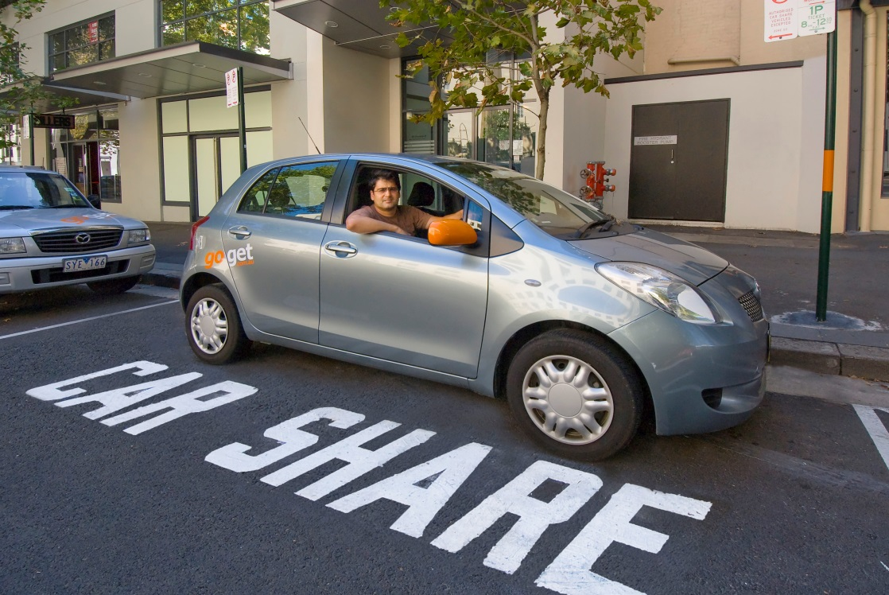
Car Sharing
A new business model for car manufacturers
  The first major change in business model since the beginning of the automotive age
61

Slide 62
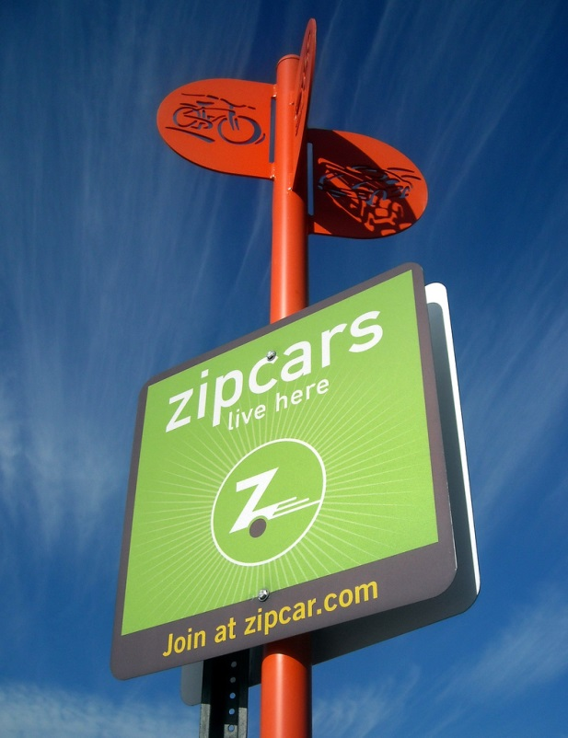
Car Sharing
Characteristics of car sharing
  No chauffeur
  Users pre-register
  Billed by the minute or hour,
  sometimes by km
    Possible membership fee
  Reserved or spontaneous
  Pick up at many distributed locations (station-based)
    Often accessible by public transport
  Renter services the car
    Fuel, occasional cleaning, maintenance
62

Slide 63



Car Sharing
Types of car sharing
  Peer to peer.
    Car owners rent their car to others.
    A small segment of the market.
63

Slide 64


Car Sharing
Types of car sharing
  Business to customer.
    Car sharing by rental companies.
64

Slide 65




Car Sharing
Types of car sharing
  Business to customer.
    Auto manufacturers
    This is the new business
    model.
    Different incentives for
    manufacturers.
65

Slide 66


Car Sharing
Types of car sharing
  Business to customer.
    Car sharing companies.
66

Slide 67
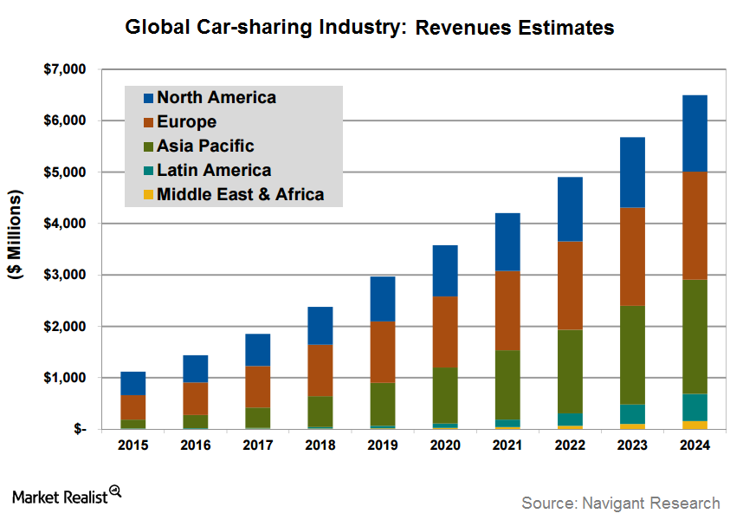
Car Sharing
Growth
of car
sharing
67

Slide 68
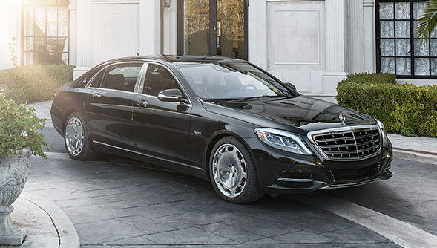
Car Sharing
High-end business model
  Maintain sales at the high end
    To customers who prefer performance to efficiency
    Allows luxury car makers to maintain current sales while expanding into low-end market
    This is why luxury brands entered car sharing first
68

Slide 69
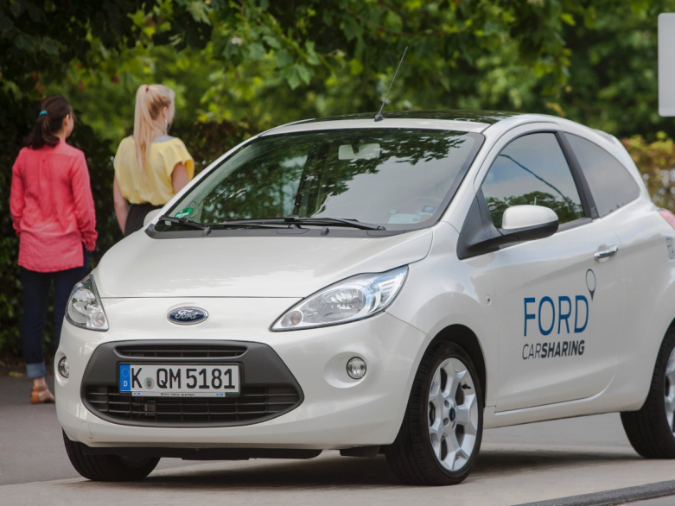
Car Sharing
Low-end business model
  Offer efficient, low-end models for car sharing
    Often, electric cars
    Manufacturer pays operating costs → incentive
    to use efficient cars
69

Slide 70
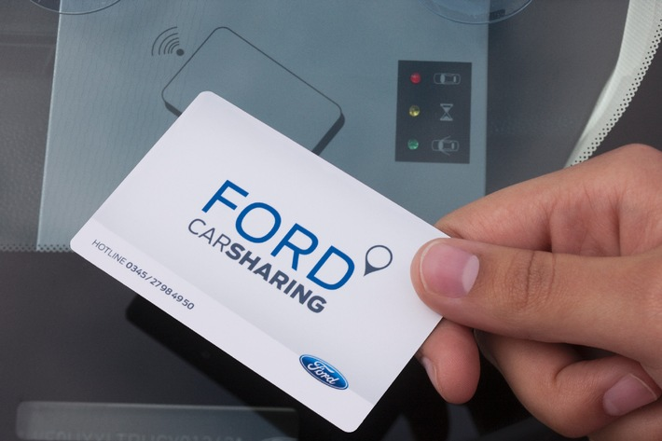
Car Sharing
Low-end business model
  The world is clogged with cars
  Sales growth must decline
  Urban dwellers
  losing interest in
  car ownership
    Expensive,
    Inconvenient,
    parking problem
    Millennials
    have a new
    mindset
70

Slide 71
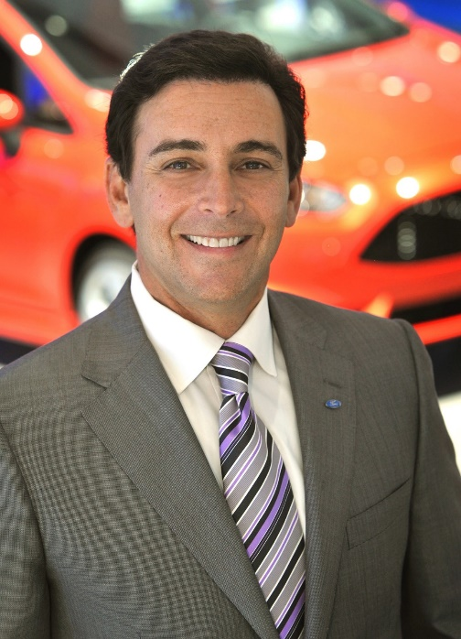
Car Sharing
Low-end business model
  Ford took the plunge, future
  uncertain.
    Promoted by Ford CEO
    Mark Fields.
      Fields ousted in 2017, partly
      due to failure to follow through.
    GM pulled out
    of car sharing,
    April 2020.
      Covid-19 put a brake
      on car sharing growth
      at both Ford & GM
Mark Fields, Ford CEO 2014-2017
“We are really emphasizing our transition from an auto company to an auto and mobility company… Across the world you see growth of these megacities, 10 million or more folks, people want mobility solutions, they want options” (2016).
71

Slide 72

Car Sharing
The consumer’s perspective
  Can avoid buying a 2nd or 3rd car
    Let the teenagers drive a shared car
  Can avoid buying a car at all
    Use public transport or
    bicycle except when it
    is necessary to haul a
    load
72

Slide 73
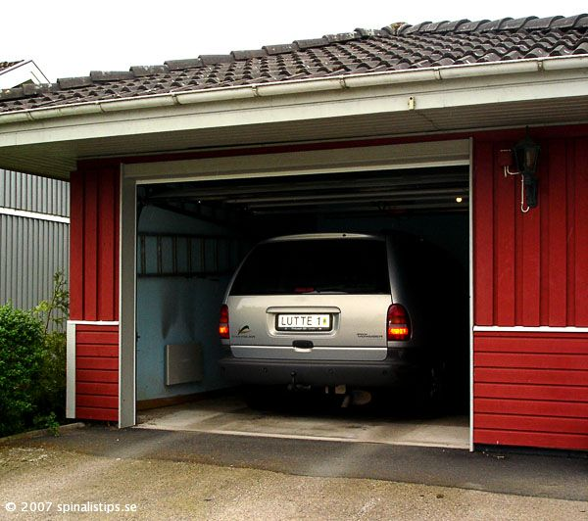
Car Sharing
The consumer’s perspective
  Save on high fixed costs for a car that is idle most
  of the day
    Purchase price,
    insurance, leased
    parking
  Forget about repair,
  maintenance,
  licensing
73

Slide 74
Car Sharing
New customer incentives
  For traditional car owner
    Car is a sunk cost.
    Variable cost relatively small.
    Owner incentivized to drive as much as possible.
  For car sharing customer
    Driving is all variable cost.
    Customer incentivized to drive as little as possible.
    Customer uses trip chaining, etc.
74

Slide 75
Car Sharing
Effect on sustainability
  The plus side
    Customers drive less
    Larger fraction of travel in efficient cars
    Fewer resources consumed in car manufacture
    Less space tied up in parking
    Less congestion due to fewer parked cars
    Less fuel waste due to less congestion
    Less rush hour traffic, due to limited number of cars
75

Slide 76
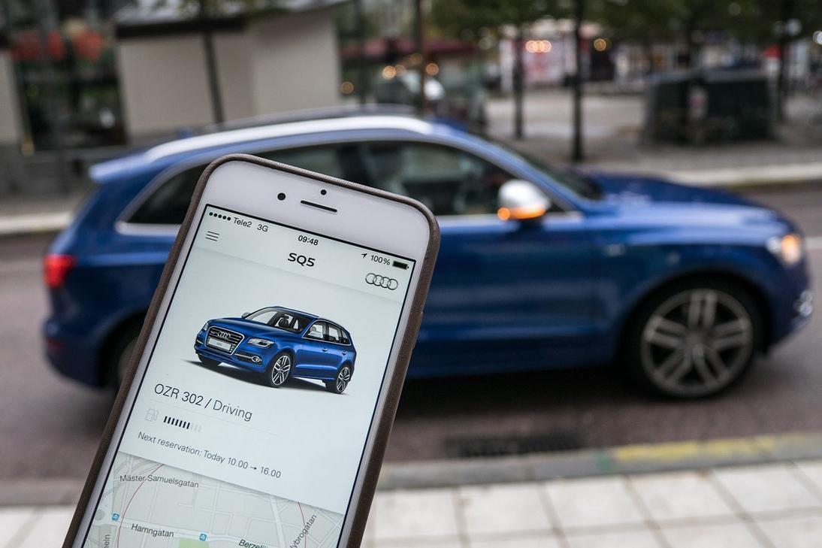
Car Sharing
Effect on sustainability
  The minus side
    Some people may switch from public transport to driving
    Not practical for
    rush hour
    commuting, due to
    limited fleet
76

Slide 77
Social sustainability

Slide 78
Social Sustainability
One definition. A sustainable society should:
  “Satisfy an extended set of human needs, and
  “be shaped in a way that…is preserved over a long period
  of time,
  “and the normative claims of social justice, human dignity
  and participation are fulfilled.”
    Littig & Griessler, 2005
Key point
  The society should be stable, rather than subject to unrest
  due to dissatisfaction and lack of enfranchisement.
  Business activity should be consistent with this goal.

Slide 79

Tea Growers in Kenya
Small tea farmers in Kenya
  Most highly-paid in the world.
  Environmentally responsible agriculture
  Kenya is 2nd largest tea exporter in the world
  Managed by private company KTDA Ltd
Worker ownership
  Farmers own tea companies
  managed by KTDA Ltd

Slide 80
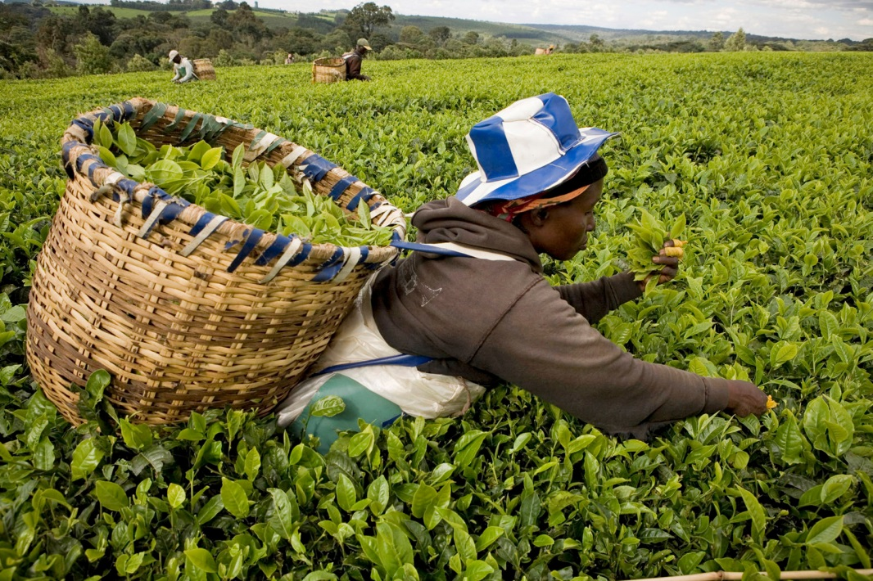
Tea Growers in Kenya
History
  After Kenyan independence in 1963, Jomo Kenyatta set up Kenya Tea Development Authority (KTDA)
  Number of small
  farmers increased
  10-fold
    Processing plants
    managed by local
    people

Slide 81
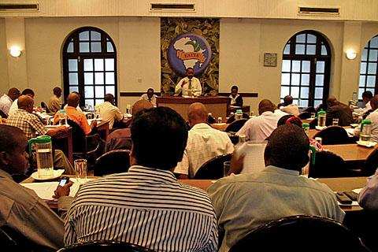
Tea Growers in Kenya
History
  Kenya’s own tea auction replaced London auction
    To save cost
    of middlemen
    Became 3rd
    largest tea
    auction in the
    world
  KTDA privatized
  in 2000 to form
  KTDA Ltd.

Slide 82
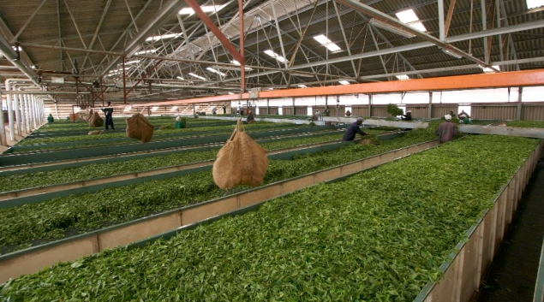
Tea Growers in Kenya
Worker ownership
  Farmers bought shares of processing plants managed
  by KTDA.
    Paid for their
    shares with a
    fraction of their
    tea production.
    Management
    board elected
    by farmers.

Slide 83
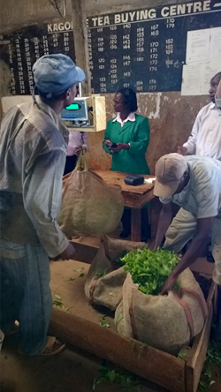
Tea Growers in Kenya
Worker ownership
  Farmers receive dividends as
  well as payment for tea.
    Farmers receive highest price
    in the world for tea produced
    by small farmers.
    Farmers received 75% of
    auction price.
    565,000 farmers
    66 processing plants
    60% of Kenya’s tea

Slide 84
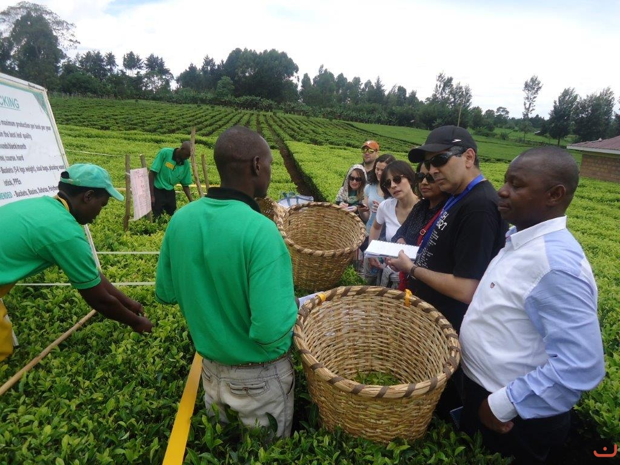
Tea Growers in Kenya
Sustainability through inclusion
Farmer field schools
  4300 schools
    Quality
    management
    (“fine plucking”)
    Sustainable
    practices

Slide 85

Affordable Housing in Mexico
Vinte: an inclusive housing business
  Inclusive business = sustainable business that benefits
  low-income communities.
  Vinte = Viviendas Integrales.
    Builds affordable, sustainable housing communities
    in central Mexico.

Slide 86
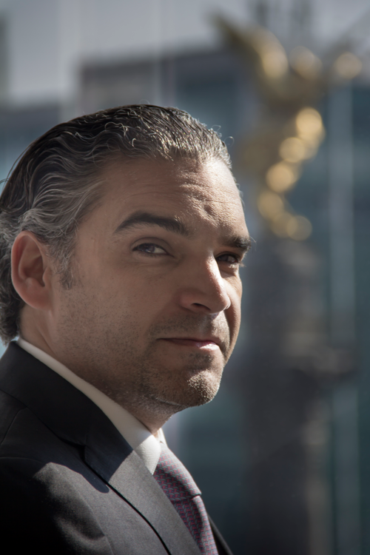
Affordable Housing in Mexico
Vinte: an inclusive housing business
  Statement from CEO:
    “What Vinte does is different… I stay
    with you. I sell you a home. I organize
    you socially. I sell you the furniture for
    your home. I sell you the technology
    for your home. I take care of the
    maintenance. And then I buy back
    your home to sell you a bigger one
    [as your family grows]. Thus our
    business model is a long-term
    chain.”
Sergio Leal, Vinte CEO

Slide 87
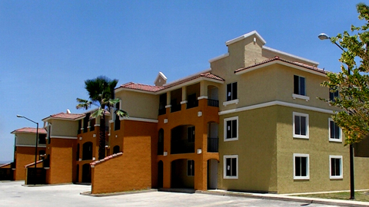
Affordable Housing in Mexico
Unique features of Vinte homes
  Affordable
    Price range US$ 27,000 – 34,000
    Kitchen, living room, 2 bedrooms, parking, services
  Larger homes also available.
    US$ 34,000 – 62,000.

Slide 88
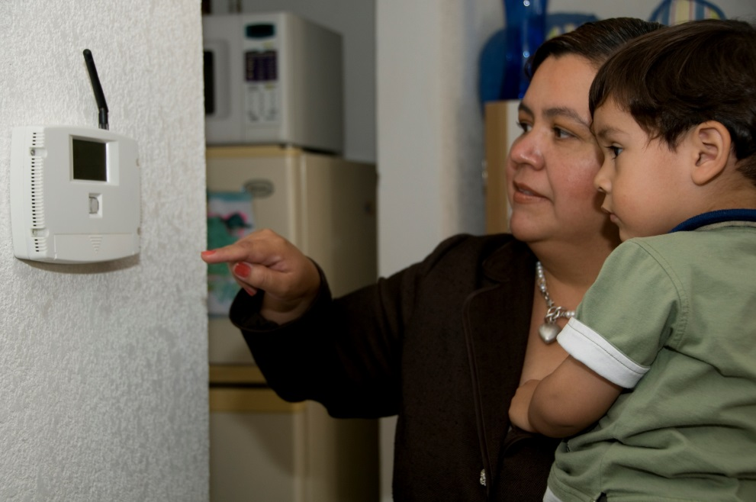
Affordable Housing in Mexico
Unique features of Vinte homes
  Mostly lower middle-class buyers
    School teachers, secretaries, factory workers
    First-time buyers.
    Grew up in settlements
    without proper access
    to water, electricity,
    roads.

Slide 89
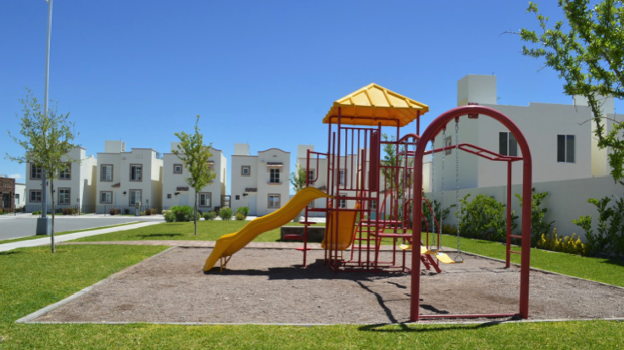
Affordable Housing in Mexico
Unique features of Vinte homes
  Amenities associated with posh housing projects
    Clean water
    Paved roads
    Bike paths
    Gated courtyards
    Street lights
    Playgrounds
    Close to good
    schools &
    shopping

Slide 90

Affordable Housing in Mexico
Unique features of Vinte homes
  Security
    Security cameras
    Walled and gated
    communities of 10-20
    houses each

Slide 91
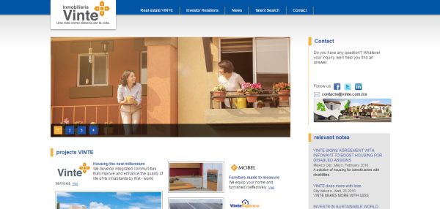
Affordable Housing in Mexico
Unique features of Vinte homes
  Information technology
    Computer and internet in every house
    Community website with information
    Online grocery ordering
    Internet access to security cameras from home and work

Slide 92

Affordable Housing in Mexico
Unique features of Vinte homes
  Environmental sustainability
    EDGE green building
    certification
    Rooftop solar cells
    Flourescent bulbs
    Solar water heaters
    Rainwater catchment
    Water-saving toilets
    and showers
    Introduced homes that use no gas in 2018.

Slide 93

Affordable Housing in Mexico
Financing
  Mortgages
    Mortgage financing through government agency
    INFONAVIT
    Agency takes 5% of paycheck from employer
    This is applied to down payment, monthly payments

Slide 94

Affordable Housing in Mexico
Financing
  Outside support
    INFONAVIT provides subsidy roughly equal to down payment.
    International Finance Corporation (IFC) bought 10% stake
    IFC and Inter-American Development Bank underwrote
    Vinte bond issues.
    Loan from German bank DEG, etc.

Slide 95
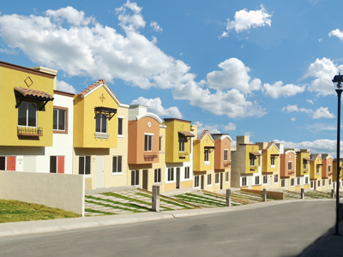
Affordable Housing in Mexico
Financial success
  49,000 homes by 2019.
  36% revenue growth,
  2017-2018.
Awards
  Financial Times 2012
  Sustainable Investment
  of the Year.
  International Finance Corp
  2013 Inclusive Business Achievement Award.
  Multiple National Housing Awards.

Slide 96
Financial sustainability

Slide 97

Sustainable Banking
Principles
  Triple bottom line
    People, Planet, Prosperity
  Serves the real economy
    Grounded in communities
  Long-term relationships with clients
    Understands their needs
  Stable, self-sustaining
    Resistant to outside disruptions
  Transparent and inclusive governance

Slide 98
Sustainable Banking
Associations
  Global Alliance for Banking on Values (GABV)
    Source of principles on previous slide
    Founded by
      BRAC Bank, Bangladesh
      GLS Bank, Germany
      ShoreBank, US
      Triodos Bank, Netherlands
  Sustainable Banking Network (SBN)
    Sponsored by International Finance Corporation (IFC)
  National Community Investment Fund
    Includes network of banks

Slide 99
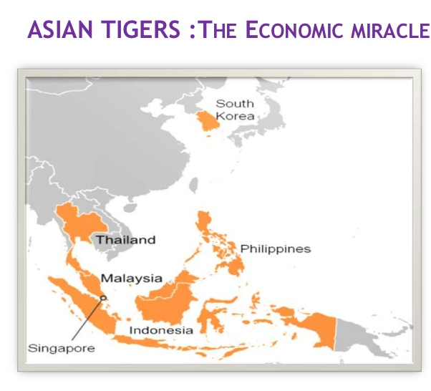
Financial Instability
Asian financial crisis, 1997
  Affected the “Asian Tigers.”
  Stock markets and
  currencies lost 70%
  of their value
  Asset bubbles
  Capital flight
    China and Taiwan
    unaffected.
    Due to family-based
    financing

Slide 100
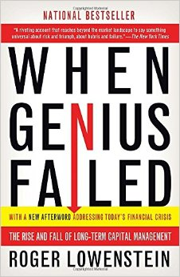
Financial Instability
Long-Term Capital Management crisis, 1998
  $126 billion hedge fund
    Principal shareholders: Nobel laureates
    Myron Scholes and Robert Merton
  Highly leveraged arbitrage
    Took advantaged of securities that were
    incorrectly priced relative to each other.
    Nearly collapsed when Russian ruble
    devalued.
    Bailed out by banking industry.

Slide 101
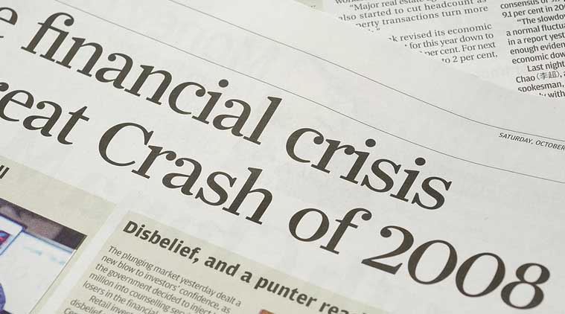
Financial Instability
Global Financial Crisis, 2008
  Worst crisis since Great Depression of 1930s
  Global impact lingers

Slide 102
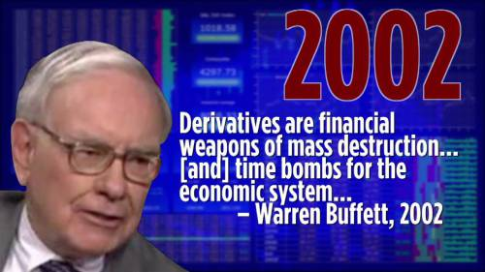
Financial Instability
Rise of derivatives
  Bets on other securities
    Futures, options, interest rate swaps, credit default swaps,
    forward contracts
  Total notional
  value (2019):
  US$640 trillion
    7 x annual
    world GDP

Slide 103

Financial Instability
Next crisis: bail-ins, not bail-outs
    Bail-in = investors, creditors and depositors take a
    “haircut” (i.e., a loss) on their assets
    Greek crisis (2010-2018?) is a precursor

Slide 104

Triodos Bank in Netherlands
Perhaps the original sustainable bank
  Conceived in 1960s
    Finally chartered in 1980.
  Focus on socially responsible investing
    But also concerned about stability
    Was remarkably unaffected by
    2008 financial crisis.
    Assets under management €5 billion
104

Slide 105

Triodos Bank in Netherlands
CEO Peter Blom:
  His views are remarkably aligned with Islamic financial principles.
    “If banks become the market, they crowd out the real economy because it becomes easier to make money with money than by producing things or delivering services. Opportunistic investors like banks because they can privatize the profits and socialize the losses. That game has been over since 2008, and should be over.
105

Slide 106
Triodos Bank in Netherlands
CEO Peter Blom:
    “Therefore, there has to be a new idea of what a bank is about… Playing in the market, thinking you can make money with money and be very bright in using tricks, that’s not where you should gain your fulfillment. I think we have to see that there can be fulfillment from things like making an entrepreneur successful, in a serving way…. What we have to prove is … that the real economy is as exciting as banking that plays with money in abstract markets.”
106

Slide 107

Triodos Bank in Netherlands
Major initiatives
  Wind Energy Fund
    Inspired by depositors who were concerned about Chernobyl nuclear plant disaster in 1986.
    First bank in Europe to create an
    investment product focusing on
    clean energy.
    Financed a Danish windfarm with
    the help of other investors.
    Investments have grown to
    € 6.8 billion.
107

Slide 108

Triodos Bank in Netherlands
Major initiatives
  Microfinance Investment Funds
    First investment in microfinance was through a South African bank in 1994.
    Top management met
    with Muhammad Yunus
    of Grameen Bank in 1995.
    Created 2 private
    microfinance funds.
    Created public Fair Share
    Fund in 2002, Triodos
    Microfinance Fund in 2009.
108

Slide 109

Triodos Bank in Netherlands
Major initiatives
  Fair Trade Fund
    Inspired by South American
    debt crisis of 1990s.
    Created 2008 to support
    producers too large for
    microfinance but too small
    for ordinary bank loans.
    Favors fair-trade and organic
    farming cooperatives
109

Slide 110

Vancity in Canada
Vancouver City Savings
Credit Union
  Started 1946 with $22
  investment by founders.
  First community-wide
  credit union in Canada.

Slide 111

Vancity in Canada
  Priority for community
  investment.
  Today, Canada’s largest
  community credit union.

Slide 112
Vancity in Canada
Recent awards
  One of Best Corporate Citizens in Canada
  (Corporate Knights)
  One of Canada’s Top 100 Employers (12 times)
  One of Canada’s Greenest Employers (10 times)
  Highest Customer Service Award
  National Credit Union Innovation Award

Slide 113

Vancity in Canada
Tamara Vrooman, CEO:
  “The public is calling for changes
  in the financial system in
  response to the excesses and
  failures of recent years.”
  “People are hungry to hear about
  a banking system that … puts the
  needs of people and their communities first.”

Slide 114
Vancity in Canada
  “Sustainable banks allocate
  almost twice as much of their
  balance sheet to lending to the
  real economy than the GSIFIs.”
    GSIFIs = 28 Global Systemically
    Important Financial Institutions
    (i.e., too big to fail).
  Sustainable banks have “better quality capital, better returns on assets and equal returns on equity…and higher levels of growth.”

Slide 115
Further reading
Website with links to 45 sustainability resources: Sustainability Resources.
Suzanne Farver, Mainstreaming Corporate Sustainability: Using Proven Tools to Promote Business Success, 2nd ed., J. Ross Publishing (2019).
Peter McAteer, Sustainability Is the New Advantage: Leadership, Change and the Future of Business, Anthem Press (2019).
Terry Yosie, "Moving the circular economy from concept to business strategy and operations Links to an external site.," The Conference Board (2017).
J. N. Hooker and T. W. Kim, "Ethical implications of the 4th Industrial Revolution for business and society," in D. Wasileski and J. Weber, Business and Society 360, v. 3: Business Ethics, Emerald (2019) 35-63.
T. A. Myers and E. Hassanzadeh, Interconnections Between Islamic Finance and Sustainable Finance Links to an external site., IISD Report, International Institute for Sustainable Development (2013)
(continued next slide).

Slide 116
Further reading
Kate Raworth, Doughnut Economics: Seven Ways to Think Like a 21st-Century Economist, Chelsea Green Publishing, 2017.
Website: Sustainable Enterprises, International Labour Organization.
Video/audio: "Businesses for people and planet," International Labour Organization.
Adeel Malik, Islamic Finance: A Very Short Introduction, Oxford University Press (2020).
Mohd Ma'Sum Billah, Modern Islamic Investment Management Principles and Practices, Palgrave Macmillan (2019).

