Slide 1
Medical Issues
A Course in Business Ethics
Module 15
John Hooker
Carnegie Mellon University
May 2022

Slide 2
Outline
The individual vaccine decision
  MMR vaccine
  Covid-19 vaccine
Requiring vaccination for service in a store or theater
Requiring vaccination at work
Requiring masks for service in a store or restaurant
Getting a booster shot

Slide 3

Refusing MMR vaccine
First consider MMR vaccine.
  MMR = measles, mumps, and rubella
  Another effective vaccine against a very contagious
  illness
    Measles is roughly as contagious as the Omicron
    variant of Covid.
  Allows us to analyze the
  issue with less emotional
  involvement.
  MMR is where much of
  today’s vaccine resistance
  got started.

Slide 4

Refusing MMR vaccine
Safety of MMR (measles/mumps/rubella) vaccine questioned
  A 1998 Lancet article claimed link between MMR and autism/colitis.
    Based on 12 children.
    Later studies show no connection, including a 2002
    Danish study of half a million children.
    Author eventually
    lost license to
    practice medicine.
    Article not retracted
    until 2010.

Slide 5

Refusing MMR vaccine
This boosted the anti-vaxxer movement
  In Europe and US.
  Measles had been eliminated in the US by 2000.
    Resurfaced in an outbreak at Disneyland in 2014.
    Unvaccinated children affected.
    US vaccination rate had dropped to 92%.
    2017 outbreak in Italy infected 4000, 88% unvaccinated.
  Anti-vaxxer parents often
  refuse MMR for their kids
  on grounds of safety.
    They also claim measles
    is a “natural” part of
    growing up (a taste of
    the naturalistic fallacy).

Slide 6
Refusing MMR vaccine
Some data
  Side effects of MMR vaccines (2016 CDC data):
    16% get a mild fever.
    5% faint rash.
    1.3% swelling of salivary glands.
    0.03% temporary fever-induced seizure.
    0.003% bleeding disorders.
  Effects of getting measles (2016 CDC data):
    10% get an ear infection.
    10% diarrhea.
    5% pneumonia (fatal in severe cases).
    0.1% encephalitis (can lead to convulsions, deafness)
    0.1-0.2% death.

Slide 7
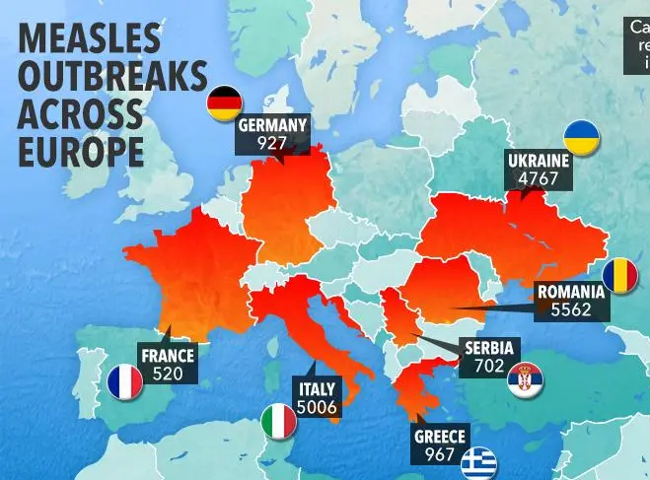
Refusing MMR vaccine
Some data
  Effects of Italian measles outbreak:*
    5% got ear infection.
    16% diarrhea.
    14% stomatitis.
    9% conjunctivitis.
    9% hepatitis.
    8% pneumonia.
    6% respiratory insufficiency.
    3% bleeding disorders.
    0.2% seizures.
    2 of 4000 got encephalitis.
    3 of 4000 died (all unvaccinated).
  *Filia et al., Eurosurveillance, Sep 2017.

Slide 8
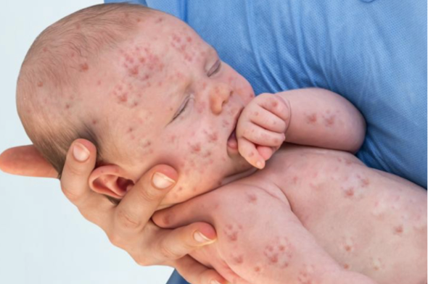
Refusing MMR vaccine
Utilitarian test
  This considers only the consequences of one person’s
  vaccination.
    MMR is 93% effective against measles.
  Potential consequences of measles are far worse,
  and much more likely, than side effects of vaccination.
    Measles is extremely contagious
    A measles case exposes
    others (including
    immunocompromised)
    and is disruptive for
    other reasons.

Slide 9
Refusing MMR vaccine
Utilitarian test
  This considers only the consequences of one person’s
  vaccination.
    MMR is 93% effective against measles.
  Potential consequences of measles are far worse,
  and much more likely, than side effects of vaccination.
    Measles is easier to catch than flu.
    A measles case exposes others (including
    immunocompromised) and is disruptive for other
    reasons.
  Yet if nearly everyone is vaccinated, the chance
  of contracting measles may be small.
    This may allow one to pass utilitarian test.
    But we have a free rider problem, so we move to the
    generalization test.

Slide 10
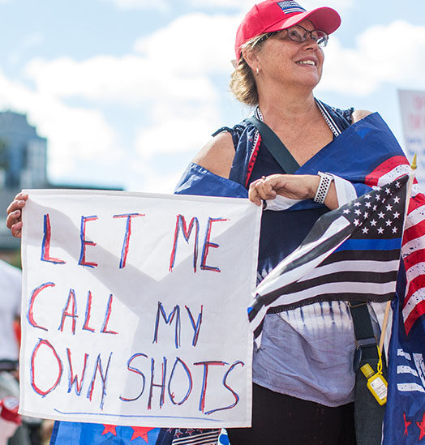
Refusing MMR vaccine
Generalization test
  We are not asking whether the government should
  mandate MMR vaccines.
    Only whether parents should allow it for their kids.

Slide 11
Refusing MMR vaccine
Generalization test
  We are not asking whether the government should
  mandate MMR vaccines.
    Only whether parents should allow it for their kids.
  Possible reasons for refusing MMR:
    Vaccination is inconvenient and
    poses some risk.
    There is only a small chance
    my kids will get measles.
  This rationale is clearly not
  generalizable.
    If all parents acted on it, the
    second reason would no longer
    apply.

Slide 12
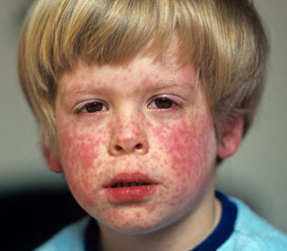
Refusing MMR vaccine
Generalization test
  But consider a different set of reasons.
    Vaccination is inconvenient and poses some risk.
    Getting measles is a natural part of growing up
    (i.e., we don’t care if other kids are not vaccinated).

Slide 13
Refusing MMR vaccine
Generalization test
  But consider a different set of reasons.
    Vaccination is inconvenient and poses some risk.
    Getting measles is a natural part of growing up
    (i.e., we don’t care if other kids are not vaccinated).
  This is generalizable, but the scope of the rationale
  is wrong.
    What if measles posed a 50% chance of death?
    Measles would no longer been seen as “a natural
    part of growing up.”

Slide 14
Refusing MMR vaccine
Generalization test
  But consider a different set of reasons.
    Vaccination is inconvenient and poses some risk.
    Getting measles is a natural part of growing up
    (i.e., we don’t care if other kids are not vaccinated).
  This is generalizable, but the scope of the rationale
  is wrong.
    What if measles posed a 50% chance of death?
    Measles would no longer been seen as “a natural
    part of growing up.”
  This seems to be the real reason:
    Vaccination poses more risk than measles.
  We have seen this rationale is clearly not generalizable.
    Universal measles is much riskier than the vaccine.

Slide 15
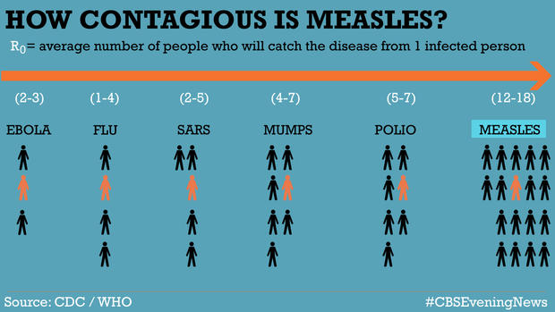
Refusing MMR vaccine
Autonomy test
  One is not rationally constrained to believe that
  foregoing MMR vaccine results in illness.
    Causing illness is normally a violation of autonomy,
    but illness here is only a possibility or probability.
    However, if parents know that their kids will be
    exposed to measles,
    we have an
    autonomy violation.
    Because measles is
    extremely
    contagious.

Slide 16

Refusing MMR vaccine
Scorecard for refusing MMR.
  Generalization test: fail
  Utilitarian test: may pass if vaccination rate is high
  Autonomy test: pass unless one knows kids will be exposed.

Slide 17
Covid vaccine
Before proceeding...
  We recognize 2 people who did something very ethical.

Slide 18
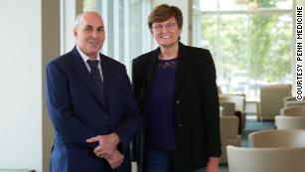
Covid vaccine
Before proceeding...
  We recognize 2 people who did something very ethical.
Drew Weissman and Katalin Karikó
Developers of messenger RNA technology
behind Pfizer/BioNTech and Moderna vaccines
Received the Lasker Clinical Medical Research Award
Previous recipients include Jonas Salk and Anthony Fauci
Karikó, Hungarian immigrant, persisted despite rejection & demotion

Slide 19
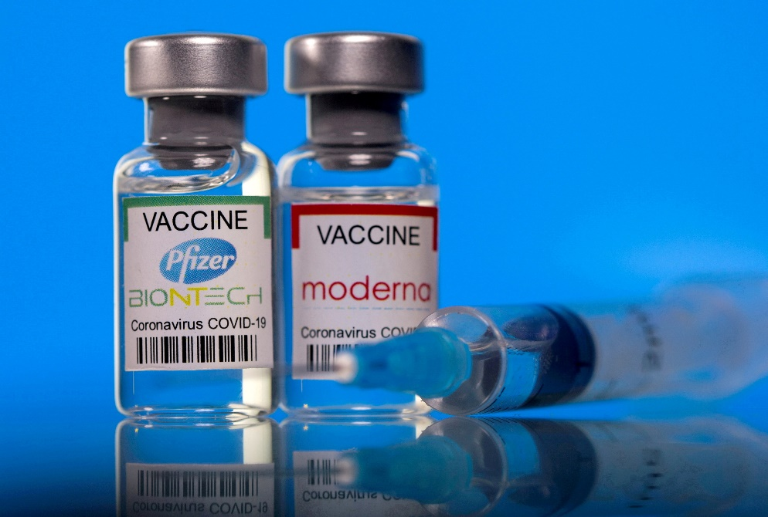
Refusing Covid vaccine
Utilitarian test
  Unlike MMR, there is a clear utilitarian obligation to get vaccinated for Covid.
    Unless there is a specific medical risk (e.g. allergic
    reaction).
    Unless one has very limited contact with other people.

Slide 20
Refusing Covid vaccine
Utilitarian test
  Unlike MMR, there is a clear utilitarian obligation to get vaccinated for Covid.
    Unless there is a specific medical risk (e.g. allergic
    reaction).
    Unless one has very limited contact with other people.
  Lack of vaccination poses several risks:
    Nonnegligible probability of contracting a serious case.
    High probably of infecting others.
    Disruption of services due to infected persons who
    must isolate 5 days.
    Medical risk to others, including vulnerable persons
    and patients denied proper treatment due to lack of resources.
    Additional burden on overworked medical staff.

Slide 21
Refusing Covid vaccine
Generalization test
  Possible reason for refusing vaccine:
    Risk of vaccination exceeds risk from Covid.
  This is probably not generalizable, even for Omicron.
    If no one were vaccinated, there would be additional
    Covid variants that would probably make contacting
    Covid much riskier.

Slide 22
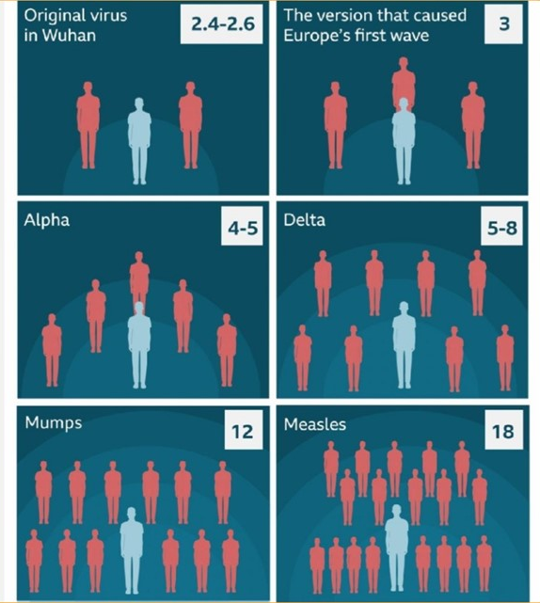
Refusing Covid vaccine
Autonomy principle
  There may be cases in
  which vaccine refusal
  violates autonomy.
    For example, one is
    certain to become
    contagious (if not ill),
    due perhaps to
    working closely with
    an unvaccinated public…
    …and one is caring for
    a high-risk individual
    at home.

Slide 23
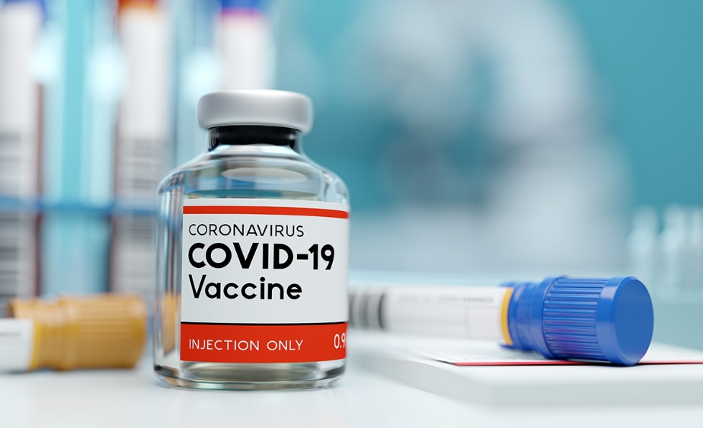
Refusing Covid vaccine
Scorecard for refusing the vaccine.
  Generalization test: fail
  Utilitarian test: fail
  Autonomy test: may fail in a few cases.

Slide 24
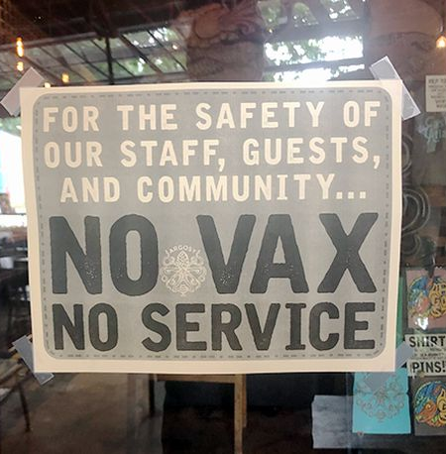
Requiring Covid vaccine
Is it ethical to require Covid vaccination for
service in a restaurant or admission to a theater?
  It is no violation of autonomy.
    One cannot have an action plan of being served in a
    restaurant or entertained in
    a theater, with or without
    vaccination.
    Refusal of service therefore
    violates no action plan.

Slide 25
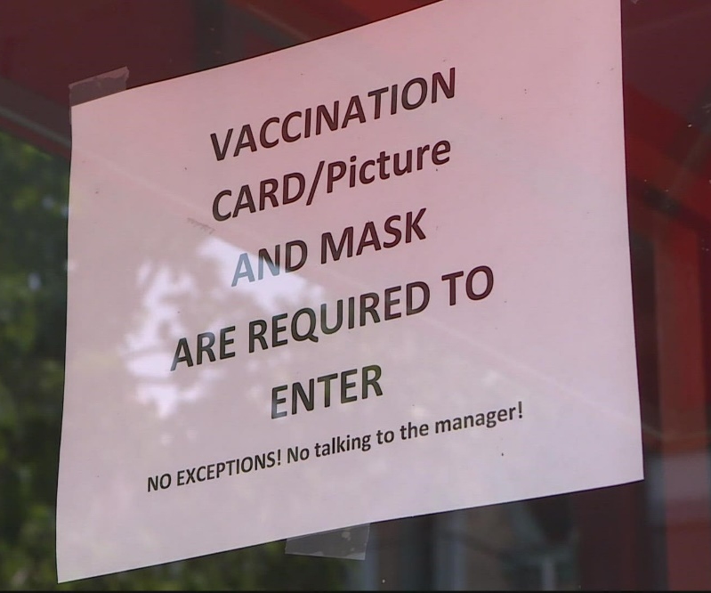
Requiring Covid vaccine
Is it ethical to require Covid vaccination for
service in a restaurant or admission to a theater?
  Compliance with the utilitarian principle is less clear.
    A vaccination rule, could be
    obligatory, because requiring
    vaccination reduces spread
    of disease at a small cost
    to the patron (who can eat
    or watch TV at home).
    Yet if there is a significant
    probability that the patron
    will attack the maître d’ or
    usher, the calculation changes.
  No evident reason it violates generalizability.

Slide 26
Requiring Covid vaccine
Scorecard for requiring the vaccine.
  Generalization test: pass
  Utilitarian test: depends on customer reaction
  Autonomy test: pass

Slide 27

Requiring masks
Is it ethical to require a mask for entry into a store?
  It is no violation of autonomy.
    For reasons already noted.
  It could violate the utilitarian principle.
    If there is a chance of a violent reaction from patrons,
    which has repeatedly occurred.
    An alternative is
    to offer a mask
    politely or simply
    to post a sign
    requesting masks.

Slide 28
Requiring masks
Is it ethical to require a mask for entry into a store?
  It is no violation of autonomy.
    For reasons already noted.
  It could violate the utilitarian principle.
    If there is a chance of a violent reaction from patrons,
    which has repeatedly occurred.
    An alternative is
    to offer a mask
    politely or simply
    to post a sign
    requesting masks.
  No reason it violates
  generalizability.

Slide 29
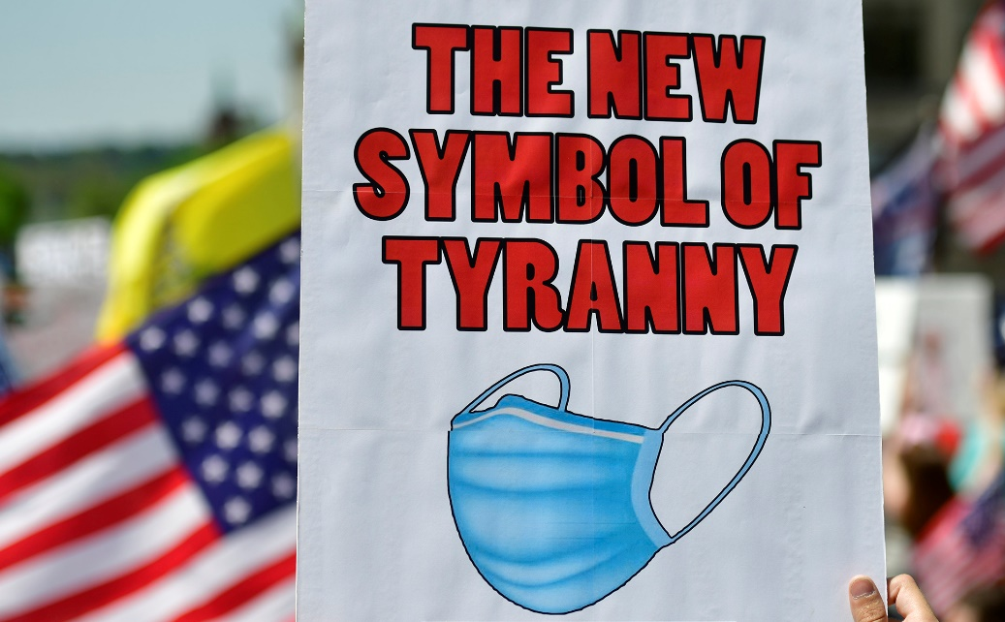
Requiring masks
Isn’t this supposed to be a free country?
  We are not asking whether the government
  should have a mask mandate.

Slide 30
Requiring masks
Scorecard for requiring masks.
  Generalization test: pass
  Utilitarian test: depends on customer reaction
  Autonomy test: pass

Slide 31
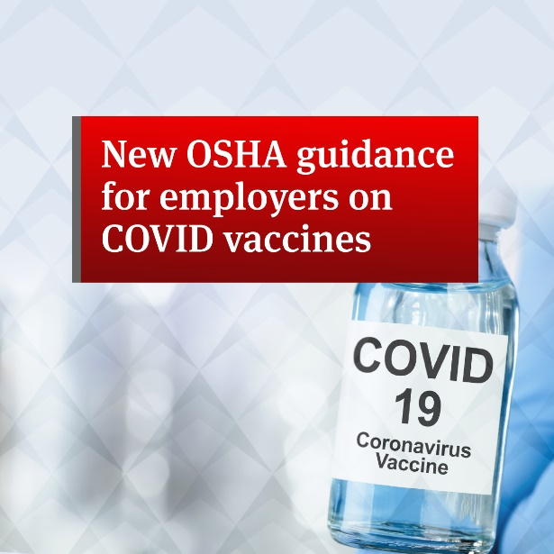
Vaccination for work
Is it ethical for firms to require employees to get vaccinated or be fired?
  OSHA issued regulations mandating that all firms that
  employ at least 100 people must require vaccination or
  regular testing (struck down by SCOTUS).
    Vaccines specifically required for
    Federal employees and contractors,
    as well as most health care
    employees (the latter was upheld).
  We are asking whether a private
  business can ethically impose some
  kind of vaccine requirement.
    We assume that no law requires
    or prohibits such a policy.

Slide 32
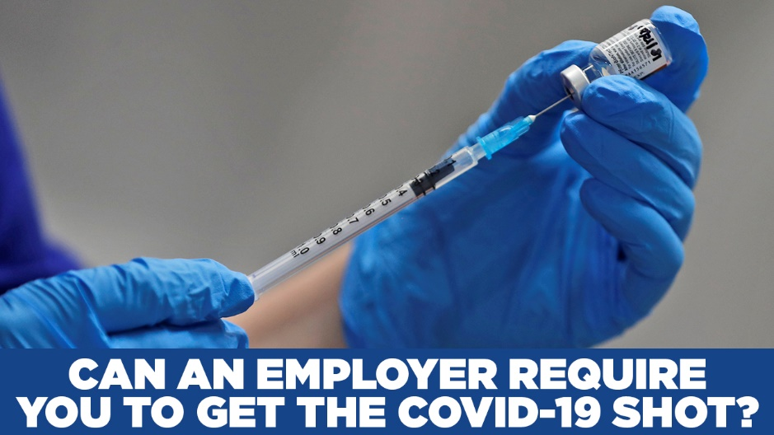
Vaccination for work
Autonomy test.
  This one is easy.
    An employee cannot have an action plan of being
    employed, with or without vaccination.
    Thus, requiring vaccination is inconsistent with no
    action plan.
    And there is no violation of autonomy

Slide 33

Vaccination for work
Generalization test.
  This one is harder.
  When one takes a job, there is an implied agreement
  about what will be required.
    Requiring an Amazon warehouse worker to babysit
    the boss’s kids is a breach of the implied agreement.
    Requiring an invasive medical procedure could fall
    into the same category.
    Except for occupations
    where such a requirement
    could be expected, due to
    prior practice or a
    sensitive health situation
    (hospital, nursing home,
    school).

Slide 34
Vaccination for work
Generalization test.
  Isn’t there an understanding that an employee will
  not create a safety hazard?
    Yes. A vaccine mandate is OK if an individual
    employee poses a significant risk that is not mitigated
    by masks, testing, or distancing.
    For example, employees recently exposed to Covid
    or who are likely to be exposed.
    But it is not enough that unvaccinated employees
    as a group pose a hazard even with masks, etc.
    The employment agreement is between the company
    and an individual, not the whole work force.

Slide 35
Vaccination for work
Generalization test.
  Isn’t there an understanding that an employee will
  not create a safety hazard?
    Yes. A vaccine mandate is OK if an individual
    employee poses a significant risk that is not mitigated
    by masks, testing, or distancing.
    For example, employees recently exposed to Covid
    or who are likely to be exposed.
    But it is not enough that unvaccinated employees
    as a group pose a hazard even with masks, etc.
    The employment agreement is between the company
    and an individual, not the whole work force.
  However, a union member implicitly agrees to abide
  by result of collective bargaining.
    So a vaccine mandate is OK if the union agrees.

Slide 36
Vaccination for work
Generalization test.
  Meanwhile, a vaccine-or-test policy is generalizable.
    Could be nearly as effective as vaccine mandate.
    Employers frequently require noninvasive medical tests
    (e.g., drug tests).
    A mask requirement is also OK. A mask can be viewed
    as part of the uniform.
    A work-at-home requirement is OK. Employers regularly
    specify the work location.

Slide 37
Vaccination for work
Generalization test.
  Meanwhile, a vaccine-or-test policy is generalizable.
    Could be nearly as effective as vaccine mandate.
    Employers frequently require noninvasive medical tests
    (e.g., drug tests).
    A mask requirement is also OK. A mask can be viewed
    as part of the uniform.
    A work-at-home requirement is OK. Employers regularly
    specify the work location.
  It is OK to require vaccination of new employees.
    There is not yet an agreement.
    They know what they are getting into.
  It is OK to require vaccination of temporary workers
    Same reason.

Slide 38
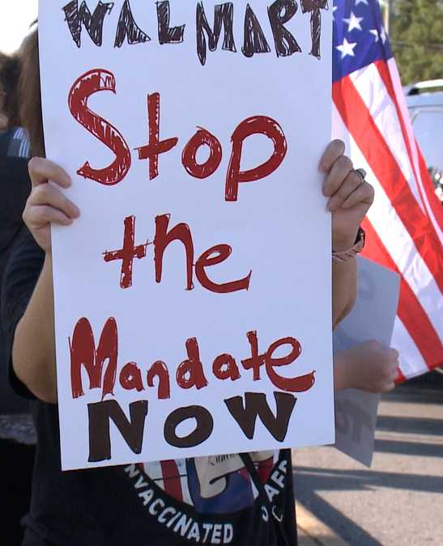
Vaccination for work
Utilitarian test.
  This could fail even when a vaccine or vaccine-or-test
  policy is generalizable..
    A requirement could create
    resistance and lead to
    large-scale resignations.
    The resulting harm may
    outweigh the benefits of
    vaccination and/or testing.
    This is an especially hard
    dilemma for small business,
    which often lacks the resources
    to require testing.

Slide 39

Vaccination for work
Scorecard for employer vaccine requirement.
  Generalization test: fail at some businesses
    Pass at hospitals, schools, other sensitive environments
    Pass for new employees, temporary workers, union members
    Vaccine-or-test is OK anywhere
  Utilitarian test: depends on employee reaction
  Autonomy test: pass.

Slide 40

Booster shots
Is it ethical to get an approved Covid booster shot?
  When much of the world’s population can’t get their
  first shot?

Slide 41
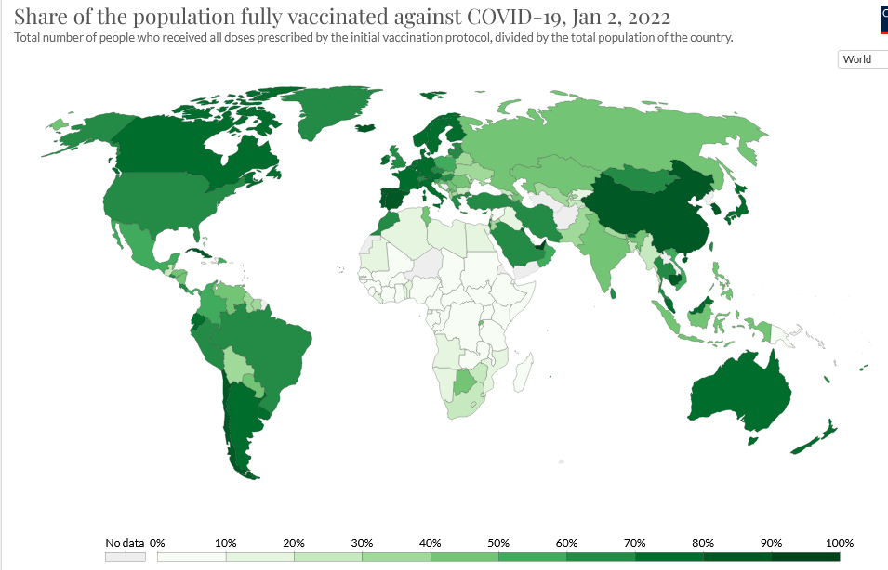
Booster shots

Slide 42
Booster shots
Is it ethical to get an approved Covid booster shot?
  It’s primarily a utilitarian issue.
  Can I rationally believe that getting a booster would
  result in no less net expected utility?
    Probably. I have no reason to think that getting a
    booster would deprive someone else of a shot.
    Meanwhile, a booster clearly results in greater
    expected utility for me and those around me.
    Public policy is another matter, because it does
    affect the vaccination rate globally.

Slide 43
Booster shots
Is it ethical to get an approved Covid booster shot?
  It’s primarily a utilitarian issue.
  Can I rationally believe that getting a booster would
  result in no less net expected utility?
    Probably. I have no reason to think that getting a
    booster would deprive someone else of a shot.
    Meanwhile, a booster clearly results in greater
    expected utility for me and those around me.
    Public policy is another matter, because it does
    affect the vaccination rate globally.
  Getting a booster appears to pass the utilitarian test.

Slide 44
Booster shots
Is it ethical to get an approved Covid booster shot?
  We can also check generalizability.
  My reasons for getting the booster…
    It is available and approved by health authorities.
    It would improve expected health outcomes, and
    utility generally, for myself and those around me.
    Getting the booster would deprive no one else
    of a shot.
  One can probably be rational in believing these reasons
  would continue to apply if everyone were to act on them.
    If so, getting the booster in these circumstances
    is generalizable.

Slide 45

Booster shots
Scorecard for getting booster shots.
  Generalization test: pass, under a suitable rationale
  Utilitarian test: pass, under current supply conditions
  Autonomy test: not an issue

Slide 46
Article in The Hill See my ethics blog
for more detailed arguments.

