Slide 1
Ethics and Technology Part 2
A Course in Business Ethics
Module 14
John Hooker Carnegie Mellon University
May 2022

Slide 2
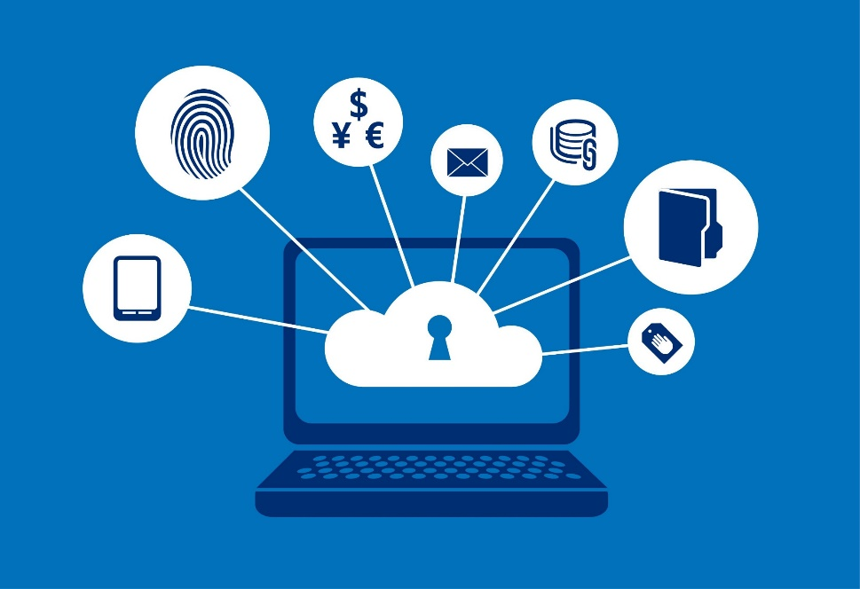
Surveillance
Electronic surveillance is everywhere.
Browsing history, cookies, keystrokes recorded.
Social media tracking data provided to advertisers.
Alexa, etc., listen in on conversations.
Shopping & purchases recorded and shared.
Embedded tracking pixels, super cookies, ip address, operating system characteristics.

Slide 3
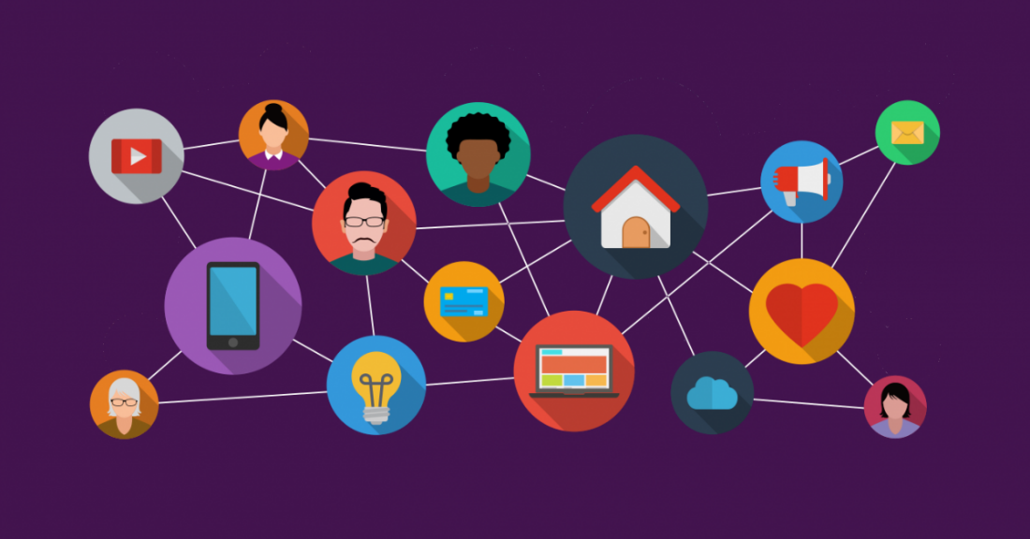
Surveillance
Electronic surveillance is everywhere.
Smart phone tracking, movements recorded.
Browsing tracked in shops and linked with purchase record.
Facial recognition by surveillance cameras
Vehicle tracking by parking meters, license plate readers
Individual dossiers assembled by data mining techniques.

Slide 4
Surveillance
Business is a major player.
Personal data collection is the dominant online business model.
Big tech and government compete for control of data.
Government often demands data from tech companies.

Slide 5
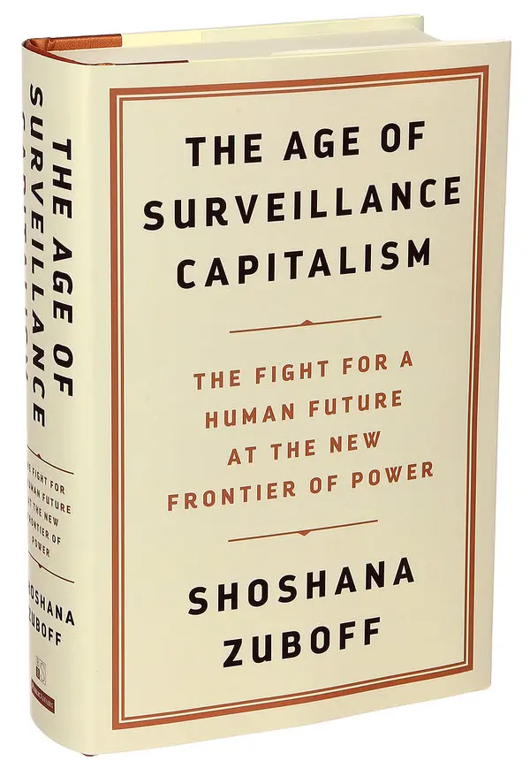
Surveillance
Encyclopedic reference:

Slide 6
Privacy
Little consensus on ethical basis for privacy.
One reason we don’t agree on what to do about privacy invasion in the tech age.
Our approach – cycle through the ethical principles
Generalization
Utilitarian
Autonomy

Slide 7
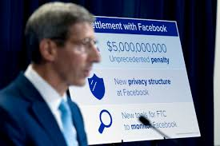
Privacy and generalizability
Argument 1: Deception
Users are misled about the lack of privacy.
“Privacy settings”
“We care about your privacy” notice, followed by fine print
In July 2019, FTC imposed $5 billion penalty on Facebook (largest ever) for “deceiving users about their ability to control the privacy of their personal information.”

Slide 8
Privacy and generalizability
Argument 1: Deception
Social media are knowingly causing users to have false beliefs about the level of privacy.
Most users remain somewhat naïve about data collection.
This is done purely for company profit.
It is not generalizable.

Slide 9
Privacy and generalizability
Argument 1: Deception
Easy to avoid deception.
Just be up front about how the site exploits user data
Prominently displayed.

Slide 10
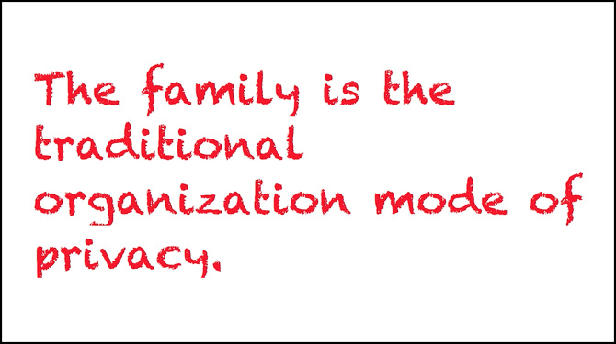
Privacy and generalizability
Argument 2: Privacy and intimacy
Western culture is primarily concerned about individual privacy.
Family privacy is a more widespread concern.
Families have intimate knowledge of each other.
This knowledge must be protected for family safety.
Intimacy is impossible without privacy.

Slide 11
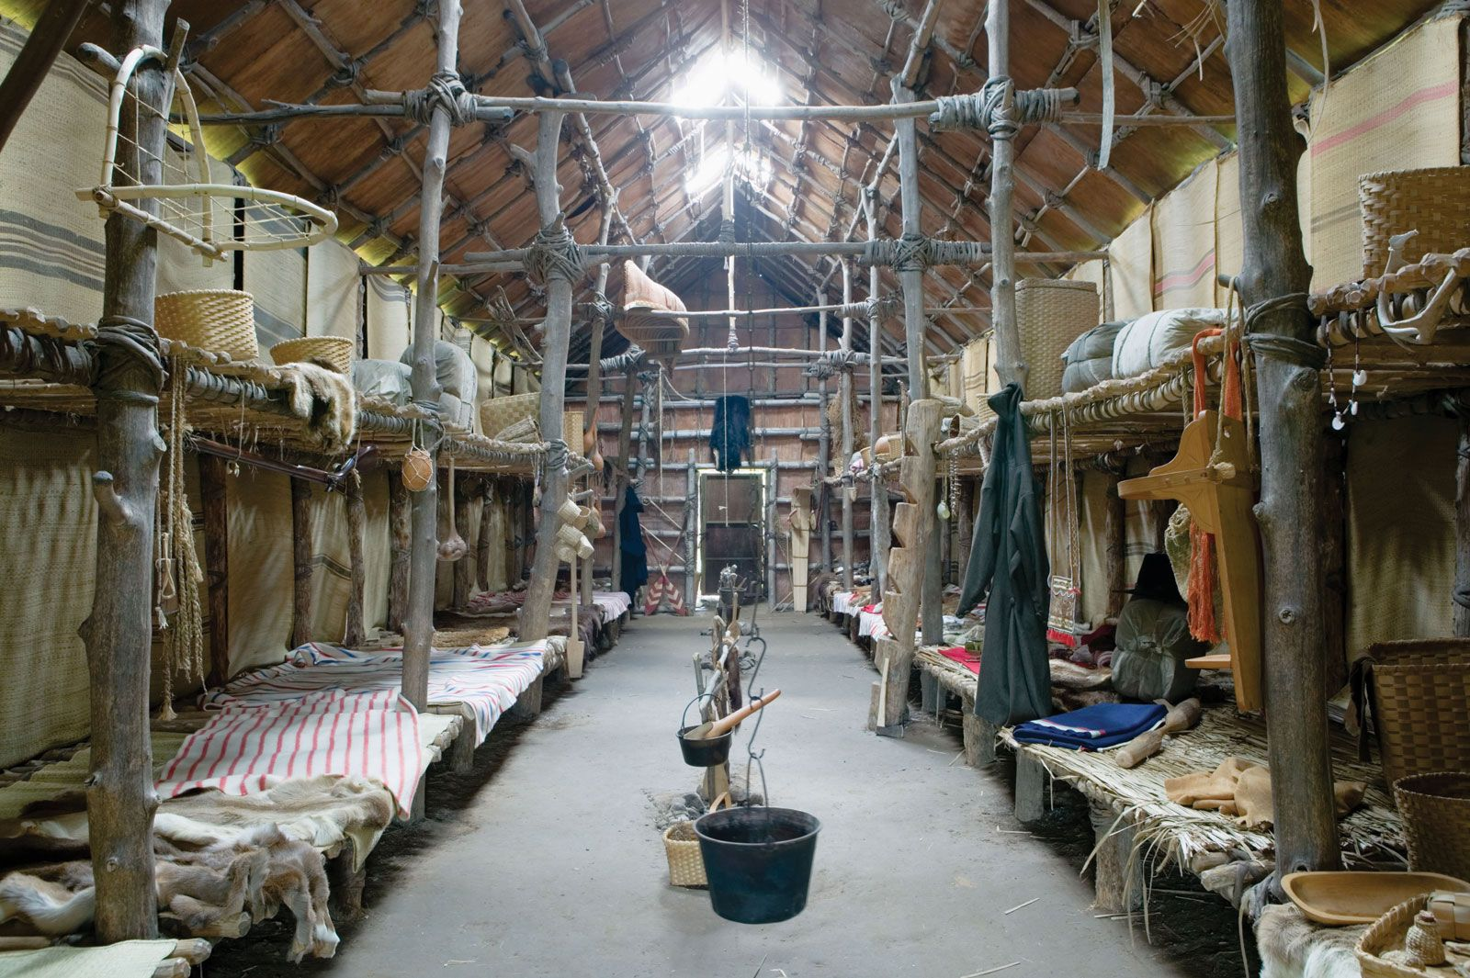
Privacy and generalizability
Argument 2: Privacy and intimacy
Some say there are cultures without privacy.
People live in multi-family dwellings.
So, privacy must not be necessary.
Inside an Iroquois longhouse

Slide 12
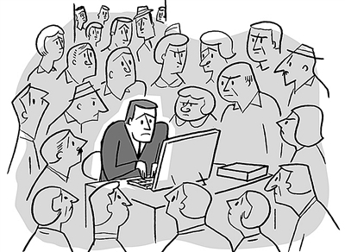
Privacy and generalizability
Argument 2: Privacy and intimacy
Yet anthropologists tell us that all cultures value some form of privacy.
To satisfy generalizability…
A business must respect the essential privacy norms of the culture in which it operates.

Slide 13
Privacy and utility
Argument 1: Surveillance is harmless
Most online surveillance is for commercial purposes.
It is pervasive but harmless.
It can be beneficial by directing ads.
And serve a greater purpose of matching supply and demand.
This is the primary function of marketing.

Slide 14
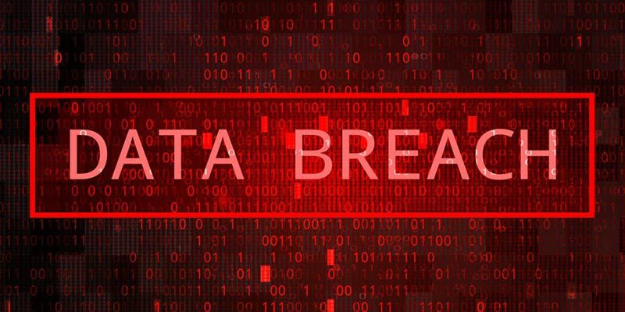
Privacy and utility
Argument 2: Surveillance is risky
Online data repositories are hacked all the time.
1291 data breaches in US in 2021 (source: Identity Theft Resource Center).
Almost daily occurrence, leading to “data breach fatigue.”
This imposes multiple risks:
Consumer: identity theft, fraudulent charges
Merchant: lawsuits, irate customers
Both: government intrusion

Slide 15
Privacy and utility
Argument 3: Inconclusive, but…
We can say this much:
Businesses must upgrade security against data breaches.
Many are lax, wanting to avoid trouble and expense.
…while hoping a breach doesn’t happen to them.
This is disutilitarian, and bad business.
A security upgrade is necessary insurance.

Slide 16
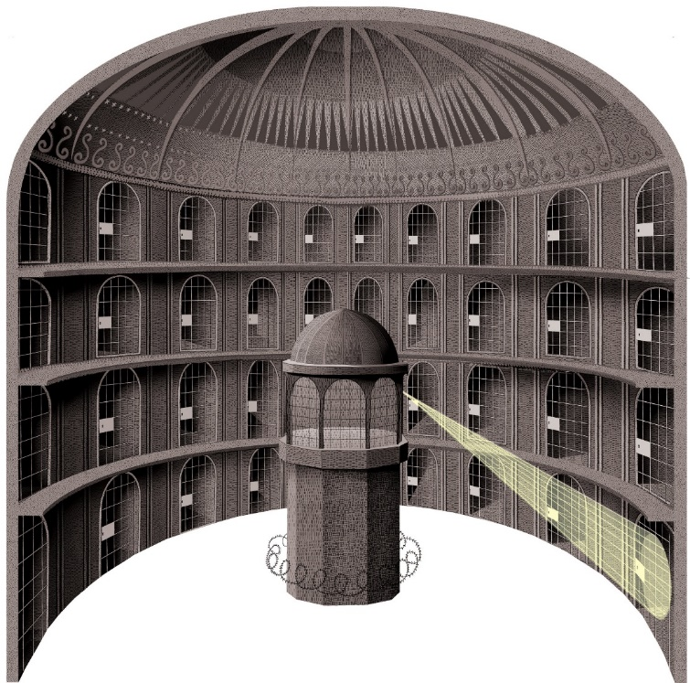
Privacy and autonomy
Precursor of constant surveillance…
Jeremy Bentham’s panopticon.
Prisoners never know when they are being watched.
“A new mode of obtaining power of mind over mind.”
Bentham, 1787
Closely analogous to our situation.
If others have power over our minds, this sounds like violation of autonomy.

Slide 17
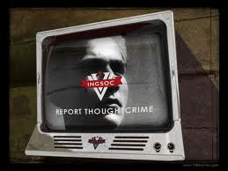
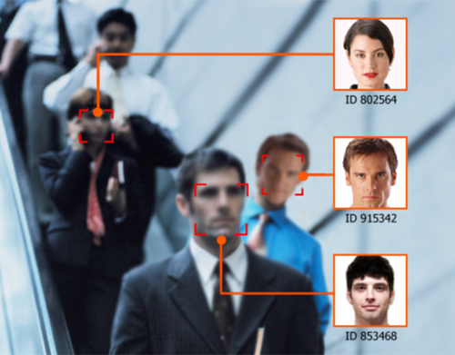
Privacy and autonomy
Precursors of constant surveillance…
George Orwell’s telescreen.
From his novel 1984.
His prediction was about 15 years early.
Facial recognition
In use today.
Online data harvesting…

Slide 18
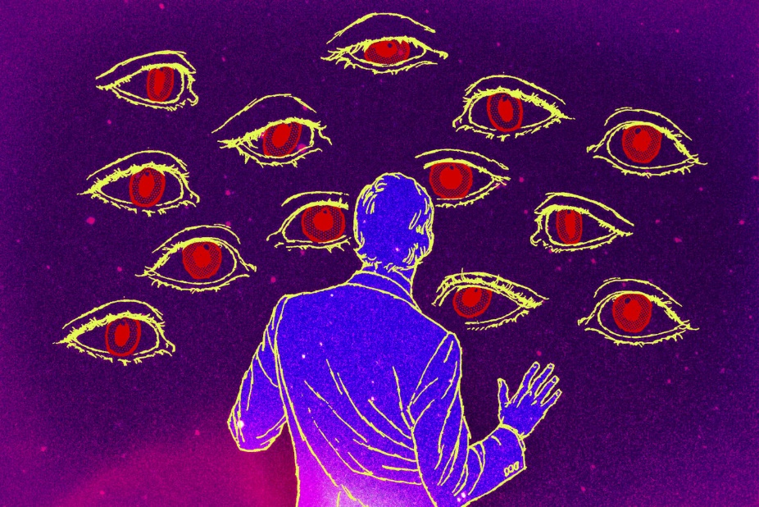
Privacy and autonomy
Science fiction scenario…
Every thought is open to scrutiny.
We cannot be ourselves.
Denial of autonomy.
Are we approaching this?

Slide 19
Conclusions…
Generalization principle
Business must fully alert customers to data harvesting.
To avoid deception
Generalized surveillance could undermine social fabric.
By interfering with intimacy.
Utilitarian principle
Utilitarian calculation unclear.
Business must at least upgrade security.
Autonomy principle
Sufficiently intrusive surveillance could destroy autonomy.

