Slide 1
Intellectual Property
A Course in Business Ethics
Module 13
John Hooker
Carnegie Mellon University
May 2022

Slide 2

Role of IP
The world’s most important kind of property.
  A major role in determining our future.
  Time for a re-examination of the concept.
  Is it really “property”?
Corporate control of IP: consistent with CSR?
  Critics say overly broad IP rights:
    Harm health (pharmaceutical patents)
    Retard technological development
    Enable monopolies
    Exacerbate inequality

Slide 3

Role of IP
We cannot resolve the issues here.
We provide some necessary background in…
  Legal aspects of IP.
  Ethical aspects of IP.

Slide 4
Legal Aspects

Slide 5
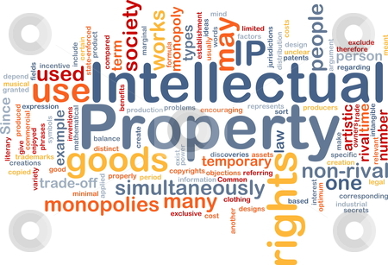
Intellectual property law
A complicated topic.
  Differs in every country.
  International law governed by many multilateral and bilateral agreements.
  Only a broad
  outline
  provided here.
  Consult a
  lawyer for
  specifics.

Slide 6

Intellectual property law
The primary international treaty is the TRIPS agreement.
  Trade-Related Aspects of Intellectual Property Rights.
  Added to GATT (General Agreement on Tariffs and Trade) at the Uruguay Round, 1994.
  Amended at 2001 WTO
  Ministerial Conference
  in Doha.
  TRIPS-plus consists
  of many bilateral
  trade agreements.

Slide 7
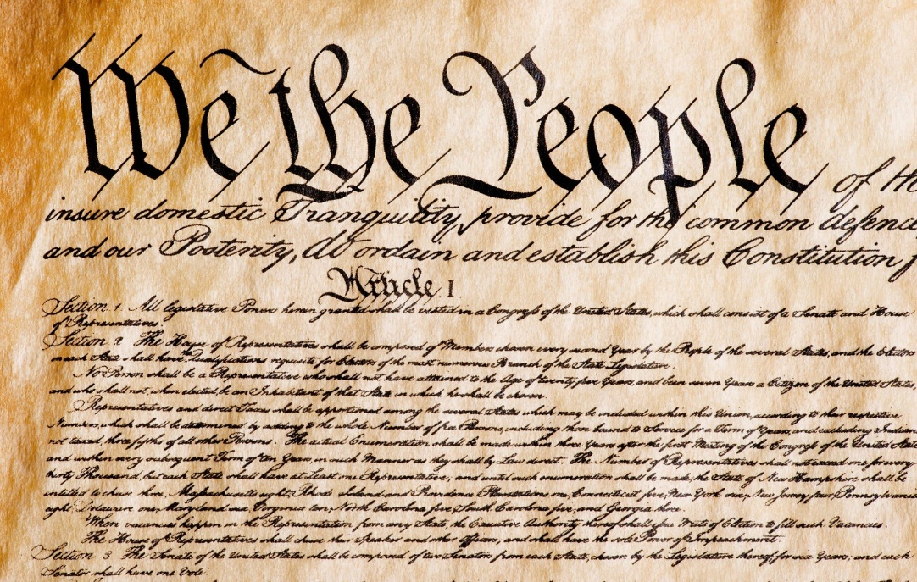
Intellectual property law
U.S. Constitution provides for Federal regulation of patents and copyrights.
  Administered by
  U.S. Patent and
  Trademark Office
  & U.S. Copyright
  Office.

Slide 8
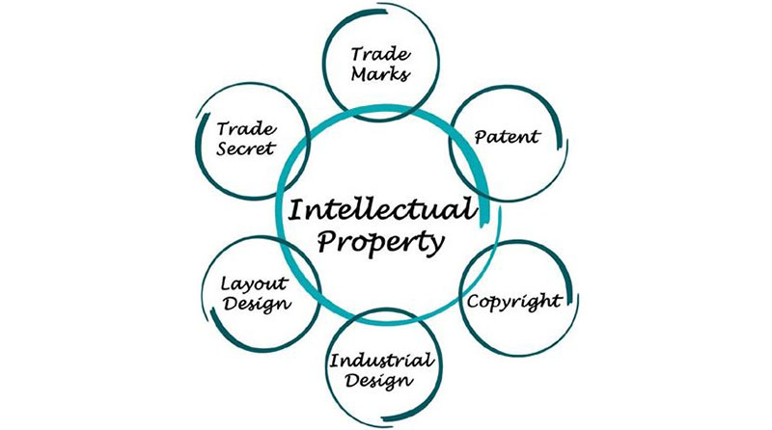
Intellectual property law
Main types of intellectual property:
  Copyright.
  Trademark.
  Patent.
  Trade secret.

Slide 9
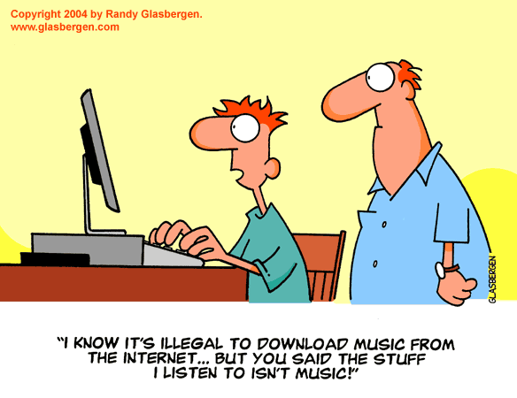
Copyright
A copyright limits the number of copies others can make
of a document or work of art without permission.

Slide 10

Copyright
A copyright limits the number of copies others can make
of a document or work of art without permission.
Duration of copyright:
  In TRIPS:
    Life + 50 years
  In U.S.:
    Individual: Life + 70 years
    Corporate-owned works:
    95 years from publication,
    or 120 years from creation,
    whichever is shorter.

Slide 11
Copyright
A copyright limits the number of copies others can
make of a document or work of art without permission.
Ideas cannot be copyrighted.
  Only a particular expression of ideas.
  Such as a literary work
  or musical composition.

Slide 12
Copyright
Fair use.
  Is it legal to download this cartoon?

Slide 13
Copyright
  From Section 107 of U.S. Copyright Act
  (emphasis added):
The fair use of a copyrighted work, including such use by reproduction in copies or phonorecords or by any other means specified by that section, for purposes such as criticism, comment, news reporting, teaching (including multiple copies for classroom use), scholarship, or research, is not an infringement of copyright.
In determining whether the use made of a work in any particular case is a fair use the factors to be considered shall include—the purpose and character of the use, including whether such use is of a commercial nature or is for nonprofit educational purposes.

Slide 14
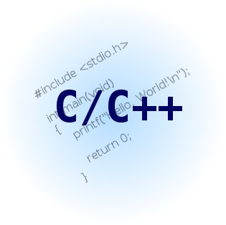
Copyright
Can one copyright software?
Generally, yes.
  The TRIPS agreement explicitly says yes.
  But one cannot copyright the underlying idea or algorithm.

Slide 15
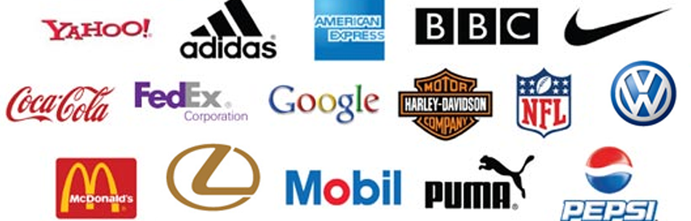
Trademark
A trademark is a word, phrase, symbol, or design
that distinguishes the maker or source of goods.
  A service mark serves the same function for a service.

Slide 16
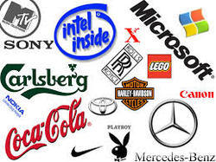
Trademark
A trademark can be registered.
  Or can be established in common law by commercial use.
Legal rights to a
trademark can last
forever.
  As long as it is in
  commercial use.
    Cannot have legal
    rights to a trademark
    already registered
    or in use by another
    company in the
    same product class.

Slide 17
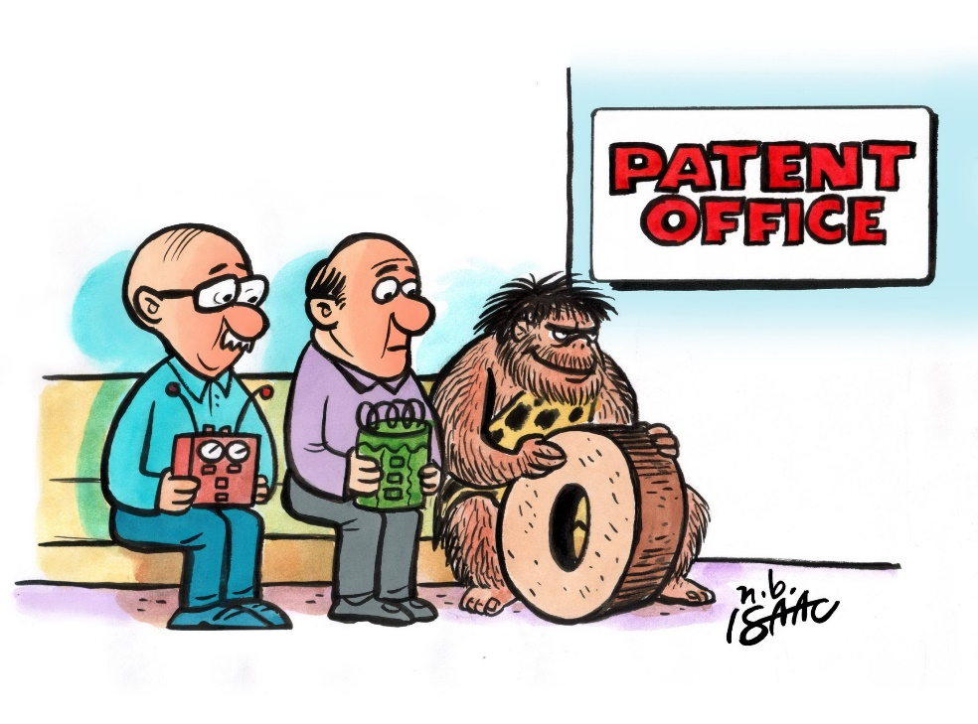
Patent
Designed to encourage disclosure of ideas in
exchange for limited period of exclusive use.
  20 years in TRIPS
  In U.S.: 20 years, except
  14 years for a design
  patent
Can patent:
  A new method, device,
  or material.

Slide 18


Patent
Cannot patent:
  A pure idea, such as a theorem.
  Anything that occurs in nature.
  A “way of doing business,” even if automated by computer.
  “Look and feel,”
  e.g. spreadsheet.

Slide 19

Patent
Can software be patented?
  Controversial, varies by country.
  TRIPS agreement is vague.
  In the U.S. one can patent:
    A software-based invention
    Software that improves computer functionality
    Software that solves a problem that arises only in the context of computer technology
  Ask a patent lawyer (a recognized specialty)

Slide 20
Patent
Can an algorithm be patented?
  In principle, no.
    Technically, it must be embodied in some device.
  In practice, yes.
    Many algorithms have been patented.
    Patent is not issued for source code.
    It is issued for a “series of steps.”
    …which is an algorithm
    However, bubble sort was denied a patent.

Slide 21

Patent
A patent is registered in the name of the inventor.
The owner may be someone else, or a company.
  An employer normally owns any idea conceived by someone working for hire.

Slide 22

Patent
Who works for hire?
  Normally, full-time employees work for hire and do not retain IP rights.
  Normally, consultants do not work for hire, depending on contract.

Slide 23

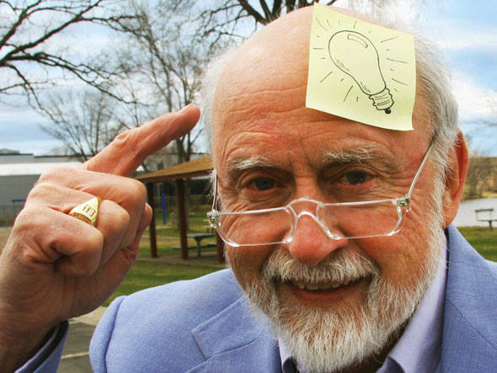
Patent
Case study: Post-it Notes
  Invented by Arthur Fry in 1974
    To make notes in choral music.

Slide 24
Patent
Case study: Post-it Notes
  Invented by Arthur Fry in 1974
    To make notes in choral music.
  Fry was employed by 3M.
    3M marketed Post-it Notes in 1980.
    Today, over $2 billion annual revenue.
    Fry received zero royalties for his invention.

Slide 25
Patent
Case study: Post-it Notes
  Invented by Arthur Fry in 1974
    To make notes in choral music.
  Fry was employed by 3M.
    3M marketed Post-it Notes in 1980.
    Today, over $2 billion annual revenue.
    Fry received zero royalties for his invention.
    But he was promoted to “Corporate Researcher”
    National Inventors Hall of Fame, 2010.

Slide 26
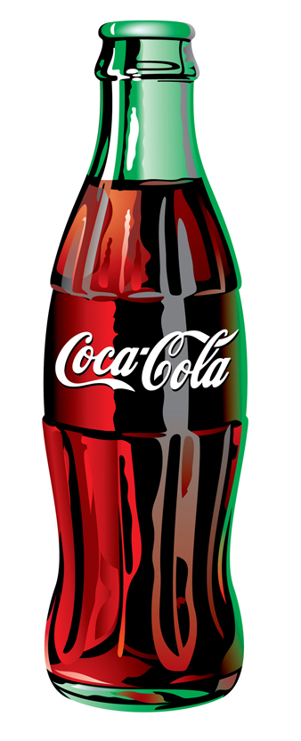
Trade secret
A trade secret is a secret formula or device that
provides a commercial advantage.
  It can be bought, sold and licensed.
It remains intellectual property
forever, or until the secret gets out.
  For example, the formula for
  Coca-Cola.

Slide 27
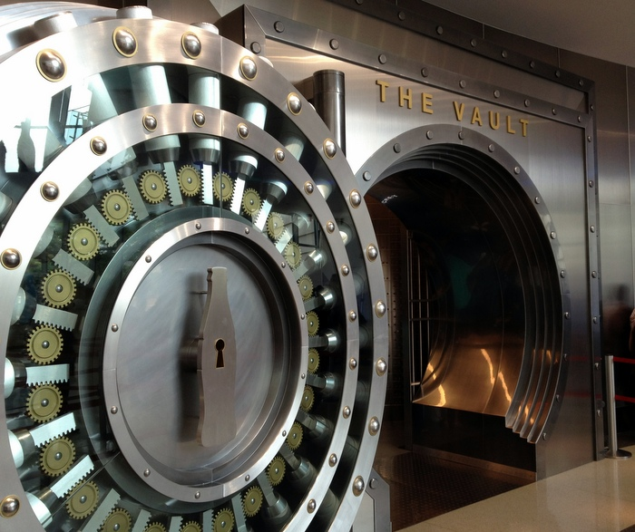
Trade secret
  There is one copy of the Coca-Cola formula.
  Kept in a vault in Atlanta, USA.
    Two people have access
    to the vault.
    Their identities are secret.
    Not allowed to travel
    together
    When one is about to die,
    he/she chooses a
    successor
  Syrup shipped as
  9 components, combined
  at factory.

Slide 28

Trade secret
The law does not prohibit use of a trade secret.
  It only prohibits others from stealing a trade secret.
It is normally legal for another company
to conceive the idea independently and
use it.
  Reverse engineering is not
  theft (the idea was not really
  secret).

Slide 29
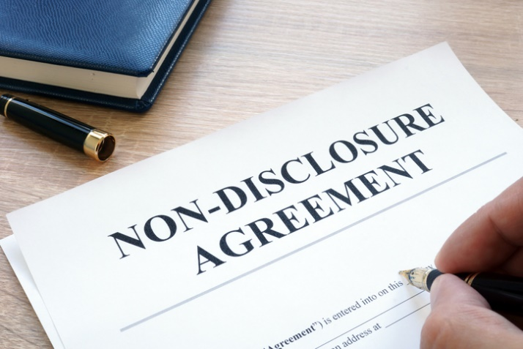
NDAs
A nondisclosure agreement
prevents disclosure of
proprietary information.
  The duration of the NDA is usually stated (1-5 years).
    If not stated, it may be forever.
  “Proprietary” is defined in the NDA.
  Disclosure of trade secrets at any time is illegal.
    With or without an NDA.
    Generally, the company identifies what it considers
    to be trade secrets.

Slide 30
Ethical aspects

Slide 31

Property
Violating property rights is inconsistent with generalization principle.
  The thief takes someone’s property because he wants it to be his property.
  But if no one respects property rights, there will be no property at all – not even for the thief.

Slide 32

Intellectual property
But does the concept of intellectual property make sense?
  Is there an ethical basis for it?

Slide 33
Intellectual property
The concept of intellectual property is relatively recent.
  Can leave the impression that IP is like other property.

Slide 34
Intellectual property
The concept of intellectual property is relatively recent.
  Can leave the impression that IP is like other property.
  But one can use IP without denying others the
  use of it.
  Unclear that IP rights are “natural” property rights.

Slide 35
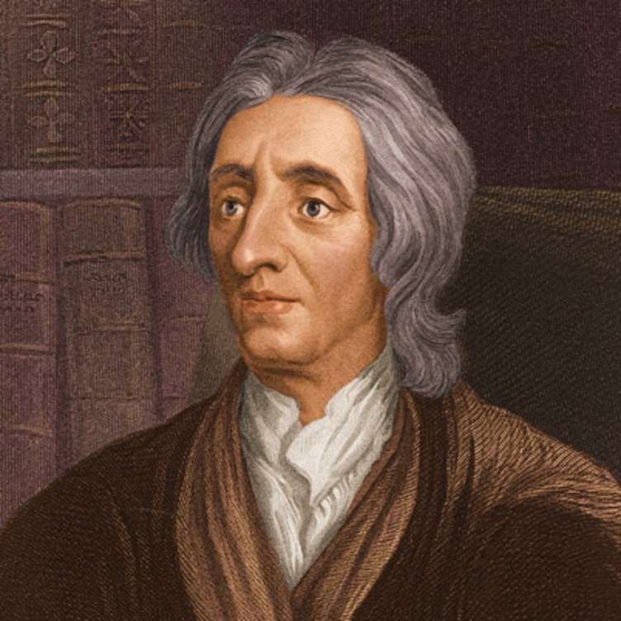
“Natural” property rights
John Locke defended “natural” property rights.
  Similar to autonomy argument.
    A home or land in which one has
    invested labor is part of oneself.
    Yet what if one sells the home
    or land? No more property rights?
John Locke, 1632-1704

Slide 36
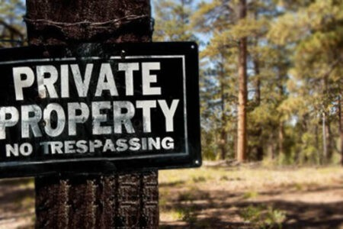
Agency defense of property
One can act only if one has to freedom to choose one’s actions.
  This presupposes some degree of control over one’s body & immediate surroundings.
  Including exclusive possession of
  some property.
  To deny this kind of freedom is
  to deny autonomy and therefore
  immoral.
  This argument doesn’t apply to
  all property.

Slide 37

Agency defense for IP?
But one doesn’t need exclusive use of IP.
  Others can use it simultaneously.
  So agency argument does not apply to IP.

Slide 38
Utilitarian defense for IP
None of the previous says that there is no “right” to IP.
  Only that there is no “natural” right.

Slide 39
Utilitarian defense for IP
None of the previous says that there is no “right” to IP.
  Only that there is no “natural” right.
There may be a utilitarian obligation to respect IP rights.

Slide 40
Utilitarian defense for IP
Utilitarian argument for IP
  IP rights provide incentive to develop new ideas.
    This increases overall utility.
  Patent law allows free discussion and exchange of ideas, despite IP rights.
    Original intent of patent law.
    Also increases utility.
      But trade secrets, nondisclosure agreements restrict discussion.

Slide 41
Utilitarian defense for IP
So IP rights are not rights to exclusive use of IP, but rights to make a profit from it.
Unlike “natural rights,” IP rights must be justified by consequences to society.
  No “balancing” of IP with “human rights” that are based on generalization and autonomy principles.

Slide 42
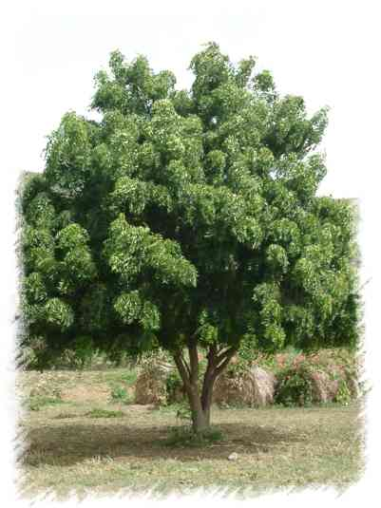
Back to TRIPS agreement
Some have criticized TRIPS agreement for trying to balance human and IP rights.
  Particularly when companies
  patent life-saving or
  indigenous drugs and
  charge high prices.
  For example, drugs from
  neem tree in India
    70+ Western patents
    WR Grace was sued in 2000
    landmark case – EU revoked
    1995 patent. But others in force.

Slide 43
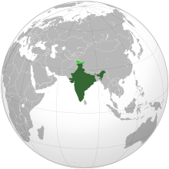
Back to TRIPS agreement
Lawsuits for individual patents are too cumbersome.
Now, a state (e.g. India) may issue a compulsory license to a pharmaceutical patent.
  Companies lose patent rights.
  …but receive royalties set by
  the state.

Slide 44
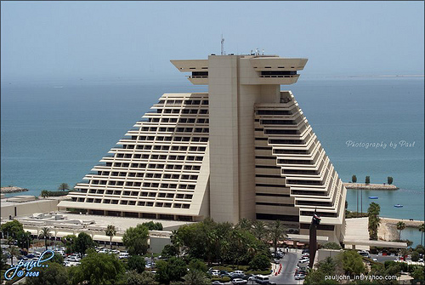
Back to TRIPS agreement
Doha amendments give countries the right to determine the grounds on which they grant compulsory licenses.
  GATT signatories
  have taken
  limited action to
  implement Doha
  reforms.

Slide 45

Movement away from IP
Software has been a pioneer in movement away from IP.
  Beginning with GNU project. Richard Stallman, GNU Manifesto, 1985.
    Examples: Linux (and Ubuntu) computer operating system.
    “Free software” in GNU license means freedom to run, copy, distribute, change, improve – not necessarily free of cost.

Slide 46

Movement away from IP
Creative commons has a broader purpose.
  Organization that promotes open source and
  pubic domain licensing.
    Particularly health-related
    Provides licenses that waive various rights.
      BY (attribution)
      SA (share-alike)
      NC (non-commercial)
      ND (no derivative).

Slide 47
Conclusion
Intellectual property is ethically (and legally) different than other kinds of property.
  IP rights must be justified on utilitarian grounds.
  They can never override “natural” property rights or other rights based on generalization and autonomy principles.

Slide 48
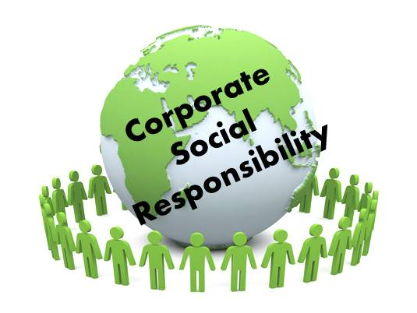
Why CSR?
Because corporations are the major source of private capital accumulation,
  …and have profound influence on the world,
  …and because trans-national corporations can circumvent national regulation,
We must assess their
responsibility to society.

Slide 49
Basic Responsibilities
CSR imposes 3 broad types of obligations
on a corporation,
    Based primarily on the utilitarian principle:
  Its products & services should benefit customers.
  Its products should benefit the larger society while
  not harming the natural environment.
  Its other activities should have a beneficial effect.
    Employment, labor relations, advertising, pricing,
    investor relations, finance, resource consumption,
    waste generation, etc.

Slide 50
Products that Benefit Customers
Products and services should benefit, and
not harm, customers who buy them.
  Straightforward utilitarian obligation.

Slide 51
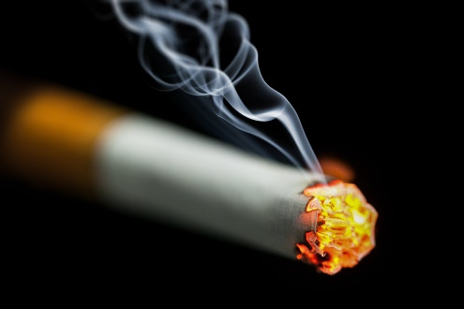
Products that Benefit Customers
Products and services should benefit, and
not harm, customers who buy them.
  Straightforward utilitarian obligation.
This may seem obvious, but it has been disputed.
  Some say business should provide what people want
  rather than try to be paternalistic.
    Such as cigarettes, unhealthy fast food.
    As long as customers are
    fully informed adults.

Slide 52
Products that Benefit Customers
Argument: Since customers buy the product voluntarily, the company is not “responsible”
for ill effects.
  We assume they are fully informed of the risks.
  Besides, people should have the “freedom” to buy
  what they want.

Slide 53
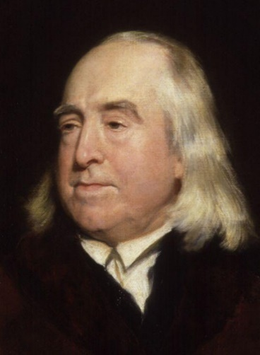
Products that Benefit Customers
This conflicts with the utilitarian principle.
  It is concerned with the utility or disutility that ultimately results.
    Even if it depends on the free choices of others.

Slide 54
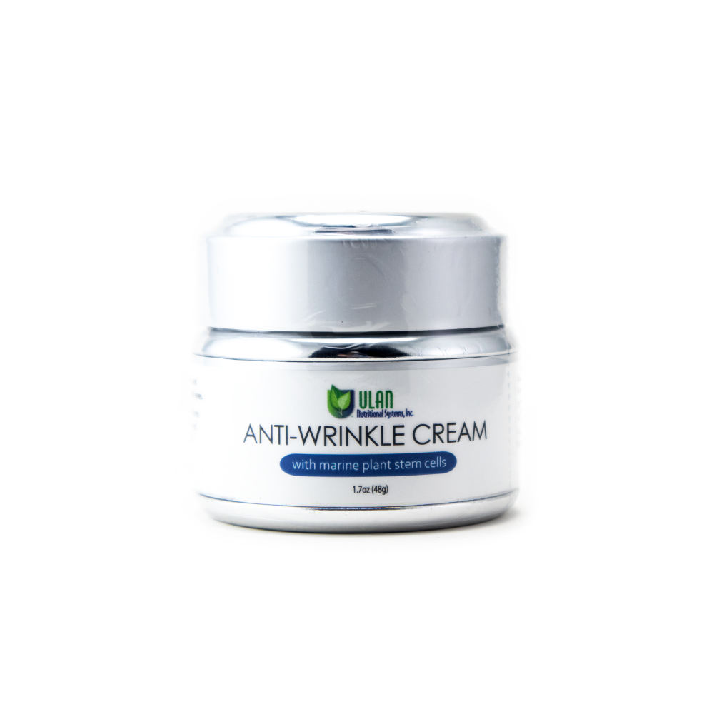
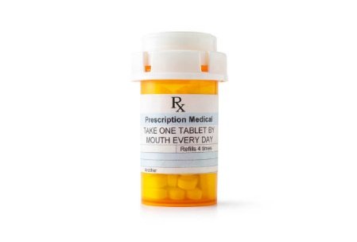
Products that Benefit Customers
Example.
  A pharmaceutical company has 2 options for product development, equally profitable. Only 1 can be selected.
    An anti-viral drug* that can relieve enormous suffering.
    A ground-breaking anti-wrinkle cream.
*The company has exclusive patent rights, and no other company is interested
in buying the rights due to lack of production facilities.

Slide 55
Products that Benefit Customers
Example.
  A pharmaceutical company has 2 options for product development, equally profitable. Only 1 can be selected.
    An anti-viral drug* that can relieve enormous suffering.
    A ground-breaking anti-wrinkle cream.
  The drug is the utilitarian choice.
    Even though its use depends on
    the free choices of doctors and
    patients to use it.
    No reason to deny that the company
    is “responsible” for its benefits.
*The company has exclusive patent rights, and no other company is interested
in buying the rights due to lack of production facilities.

Slide 56
Products that Benefit Customers
Another example.
  The only shop in town refuses to sell cigarettes because
  they are unhealthy.
  Customers argue that they have a “right” to buy what they want.
    This is only a claim, not an argument.

Slide 57

Products that Benefit Customers
  Customers argue that they should have the “freedom”
  to buy what they want.
    No one is suggesting that cigarette sales be banned.
    But is the merchant violating autonomy?

Slide 58
Products that Benefit Customers
  Customers argue that they should have the “freedom”
  to buy what they want.
    No one is suggesting that cigarette sales be banned.
    But is the merchant violating autonomy?
  No.
    Customers cannot have an action plan of being sold cigarettes.
    They can only decide to buy cigarettes if they are for sale.
    No interference with this action plan.
    The autonomy principle doesn’t require a merchant to give customers anything they want, just because they want it.

Slide 59
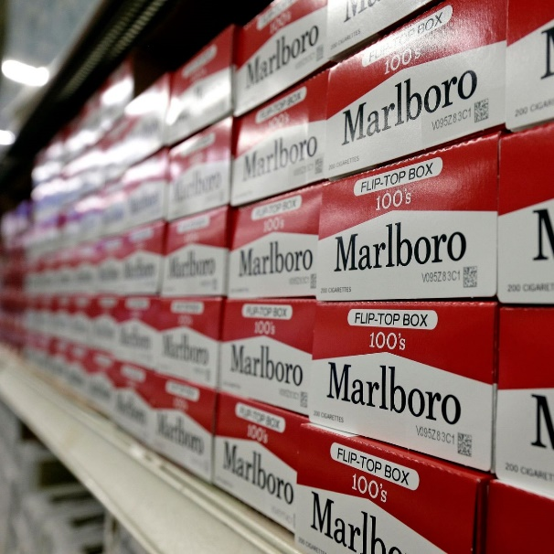
Products that Benefit Customers
  Is the shop owner really obligated to discontinue cigarette sales?
  Probably not, for a small shopkeeper.
    Health data indicate that cigarette
    sales in general are disutilitarian…
    But a small shopkeeper can use
    a futility argument – customers can
    always get their cigarettes elsewhere.
    The story is different for a major
    chain (e.g. CVS) or manufacturer,
    whose decision could affect utility.

Slide 60

Products that Benefit Society
Products and services should benefit society
at large, without harming the environment.
  Again, a straightforward utilitarian obligation.

Slide 61
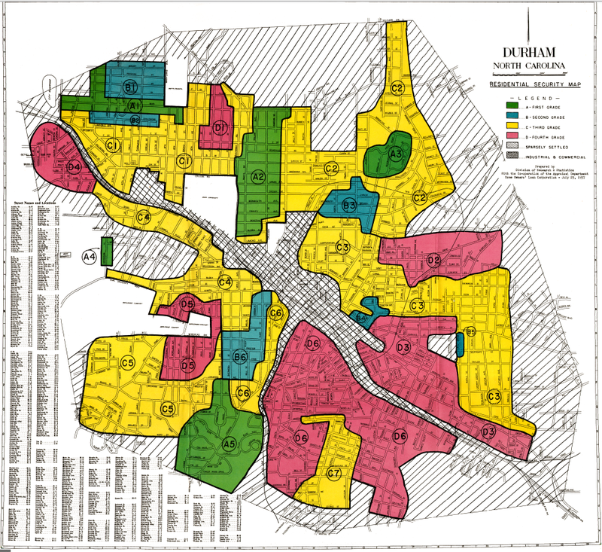
Products that Benefit Society
Example
  Mortgage loan applicants should be properly vetted.
    Even when the loan will be sold and become part of a mortgage-backed security.
    This promotes financial
    stability.
  But without redlining.
    That is, refusing to consider
    properties in low-income
    areas.
    This promotes social
    stability.

Slide 62

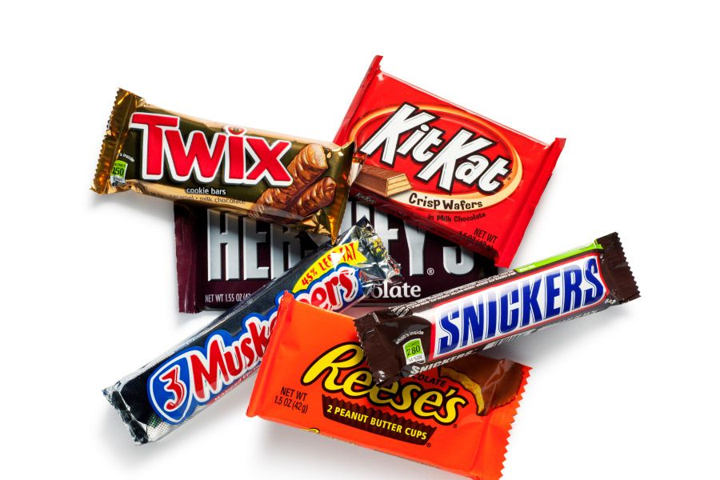
Products that Benefit Society
This has also been questioned.
  The utilitarian principle demands too much.
    It requires maximum utility.
  For example,
    It “says” one cannot
    ethically sell balloons
    and candy bars.
    Because selling
    antibiotics (e.g.)
    creates more utility.

Slide 63

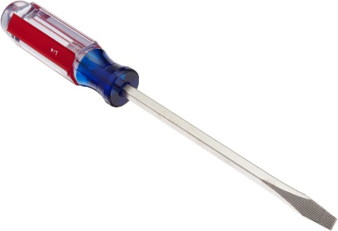
Products that Benefit Society
Not so.
  The utilitarian principle only requires one to consider action plans that are otherwise ethical.
    Selling items that maximize utility, simply because they maximize utility, is not generalizable.
    The economy would collapse, because nobody would
    sell the many other items that are necessary to run society, such as screwdrivers and toilet paper.

Slide 64
Products that Benefit Society
Selling balloons for the right reason is
ethical.
  A generalizable action plan:
    If products and services necessary to run
    the economy are widely available, I am
    equipped to sell balloons, I see an
    opportunity to sell them, and I have a
    particular interest in selling balloons, then
    I will sell balloons.

Slide 65
Products that Benefit Society
Selling balloons for the right reason is
ethical.
  A generalizable action plan:
    If products and services necessary to run
    the economy are widely available, I am
    equipped to sell balloons, I see an
    opportunity to sell them, and I have a
    particular interest in selling balloons, then
    I will sell balloons.
  It is also utilitarian.
    If I can rationally believe that I would create
    no more utility doing something else.
    Or I can use a futility argument – what I don’t
    sell, others will sell.

Slide 66
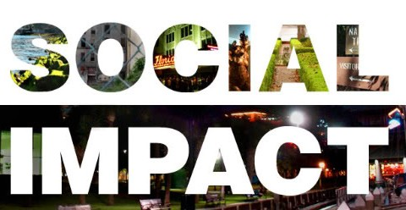
Other Social Impacts
Activities other than selling products or services
should have a beneficial effect.
    Employment, labor relations, advertising, pricing,
    investor relations, finance, resource consumption,
    waste generation, etc.
    We discuss these throughout the course, including
    a module on sustainability.

Slide 67
Further reading
J. N. Hooker, Advanced Introduction to Business Ethics, Edward Elgar (2021) Chapters 5-6.

