Slide 1
Corporate Social Responsibility
A Course in Business Ethics
Module 12
John Hooker
Carnegie Mellon University
May 2022

Slide 2

Why CSR?
Because corporations are the major source of private capital accumulation,
  …and have profound influence on the world,
  …and because trans-national corporations can circumvent national regulation,
We must assess their
responsibility to society.

Slide 3
Basic Responsibilities
CSR imposes 3 broad types of obligations
on a corporation,
    Based primarily on the utilitarian principle:
  Its products & services should benefit customers.
  Its products should benefit the larger society while
  not harming the natural environment.
  Its other activities should have a beneficial effect.
    Employment, labor relations, advertising, pricing,
    investor relations, finance, resource consumption,
    waste generation, etc.

Slide 4
Products that Benefit Customers
Products and services should benefit, and
not harm, customers who buy them.
  Straightforward utilitarian obligation.

Slide 5
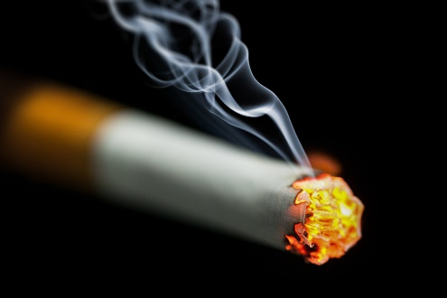
Products that Benefit Customers
Products and services should benefit, and
not harm, customers who buy them.
  Straightforward utilitarian obligation.
This may seem obvious, but it has been disputed.
  Some say business should provide what people want
  rather than try to be paternalistic.
    Such as cigarettes, unhealthy fast food.
    As long as customers are
    fully informed adults.

Slide 6
Products that Benefit Customers
Argument: Since customers buy the product voluntarily, the company is not “responsible”
for ill effects.
  We assume they are fully informed of the risks.
  Besides, people should have the “freedom” to buy
  what they want.

Slide 7
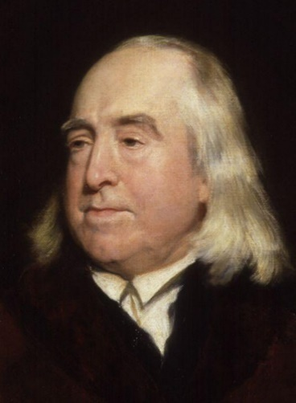
Products that Benefit Customers
This conflicts with the utilitarian principle.
  It is concerned with the utility or disutility that ultimately results.
    Even if it depends on the free choices of others.

Slide 8
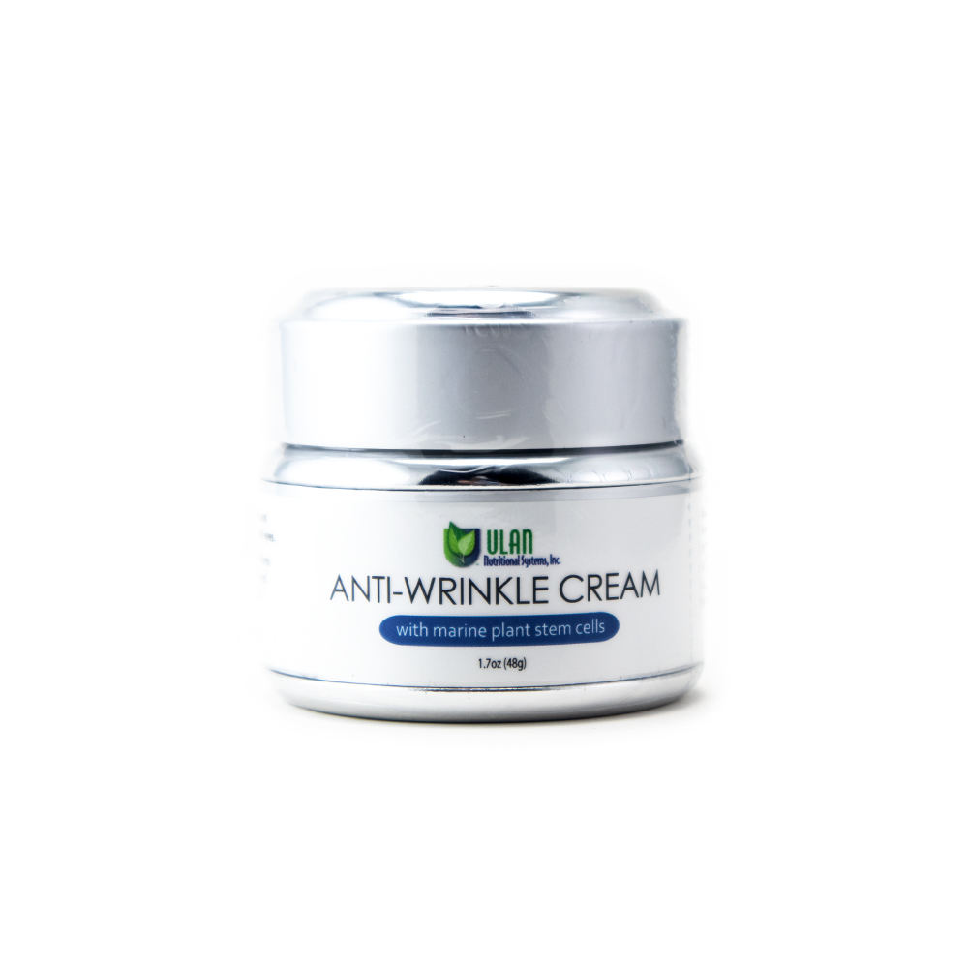

Products that Benefit Customers
Example.
  A pharmaceutical company has 2 options for product development, equally profitable. Only 1 can be selected.
    An anti-viral drug* that can relieve enormous suffering.
    A ground-breaking anti-wrinkle cream.
*The company has exclusive patent rights, and no other company is interested
in buying the rights due to lack of production facilities.

Slide 9
Products that Benefit Customers
Example.
  A pharmaceutical company has 2 options for product development, equally profitable. Only 1 can be selected.
    An anti-viral drug* that can relieve enormous suffering.
    A ground-breaking anti-wrinkle cream.
  The drug is the utilitarian choice.
    Even though its use depends on
    the free choices of doctors and
    patients to use it.
    No reason to deny that the company
    is “responsible” for its benefits.
*The company has exclusive patent rights, and no other company is interested
in buying the rights due to lack of production facilities.

Slide 10
Products that Benefit Customers
Another example.
  The only shop in town refuses to sell cigarettes because
  they are unhealthy.
  Customers argue that they have a “right” to buy what they want.
    This is only a claim, not an argument.

Slide 11

Products that Benefit Customers
  Customers argue that they should have the “freedom”
  to buy what they want.
    No one is suggesting that cigarette sales be banned.
    But is the merchant violating autonomy?

Slide 12
Products that Benefit Customers
  Customers argue that they should have the “freedom”
  to buy what they want.
    No one is suggesting that cigarette sales be banned.
    But is the merchant violating autonomy?
  No.
    Customers cannot have an action plan of being sold cigarettes.
    They can only decide to buy cigarettes if they are for sale.
    No interference with this action plan.
    The autonomy principle doesn’t require a merchant to give customers anything they want, just because they want it.

Slide 13
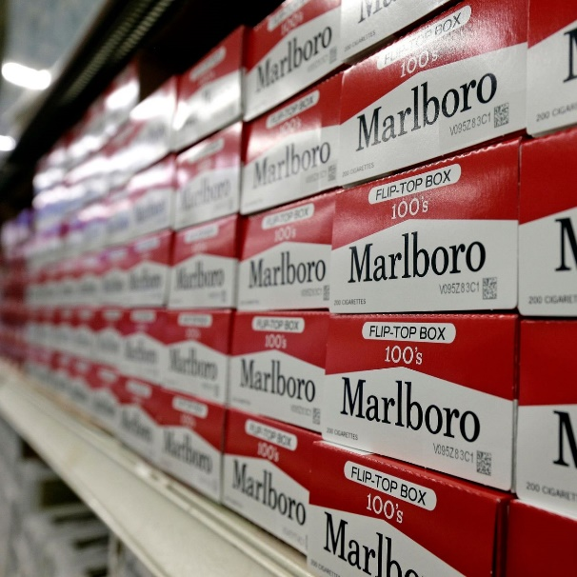
Products that Benefit Customers
  Is the shop owner really obligated to discontinue cigarette sales?
  Probably not, for a small shopkeeper.
    Health data indicate that cigarette
    sales in general are disutilitarian…
    But a small shopkeeper can use
    a futility argument – customers can
    always get their cigarettes elsewhere.
    The story is different for a major
    chain (e.g. CVS) or manufacturer,
    whose decision could affect utility.

Slide 14

Products that Benefit Society
Products and services should benefit society
at large, without harming the environment.
  Again, a straightforward utilitarian obligation.

Slide 15
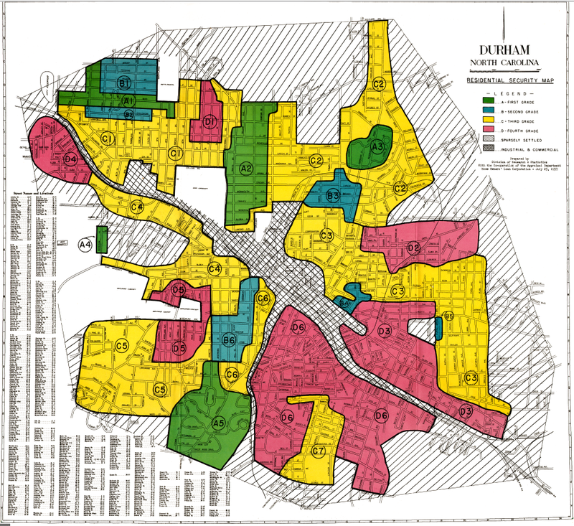
Products that Benefit Society
Example
  Mortgage loan applicants should be properly vetted.
    Even when the loan will be sold and become part of a mortgage-backed security.
    This promotes financial
    stability.
  But without redlining.
    That is, refusing to consider
    properties in low-income
    areas.
    This promotes social
    stability.

Slide 16

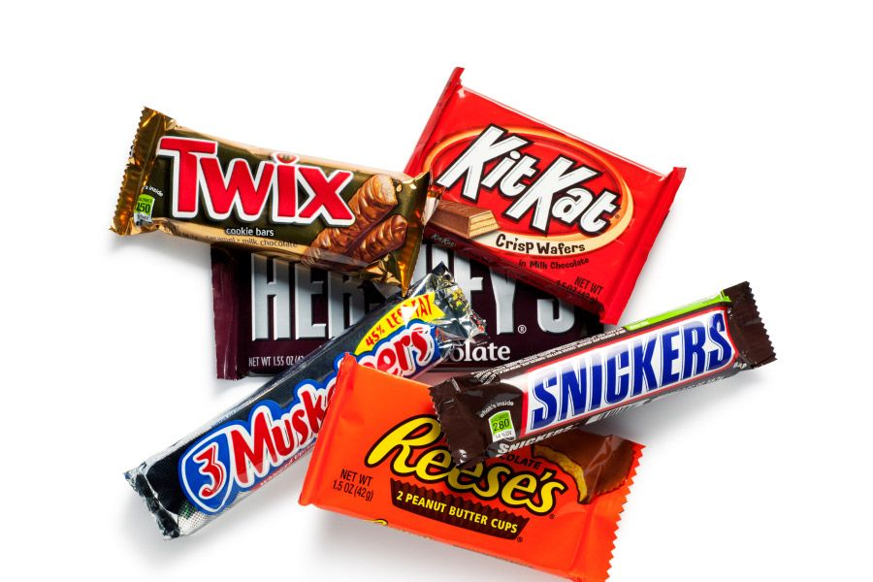
Products that Benefit Society
This has also been questioned.
  The utilitarian principle demands too much.
    It requires maximum utility.
  For example,
    It “says” one cannot
    ethically sell balloons
    and candy bars.
    Because selling
    antibiotics (e.g.)
    creates more utility.

Slide 17


Products that Benefit Society
Not so.
  The utilitarian principle only requires one to consider action plans that are otherwise ethical.
    Selling items that maximize utility, simply because they maximize utility, is not generalizable.
    The economy would collapse, because nobody would
    sell the many other items that are necessary to run society, such as screwdrivers and toilet paper.

Slide 18
Products that Benefit Society
Selling balloons for the right reason is
ethical.
  A generalizable action plan:
    If products and services necessary to run
    the economy are widely available, I am
    equipped to sell balloons, I see an
    opportunity to sell them, and I have a
    particular interest in selling balloons, then
    I will sell balloons.

Slide 19
Products that Benefit Society
Selling balloons for the right reason is
ethical.
  A generalizable action plan:
    If products and services necessary to run
    the economy are widely available, I am
    equipped to sell balloons, I see an
    opportunity to sell them, and I have a
    particular interest in selling balloons, then
    I will sell balloons.
  It is also utilitarian.
    If I can rationally believe that I would create
    no more utility doing something else.
    Or I can use a futility argument – what I don’t
    sell, others will sell.

Slide 20

Other Social Impacts
Activities other than selling products or services
should have a beneficial effect.
    Employment, labor relations, advertising, pricing,
    investor relations, finance, resource consumption,
    waste generation, etc.
    We discuss these throughout the course, including
    a module on sustainability.

Slide 21
Further reading
J. N. Hooker, Advanced Introduction to Business Ethics, Edward Elgar (2021) Chapters 5-6.

