Slide 1
Ethics and Technology Part 1
A Course in Business Ethics
Module 11
John Hooker Carnegie Mellon University
May 2022

Slide 2
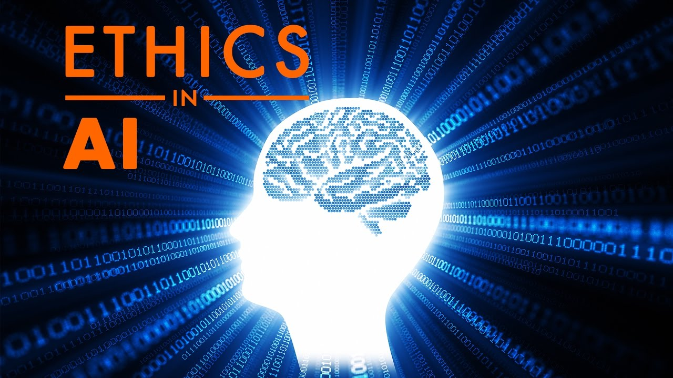
Four Issues
Bias in AI systems
Value alignment
Technological unemployment
Privacy

Slide 3
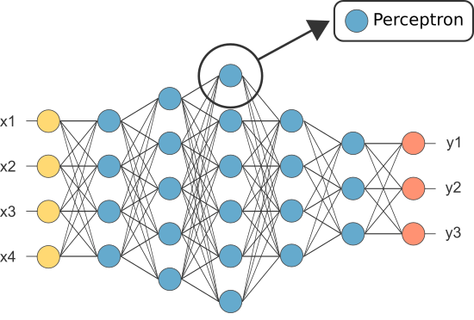
Bias in AI systems
An AI system evaluates mortgage applications
Based on “deep learning” in a multilayer neural network trained on “big data.”

Slide 4
Bias in AI systems
An AI system evaluates mortgage applications
Based on “deep learning” in a multilayer neural network trained on “big data.”
“Learning” = finding best fit, as in regression.
“Deep learning” = many layers
Overfitting, not magic

Slide 5
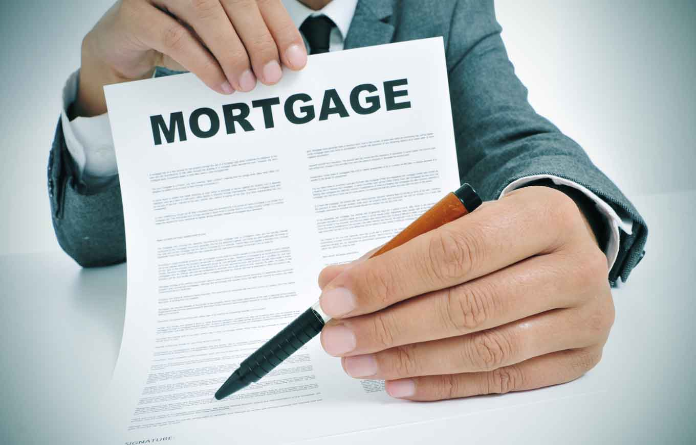
Bias in AI systems
An application may be rejected because the applicant…
Belongs to a minority group, despite sound finances.
Because default rate is higher for the minority group.

Slide 6
Bias in AI systems
An application may be rejected because the applicant…
Belongs to a minority group, despite sound finances.
Because default rate is higher for the minority group.
Remove race/ethnic group from data?

Slide 7
Bias in AI systems
An application may be rejected because the applicant…
Belongs to a minority group, despite sound finances.
Because default rate is higher for the minority group.
Remove race/ethnic group from data?
Applicant rejected due to address in low-income neighborhood, where more people are financially irresponsible.
Members of minority group more likely to live in a low-income neighborhood due to social factors.

Slide 8
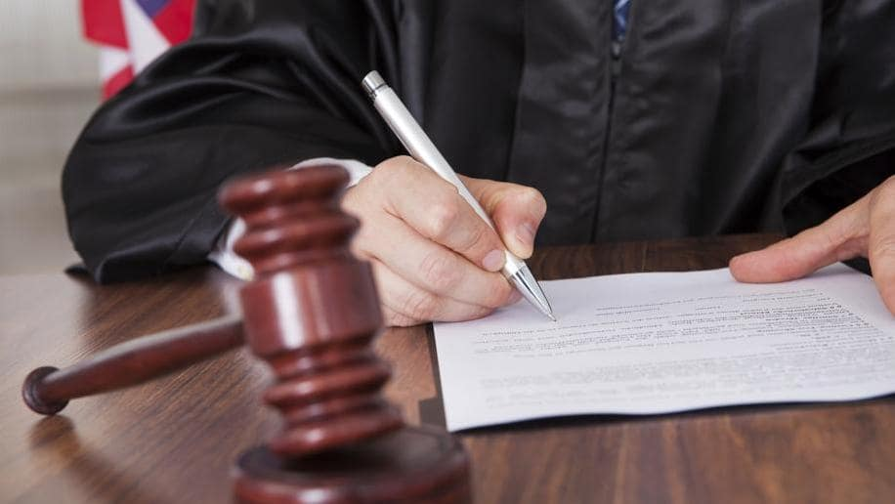
Bias in AI systems
Similar issue for other machine learning applications:
Parole (minimize recidivism risk)
Interviewing and hiring
College admissions

Slide 9
Bias in AI systems
Option 1: Get rid of AI.
Even though this reduces prediction accuracy.
Fails utilitarian principle unless using AI is not generalizable.
There is an implicit agreement with applicant to use only financial criteria. Violating this agreement is not generalizable.

Slide 10
Bias in AI systems
Option 2: Improve AI so as to satisfy implicit agreement.
Apply statistical bias metrics.
Adjust AI predictions to get rid of bias. This requires explicitly considering minority status in the decision.
Most popular approach, incentivized by equal opportunity laws.
Scheduled classes (India), Bumiputera quotas (Malaysia), affirmative action (US), etc.

Slide 11
Bias in AI systems
Statistical bias measures.
Compare statistics based on these metrics in a protected group and in the remainder of the population.
Refer to these as “minority” and “majority” groups.
 | Metric | Definition
TP | True Positives | Qualified individuals who are accepted
FP | False Positives | Unqualified individuals who are accepted
TN | True negatives | Unqualified individuals who are rejected
FN | False Negatives | Qualified individuals who are rejected

Slide 12
Bias in AI systems
Bias metrics.
Demographic parity.
The statistic is
Probability of accepting a given person (e.g., for loan) is the same for the two groups.
Very strict: Rules out selecting a greater fraction of minority persons even if they are more qualified than average.

Slide 13
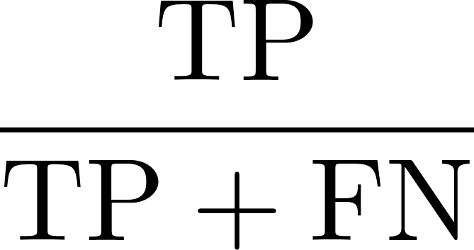
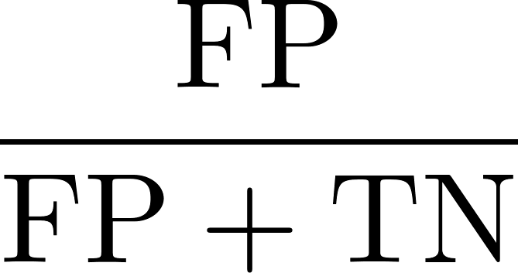
Bias in AI systems
Bias metrics.
Equalized odds.
The statistics are and
Probability of accepting a given person who is qualified is the same in the two groups (“equality of opportunity”).
Probability of accepting a given person who is not qualified is the same in the two groups.
Can allow few minority persons to be accepted if relatively few are qualified due to social and historical factors.

Slide 14
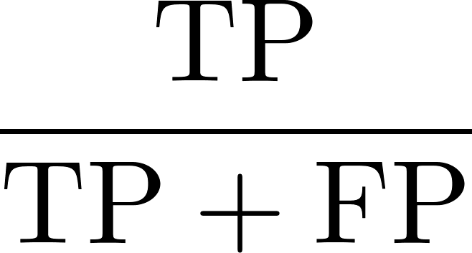
Bias in AI systems
Bias metrics.
Predictive rate parity.
The statistic is
Probability that a given accepted person is qualified is the same in the two groups.
Can allow few minority persons to be selected if those few who are selected are as likely to be qualified as other selected persons.

Slide 15
Bias in AI systems
Bias metrics.
Counterfactual fairness.
Probability of accepting a person in the minority group would have been the same in an alternative world in which that person is majority.
Loan example: Relevant factor is financial responsibility, but only minority status and address can be observed.
Acceptance decision must be the same if it were based only on financial responsibility.

Slide 16
Bias in AI systems
Bias metrics.
Counterfactual fairness.
Minority status (observed)
Financial responsibility (unobserved)
Causal relationships
Low-income neighborhood (observed)
Qualified for loan (predicted)

Slide 17
Bias in AI systems
Bias metrics.
Counterfactual fairness.
Minority status (observed)
Financial responsibility (unobserved)
Causal relationships
Inference in AI system
Low-income neighborhood (observed)
Qualified for loan (predicted)

Slide 18
Bias in AI systems
Must use Bayesian inference in a causal network to deduce financial responsibility –
Hard in practice
Bias metrics.
Counterfactual fairness.
Minority status (observed)
Financial responsibility (unobserved)
Causal relationships
Inference in AI system
Low-income neighborhood (observed)
Qualified for loan (predicted)

Slide 19
Bias in AI systems
Ethical analysis – two kinds of “fairness”
Accuracy
Minority persons are accepted based solely on whether they are qualified.
May be required by generalization principle, due to implied agreement.
Not necessarily achieved by demographic fairness.
Requires equalized odds and predictive rate parity.

Slide 20
Bias in AI systems
Ethical analysis – two kinds of “fairness”
Compensation
Minority persons are accepted based on whether they would have been qualified given equal opportunity in the past.
May be required by utilitarian principle, if consistent with generalizability (aside from public policy issue, minority person may have less chance of accurate assessment elsewhere).
Not necessarily achieved by demographic fairness, equalized odds, or predictive rate parity.
Requires counterfactual fairness (properly formulated).

Slide 21
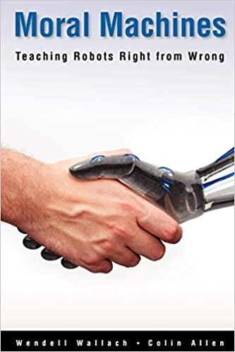
Value alignment
Value alignment tries to teach ethics to machines.
“Align” machine values with human values.
Based on crowd sourcing.

Slide 22
Value alignment
Value alignment tries to teach ethics to machines.
“Align” machine values with human values.
Based on crowd sourcing.
Problem:
“Values” is ambiguous.
What humans value (fact)
What is valuable (ethics)
Value alignment trades on this ambiguity.

Slide 23
Value alignment
Example: MIT’s Moral Machine
Crowd-source 1000s of responses to trolley-car type driving dilemmas
Derive ethical rules for self-driving car.

Slide 24
Value alignment
Two problems:
This type of dilemma rarely if ever occurs in practice.
People don’t have meaningful “values” for such cases.

Slide 25
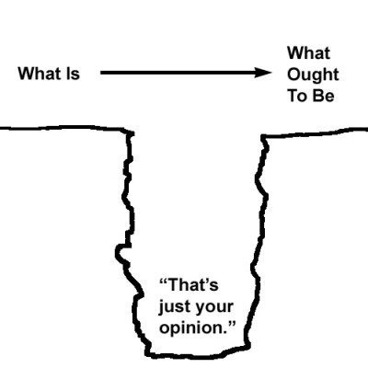
Value alignment
Two problems:
This type of dilemma rarely if ever occurs in practice.
People don’t have meaningful “values” for such cases.
This commits naturalistic fallacy.
We can’t infer “values” from “values.”
We can’t infer what we ought to do purely from facts.
We can’t infer ethical driving rules from driving opinions and behavior.

Slide 26
Value alignment
To avoid naturalistic fallacy:
We need an ethical premise.
Such as, “We should drive the way most people think we should drive.”
No such premise seems reasonable.
Designers of Moral Machine had 2nd thoughts.
“A word of warning: the preferences we found are not meant to instruct car programmers as to how they should regulate AVs.... The public can be ill-informed and biased, and some of the preferences we report are troubling.”
Edmond Awad, “Your (future) car’s moral compass,” Behavioral Scientist, Feb 11, 2019.

Slide 27
Value alignment
There is no substitute for ethical principles.
Driving practices and norms are relevant, of course.
But they alone don’t determine what is ethical.

Slide 28
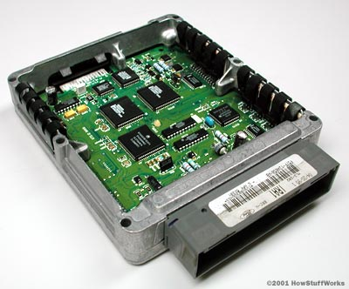
Value alignment
There is no substitute for ethical principles.
Driving practices and norms are relevant, of course.
But they alone don’t determine what is ethical.
Principles can be incorporated into AI technology.
For example, by using rule-based AI – already a trend.
We know how to build huge, complicated rule bases.
Non-self-driving cars are already regulated by >100,000 lines of code.

Slide 29
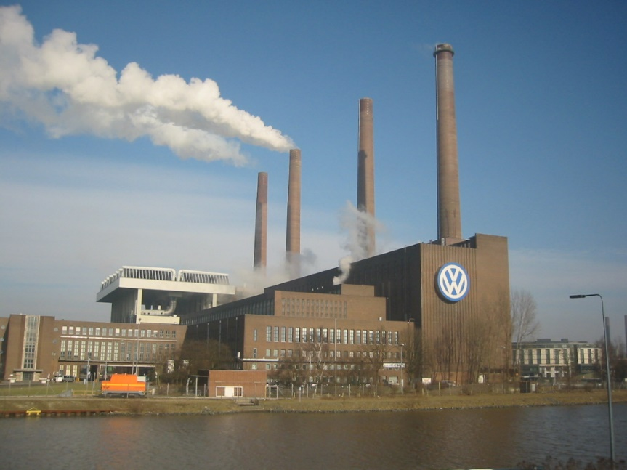
Technological unemployment
The Industrial Revolution destroyed countless jobs.
Will AI and 4th industrial revolution do the same?

Slide 30
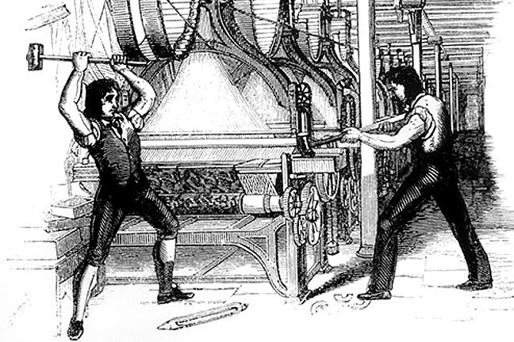
Technological unemployment
One opinion: the economy will adjust, as before.
The Luddites were wrong.
They smashed machines, believing that mechanization would lead to mass unemployment
But new jobs replaced the old ones.
The same will happen in this century.

Slide 31
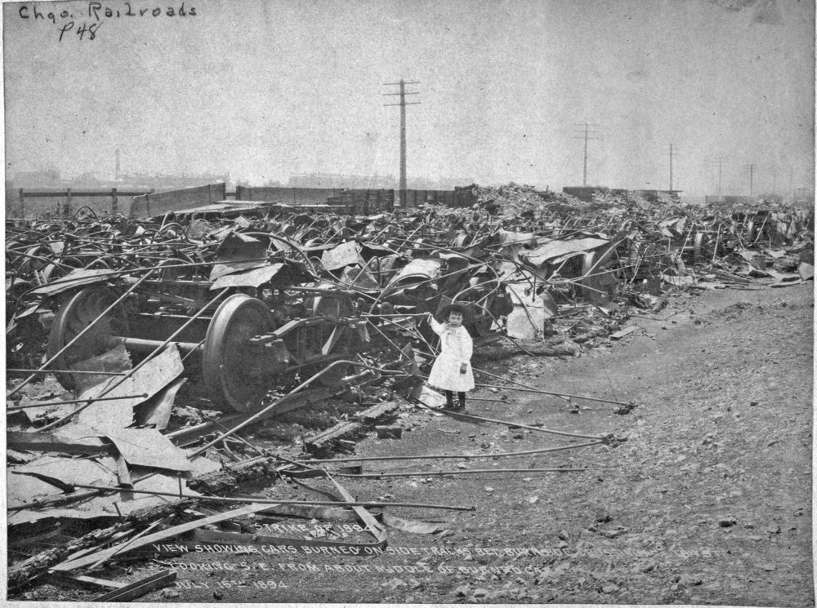
Technological unemployment
…although the “adjustment” brought 150 years of violent strikes and political revolution.
Destruction in Chicago from Pullman strike, 1894
Bolsheviks storming the Winter Palace, St Petersburg (Petrograd) Russia, 1920

Slide 32
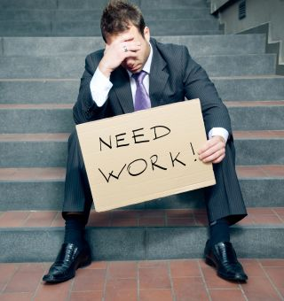
Technological unemployment
Another opinion: It will be different this time
AI will lead to mass unemployment with no historical precedent.
Because it replaces human brains.
Current labor shortage may only hasten the trend by incentivizing automation.

Slide 33
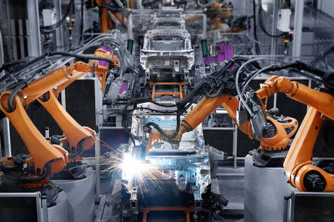
Technological unemployment
Robotic manufacturing
No human in sight on many a factory floor.
Main reason for shrinkage of middle class, not offshoring.

Slide 34
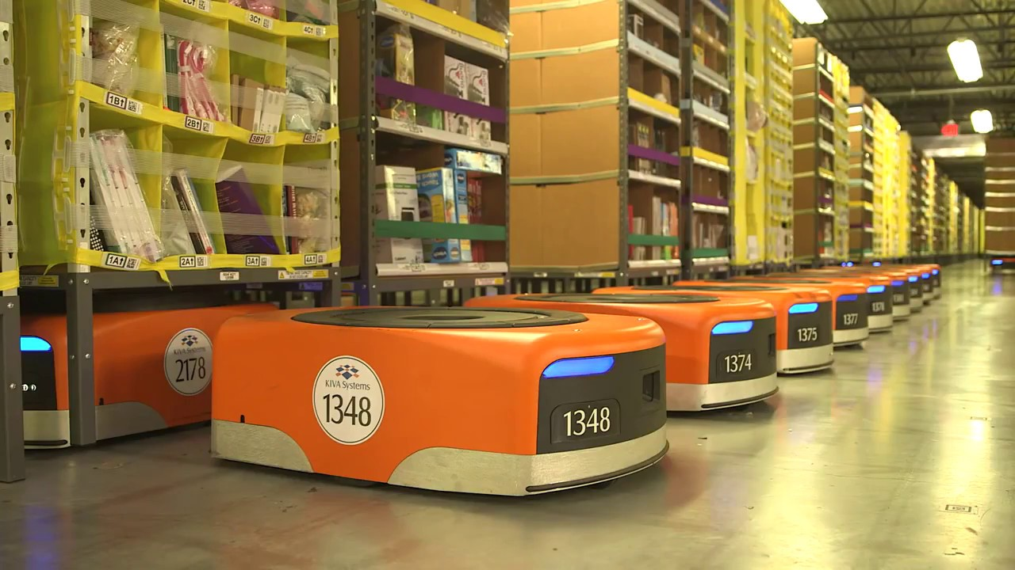
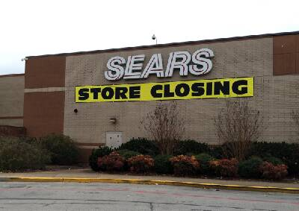
Technological unemployment
Warehousing, retailing are shedding workers by the day.
Robots in Amazon fulfillment center 200,000 hired so far

Slide 35
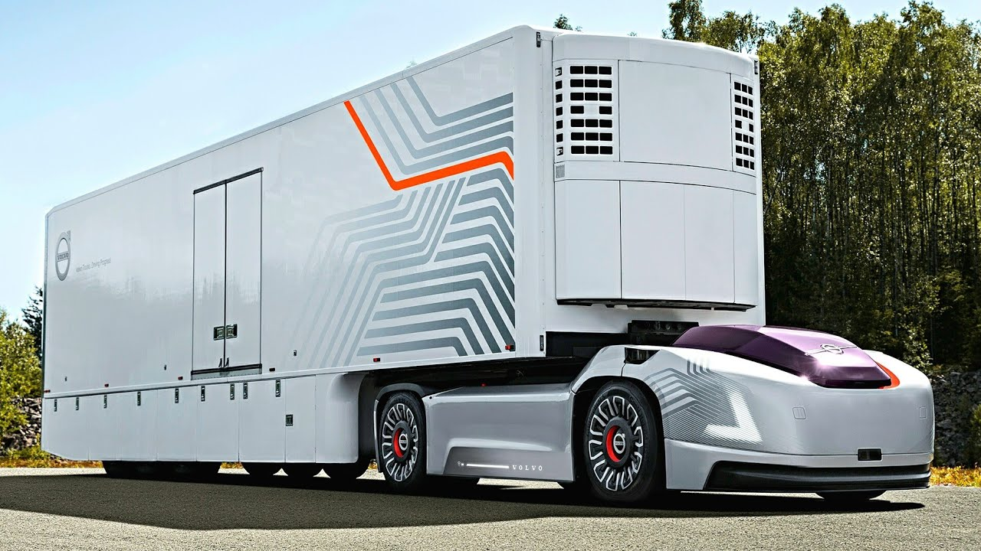
Technological unemployment
Self-driving vehicles will take over transport.
3.5 million truck drivers will be out of work.
What happens to > 2 million Uber & Lyft drivers in U.S.?

Slide 36
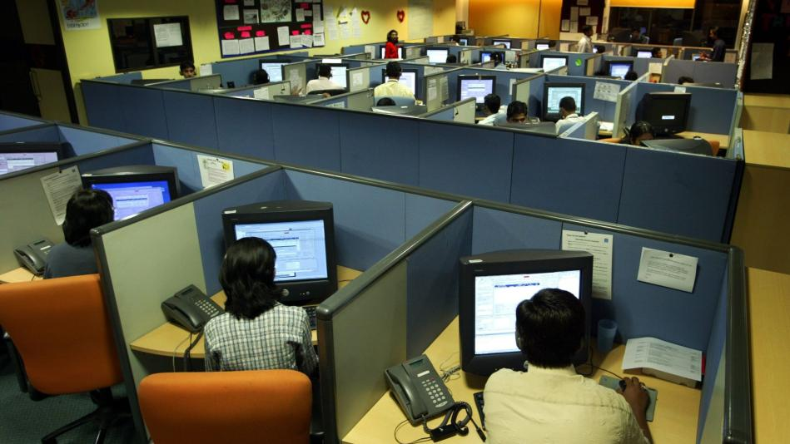
Technological unemployment
White-collar tasks to be replaced by deep learning
Loan processing
Stock trading
Investment advice
Credit rating
Online ad placement
Job applicant screening
Parole decisions

Slide 37
Technological unemployment
Medical technicians may become obsolete.
Is AI better than humans at reading medical scans?

Slide 38
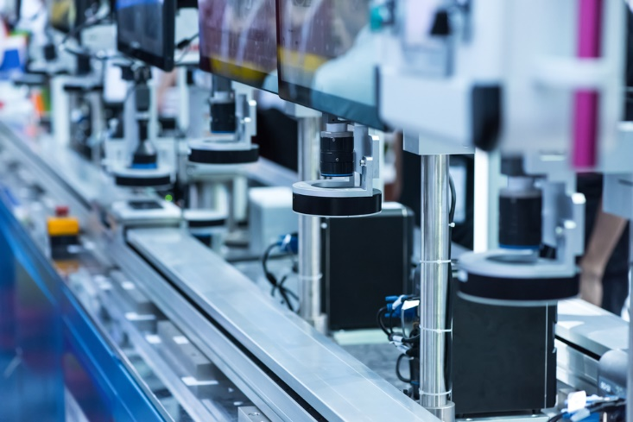
Technological unemployment
What to do?
We need some kind of wealth redistribution from AI-intensive industry to the general population.
We already have this for manufacturing
Manufacturing is extremely labor productive, due to technology.
The economy redistributes this wealth in various ways.
But the redistribution mechanism is failing even for manufacturing.
What will happen when AI takes over?

Slide 39
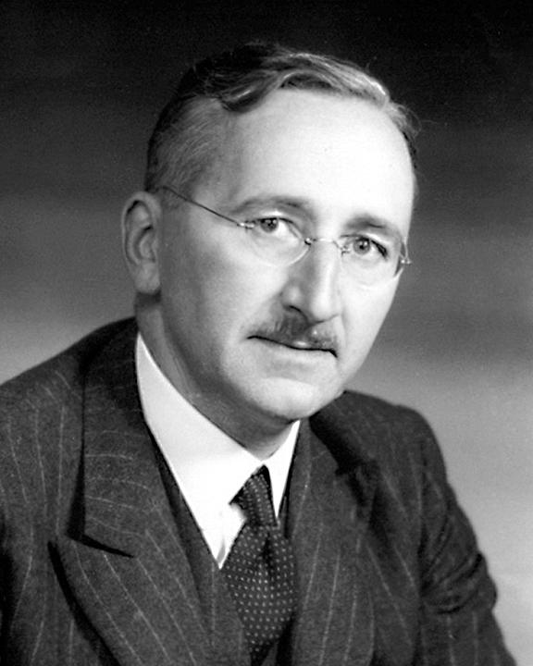
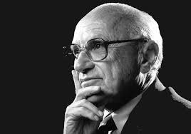
Technological unemployment
One proposal: Universal basic income
An old idea from the political left and right.
Advocated by staunch libertarians Milton Friedman and F. A. Hayek in 1960s, as well as Andrew Yang in recent years.
Milton Friedman 1912-2006
F. A. Hayek 1899-1992

Slide 40
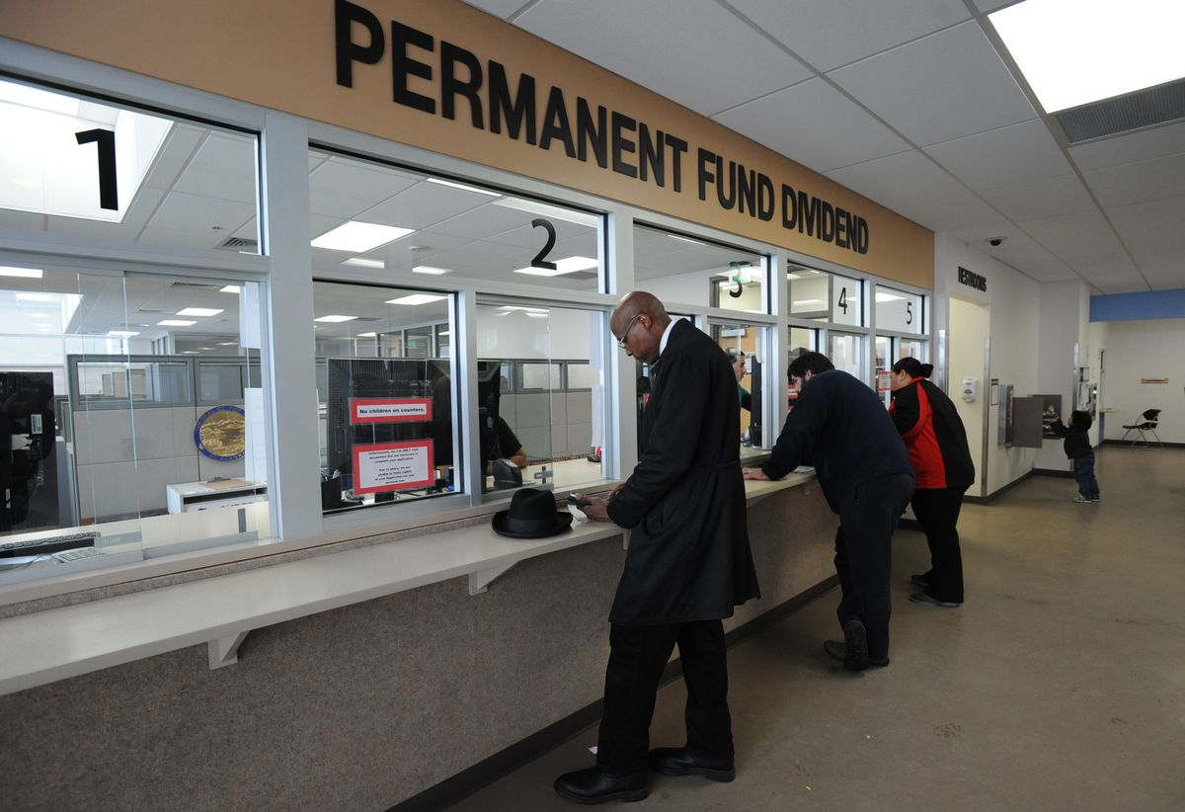
Technological unemployment
One proposal: Universal basic income
Current examples:
Alaska Permanent fund ($800-2000/yr).
Brazil’s Bolsa Familia (conditioned on school and vaccination for children). Similar plans in Mexico, Chile, Honduras, Jamaica, Malawi, Zambia.
What does business do in the meantime?

Slide 41
Technological unemployment
Proposal: Worker ownership
Workers own and perhaps manage the workplace.
Famous example: Mondragon Cooperative in Spain.

Slide 42
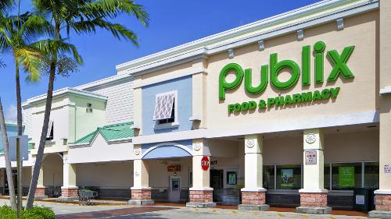
Technological unemployment
Proposal: Worker ownership
U.S. examples (ESOPs):
Publix Supermarkets (175,000 employees)
UPS (481,000 employees, partial employee ownership)
Brookshire Brothers retailing (7000 employees)
Winco Foods (18,000 employees)
Robert W. Baird (3100 employees, finance)
Recology (4100 employees, waste management)

Slide 43
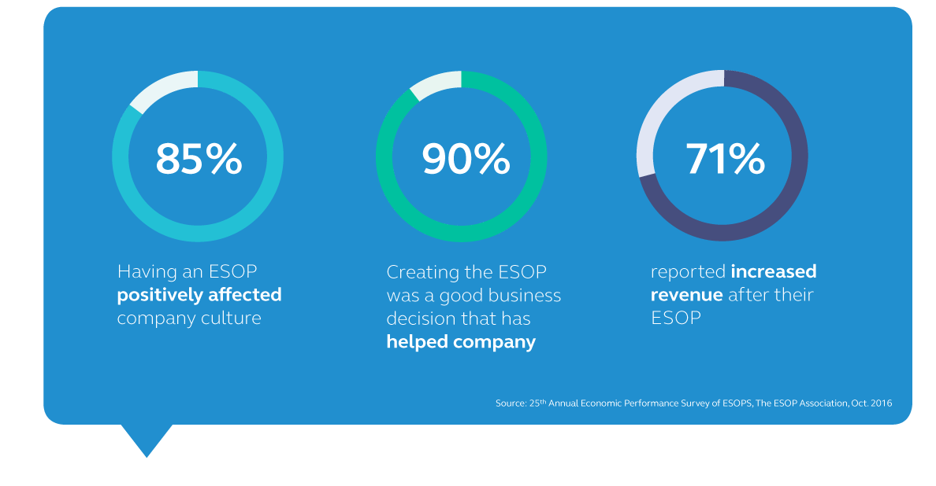
Technological unemployment
Proposal: Worker ownership
Pros:
Workers will own AI-based technology and benefit directly.
Democracy in the workplace.
Benefits of tech spread within the firm.
Cons:
How to raise the capital?
Enough to cover entire work force?

Slide 44
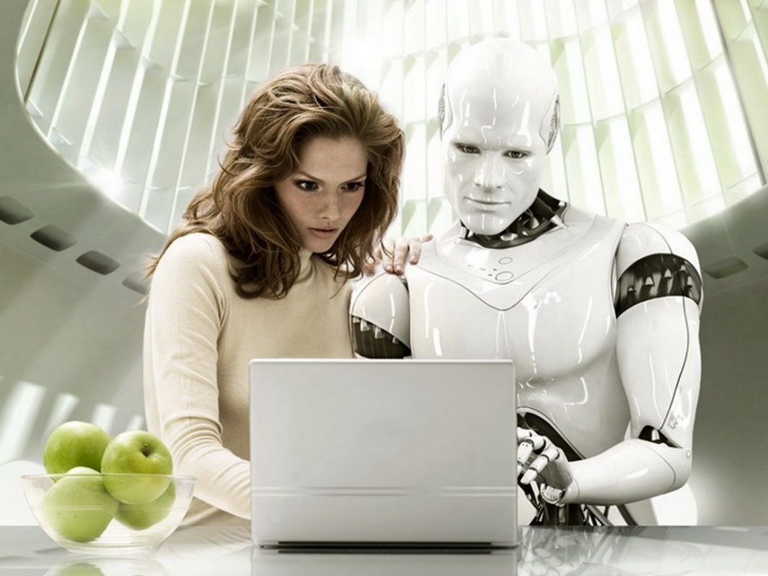
Technological unemployment
Proposal: Augmentation
Move beyond automation by using machines to enhance human capabilities rather than displace them.
Humans work alongside robots, train them.

Slide 45
Technological unemployment
What can a firm do?
Generalization argument for automation probably fails.
Current worker benefits depend on historical automation, but by innovators rather than employers in general.
Try automation with augmentation.
Clearly utilitarian if feasible.
Try delayed automation with attrition.
Benefit to workers may outweigh utilitarian cost of delay.
If competition forces automation and layoffs now, do it.
Far more utilitarian to automate than to go out of business.

Slide 46
Further reading
Jonathan Shaw, “Artificial intelliegnce and ethics: Ethics and the dawn of decision-making machines,” Harvard Magazine (Jan-Feb 2019).
Cathy O'Neil, Weapons of Math Destruction: How Big Data Increases Inequality and Threatens Democracy, Crown Publishers (2016).
Nick Bostrum and Eliezer Yudkowsky, “The ethics of artificial intelligence,” in K. Frankish, ed., The Cambridge Handbook of Artificial Intelligence (2014) 316-334.
J. N. Hooker and T. W. Kim, “Ethical implications of the 4th Industrial Revolution for business and society Links to an external site,” in D. Wasileski and J. Weber, Business and Society 360, v. 3: Business Ethics, Emerald (2019) 35-63.

