Slide 1
Case Studies Revisited
A Course in Business Ethics
Module 10
John Hooker
Carnegie Mellon University
May 2022

Slide 2
Ford Pinto
The cost-benefit analysis was a legitimate utilitarian calculation.
  Considered net expected utility, measured in monetary
  terms.
    Not just company cost.
  Failure to fix the defect may well have satisfied the
  utilitarian principle.
  But there are two other principles to satisfy!

Slide 3
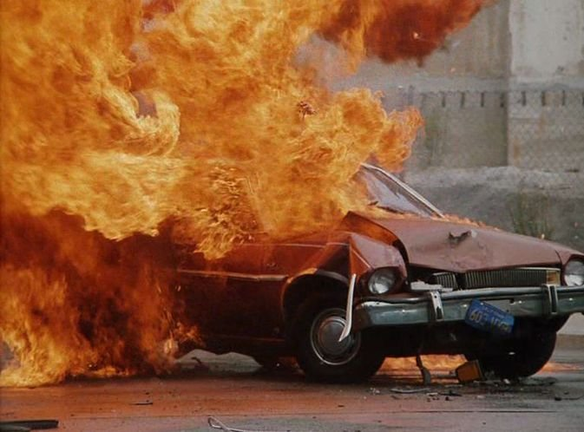
Ford Pinto
Failure to fix violates autonomy.
  Ford was rationally constrained to believe that the
  defect would cause serious injury or death for at least
  one person.
    In fact, many people (as assumed by Ford’s
    cost/benefit analysis).
    This is violation of
    autonomy without
    informed consent.

Slide 4
Ford Pinto
Failure to fix violates autonomy.
  Why no informed consent?
    True, all car manufacturers are rationally
    constrained to believe that people will be
    killed in their cars.
    But customers give informed consent to
    this risk, because they
    assume the normal risks
    of driving.
    A defective gas tank is
    not normal and therefore
    not a risk assumed by
    the customer.

Slide 5

Ford Pinto
Failure to fix may violate generalization principle.
  Violation of implied warranty.
    There is an implied agreement that the product is
    fit for the purpose for which it is sold (warranty of merchantability).
    Perhaps a car that can explode in
    low-speed collisions is unfit for
    driving your kids to school
    (for example).
    Violation of this agreement,
    merely for profit or convenience,
    is contrary to generalization principle.

Slide 6
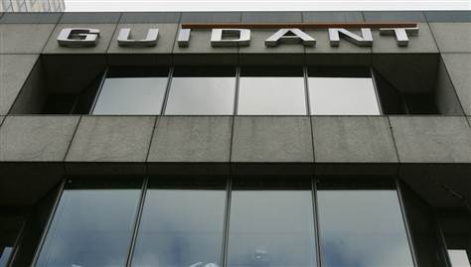
Guidant Corporation
Guidant’s decision conforms to utilitarian principle.
  It minimized risk for 14,000 patients.
  Would have potentially saved 100-200 lives.
    If problem had not been broadcast by news media.

Slide 7
Guidant Corporation
Guidant’s decision conforms to utilitarian principle.
  It minimized risk for 14,000 patients.
  Would have potentially saved 100-200 lives.
    If problem had not been broadcast by news media.
    This is a factual claim. If it is false, the analysis is
    different.
    Possibly, the risk of
    replacement is predictably
    lower for some patients,
    but for the sake of
    argument we assume
    otherwise.

Slide 8
Guidant Corporation
Violation of autonomy?
  Patients have a right to know about their health status?
    A right claim is not an argument.
  But patients want to know.
    The autonomy principle doesn’t require us to give
    people anything they want just because they want it.

Slide 9
Guidant Corporation
Violation of autonomy?
  Did Guidant interfere with patient’s action plan to be
  informed of risk?
    This is not an action plan.
    An action plan must involve an action by the agent.
    Informing the patient is an action taken by the
    company.
    No interference with action plans.

Slide 10
Guidant Corporation
Violation of autonomy?
  Exposure to lethal risk without informed or implied
  consent?
    In the Ford case, failure to fix the defect was violation
    of autonomy without implied consent.
    Failure to recall exposed customers to continued
    unnecessary risk without implied consent.
    However, Guidant fixed the defect.
    Failure to recall did not expose patients to continued
    unnecessary risk.
    If replacement had lower risk, this would be an
    autonomy violation.

Slide 11
Guidant Corporation
Violation of autonomy?
  Suppose the facts are somewhat different…
    The risk of replacement is known to be less than risk
    of malfunction for young people.
    Then failure to notify young people is a violation of
    autonomy, since it increases risk without informed
    consent.
    Older patients may learn of the defect and demand
    replacement, increasing their risk. But they give
    informed consent to the higher risk, & there is no
    autonomy violation.
    Behavior of older patients may result in less utility
    than informing no one. But utility maximization need
    only consider options that satisfy other principles
    (autonomy).

Slide 12
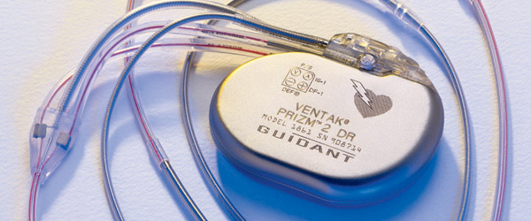
Guidant Corporation
Violation of generalization principle?
  Implied warranty perhaps not an issue.
    Defibrillator was fit for the purpose for which it was sold.
    Patients are willing to replace it, even though the risk of replacement is higher than the original risk of failure.
    So they presumably would have been willing to receive
    the implant in full knowledge of the risk.

Slide 13
Guidant Corporation
  Is it deception?
    Deception is causing someone to believe something you
    know is false.
    Failure to notify doesn’t obviously cause patients to believe
    the device is safer than it is.
    It may cause patients to believe that no (significant?) defect
    has been discovered.
    This may be ungeneralizable if the reason for not notifying
    is to cause them to believe this.
    But the reason is only to reduce risk, which may be
    generalizable (already generalized?).

Slide 14
Guidant Corporation
Conclusion
  Guidant made an ethical choice.
    It was a hard choice that was hard to defend.
    But without analysis, the ethical path is uncharted
    as well as hard.
  Given slightly different facts, the choice would have been unethical.

Slide 15
Guidant Corporation
Follow-up.
  Guidant later got into
  legal trouble.
    For failing to notify FDA
    of additional problems
    with its defibrillator, and
    continuing to sell some
    defective devices.
    FDA also found quality
    control problems at
    plants.
  Guidant sentenced in 2011 to pay $296 million in fines
  and forfeiture.

Slide 16
Further reading
Dennis A. Gioia, “Pinto fires and personal ethics: A script analysis of missed opportunities,” Journal of Business Ethics 11 (1992).
Martin E. Sandbu, “Dicing with death? A case study of Guidant Corporation's implantable defibrillator business.” In M. W. Hoffman et al., Readings and Cases in Corporate Morality, 5th ed. (2014).

