Slide 1
Autonomy Principle
A Course in Business Ethics
Module 9
John Hooker Carnegie Mellon University
May 2022

Slide 2
Autonomy
Fundamental obligation: respect autonomy.
This rules out murder, coercion, slavery, etc.
Why this obligation?
Will explain shortly…

Slide 3
Autonomy
Autonomy = self-law
I act autonomously when I freely make up my own mind about what to do, based on coherent reasons I give for my decision.
An agent is someone who can act autonomously.
Sometimes called a “moral agent.”
Agency is the exercise of autonomy.

Slide 4
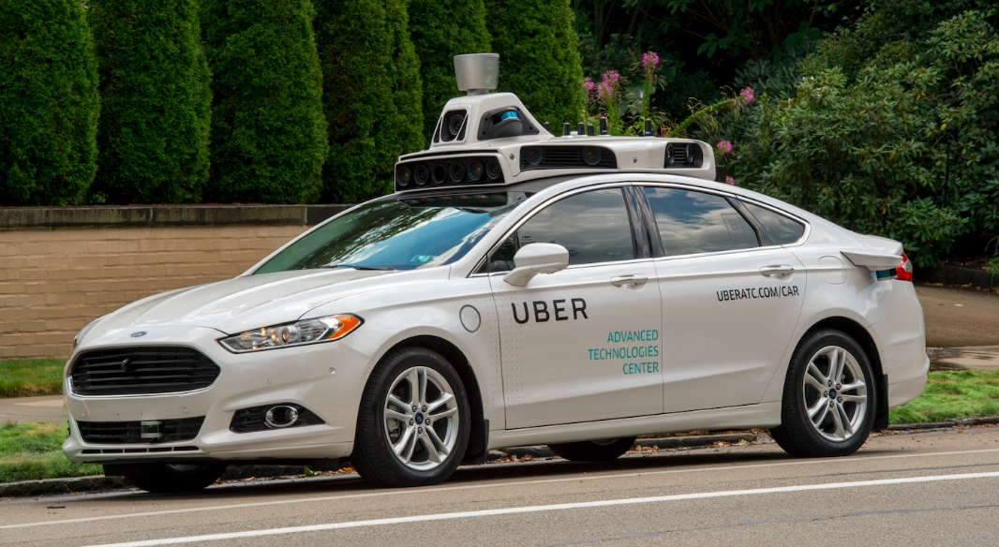
Autonomy
Autonomous vs. programmed
An “autonomous car” is not autonomous in this sense.
It is only programmed.
…and therefore independent of real-time human control.

Slide 5
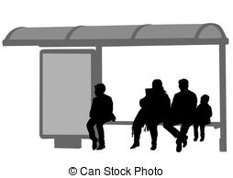
Action plans
To make things more precise…
An action has the form of an action plan.
If the reasons for my action apply, then do it.
Example: “If I want to catch the bus, and the bus stop is across the street, and no cars are coming, then cross the street.”

Slide 6
Coercion
Coercion violates my autonomy if it interferes with my action plan.
I start to cross the street to catch a bus, no cars are coming, and you pull me off the street.
This interferes with my action plan.
A violation of autonomy.

Slide 7
Coercion
Coercion does not violate my autonomy if it is consistent with my action plan.
I start to cross the street to catch a bus, and you pull me out of the path of a car.
This is consistent with my action plan.
Not a violation of autonomy.

Slide 8
Autonomy principle
An action plan is unethical if the agent is rationally constrained to believe* that…
it interferes with the ethical action plans of some collection of other agents without informed or implied consent.
*it is irrational not to believe...

Slide 9
Autonomy principle
Why?
Let’s say I interfere with your ethical action plan.
If I were you, I would be interfering with my own action plan, which makes no sense.
But the universality of reason says that when choosing an action, it should not matter whether I am me or I am you.
So interfering with an ethical action plan is self-contradictory.

Slide 10
Autonomy principle
I must be rationally constrained to believe there is a conflict of action plans.
That is, it is irrational not to believe this.
If someone falls into a manhole I leave unprotected while working under a busy street, this is not a violation of autonomy.
It is only probable that someone will fall in.
My neglect violates the utilitarian principle.

Slide 11
Autonomy principle
I must be rationally constrained to believe there is a conflict of action plans.
That is, it is irrational not to believe this.
However, suppose I replace the manhole cover with one that will collapse when someone steps on it (a booby trap).
And it is on 5th Ave NYC.
I must believe this will interfere with someone’s action plans.
This violates autonomy.

Slide 12
Autonomy principle
Suppose my commanding officer orders me to torture a prisoner.
Futility argument: results are the same if I refuse, as someone else will obey the orders.
This shows that the torture passes utilitarian test.
Abu Ghraib Prison, Iraq

Slide 13
Autonomy principle
Suppose my commanding officer orders me to torture a prisoner.
Futility argument: results are the same if I refuse, as someone else will obey the orders.
This shows that the torture passes utilitarian test.
Autonomy argument: My torture violates autonomy of the prisoner.

Slide 14
Informed consent
Coercion does not violate autonomy if there is informed consent.
I attend a concert where there are strict rules against recording the performance.
Yet I record it anyway.
Ushers compel me to leave.
This does not violate my autonomy
I gave informed consent.
My action plan was, “If I am not kicked out for doing so, I will record the performance.”
The ushers did not interfere with this action plan.

Slide 15
Informed consent
Coercion does not violate autonomy if there is informed consent.
My employer tells me I must transfer to another city or be fired.
This seems inconsistent with my action plan.
But by taking the job, I implicitly agreed to abide by the company’s business decisions.
So my action plan is consistent with the company’s decision.

Slide 16
Limits on autonomy
The autonomy principle doesn’t require you to allow people to do anything they want.
You can interfere with unethical action.
Because unethical action is not really action, and so there is no interference with an action plan.

Slide 17
Limits on autonomy
The autonomy principle doesn’t require you to allow people to do anything they want.
You can interfere with unethical action.
Because unethical action is not really action, and so there is no interference with an action plan.
You can defend yourself, because attacking you is unethical.
You can keep people off your property, because trespassing when forbidden by owner is illegal and therefore unethical.

Slide 18
Interference principle
More than minimal coercion is problematic.
I can’t lock you in a closet to prevent you from cheating on your income tax.
This interferes with many ethical actions.

Slide 19
Limits on autonomy
A restaurant can ethically refuse to serve me unless I wear a mask.
This does not interfere with my action plan.
I cannot have an action plan of being served. This is not my decision to make.
I can only have an action plan of eating in the restaurant if served.
A government mandate is another issue.

Slide 20
Limits on autonomy
However, a prison guard cannot ethically refuse to serve me food and water.
True, I cannot have an action plan of being served food and water.
But deprivation of necessities interferes with any and all of my ethical action plans.
It therefore violates autonomy.

Slide 21
Limits on autonomy
My boss cannot ethically require me to contribute to a political party I don’t support.
I gave no informed consent to this.
But there is no violation of autonomy.
I cannot have an action plan of being employed while making no political contributions.
But this violates generalizability.
It is a breach of the employment agreement, which implicitly promises that my duties will be related to the operation of the business.

