Slide 1
Everyday Dilemmas
A Course in Business Ethics
Module 8
John Hooker Carnegie Mellon University
May 2022

Slide 2
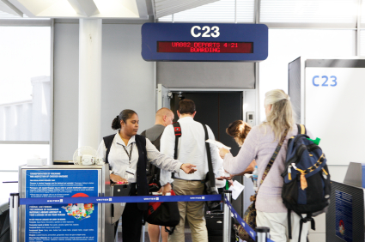
Boarding the plane
The airline boards by zones…
To expedite boarding
Early zones are nearer the back and windows.
But the agent isn’t checking zones.
So I board early.
Is this OK?

Slide 3
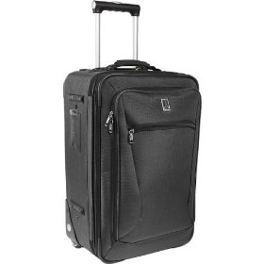
Boarding the plane
Generalization test.
My reasons:
I want to be sure to find space for my bag.
Nobody is checking the zones.
This doesn’t seem to be generalizable.
But exactly why?

Slide 4
Boarding the plane
Generalization test, 1st attempt.
Fails, because I wouldn’t want everyone else with a large carry-on to do the same.
Too many people would get ahead of me.
Wrong.
It doesn’t matter what I “want.”

Slide 5
Boarding the plane
Generalization test, 2nd attempt.
Fails, because if everybody with a bag tried to board early...
It would defeat the purpose of expediting the boarding process.
Wrong.
It would defeat the airline’s purpose.
What matters is my purpose— finding space for my bag.

Slide 6
Boarding the plane
Generalization test, 3rd attempt.
Fails, because if everybody with a bag tried to board early...
I would no longer be sure to find space for my bag, or…
The agents would always check zones..
Correct.
Boarding early, for these reasons, is not generalizable.

Slide 7
Boarding the plane
Utilitarian test.
Boarding out of order marginally slows the boarding process...
There is no net effect on bag space.
But net reduction in utility.
Fails the test.

Slide 8
Boarding the plane
Scorecard.
Generalization test: fail
Utilitarian test: fail
Autonomy test: not applied

Slide 9
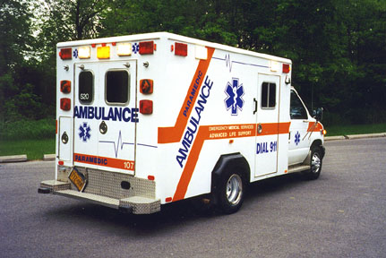
The ambulance
I am an emergency paramedic.
I have a meeting with my boss.
Heavy traffic will make me late.
So I use the siren and lights.
Ethical?
It’s not legal, but let’s suppose it is.

Slide 10
The ambulance
Generalization test.
My reasons:
Traffic will make me late for an appointment with the boss.
I won’t be caught.
This is a rare circumstance for EMS workers.
Passes the test.

Slide 11
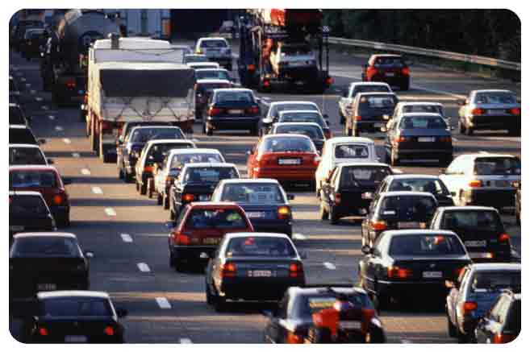
The ambulance
Generalization test.
Problem:
The scope is too narrow.
Why wouldn’t I use the siren if I were late for a job interview, a flight, etc. etc.?
Nothing in my rationale distinguishes these cases.
In effect,
I am using the siren because I really want to get there on time.
Not generalizable.

Slide 12
The ambulance
Generalization test.
But I insist:
I would use the siren only in these particular circumstances.
Then why?
I don’t have to predict what I would do.
I must have a rationale for singling out these particular circumstances.
I don’t have one.
So I fail the test.

Slide 13
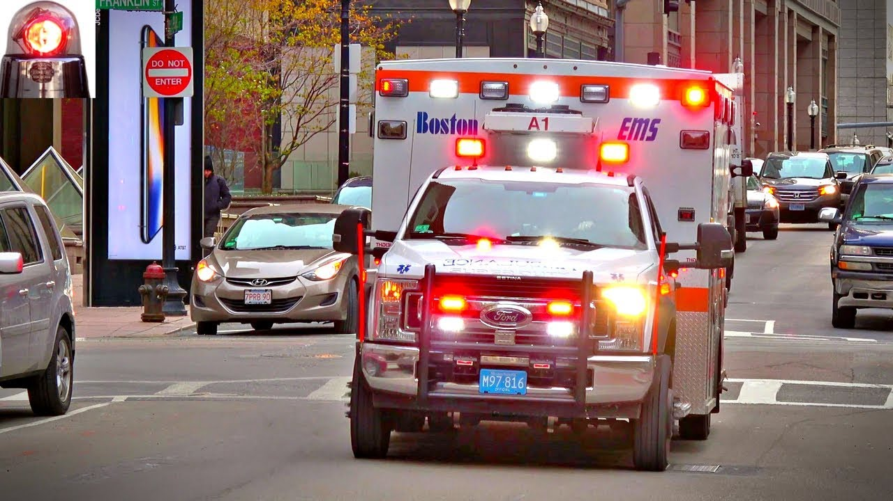
The ambulance
Utilitarian test.
Screaming through traffic without a patient does not maximize utility.
The risk of an accident outweighs any benefit to me.
It is different with a patient in the ambulance.
Expected benefit of prompt medical attention outweighs expected cost.
So I fail the test.

Slide 14
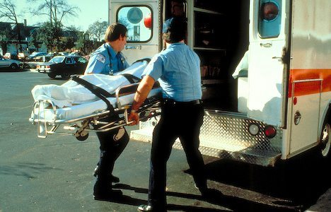
The ambulance
Scorecard.
Generalization test: fail
Utilitarian test: fail
Autonomy test: not applied

Slide 15
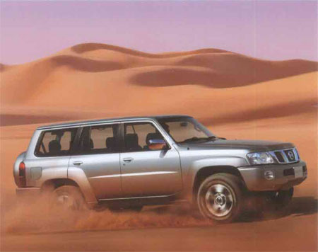
A damaged car
I want to buy a new car from a dealership.
And trade in my old car.
We negotiate a price for the new and old cars.
But I’m not sure I like the deal.
The salesman gives me a lunch voucher, so I can think about it over lunch.

Slide 16
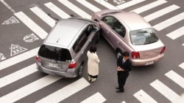
A damaged car
While driving the old car back from lunch,
I have a minor accident.
The damage is not conspicuous, but the bumper must be replaced..
I estimate the repair bill at $1000.

Slide 17
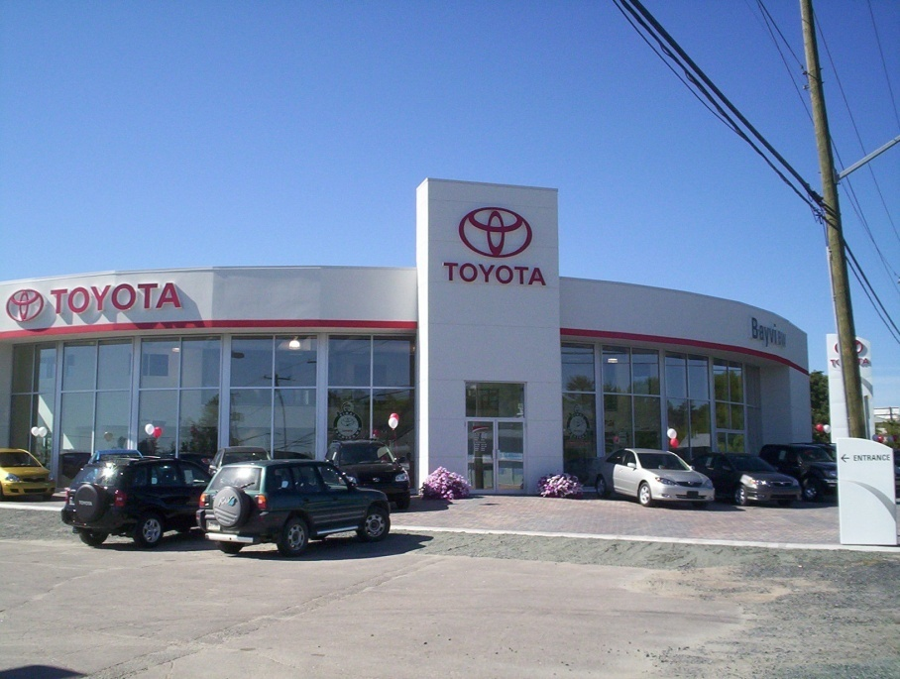
A damaged car
The dealer doesn’t notice any damage.
The price he offered me for my old car was $1000 below book value.
Should I go ahead with the deal…
Without mentioning the damage?

Slide 18
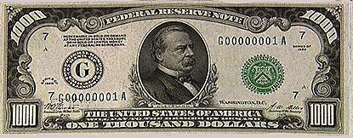
A damaged car
Utilitarian test.
The utility cost is greater to me than to the dealer.
Partly because the repair cost to me is inflated.
So failure to mention the damage creates a net increase in utility.
It passes the test.

Slide 19
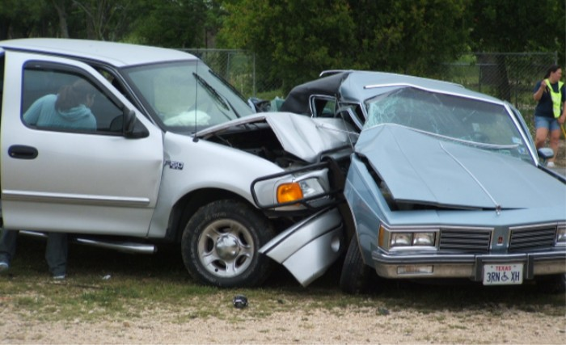
A damaged car
Generalization test.
We have a sales agreement.
Violating an agreement merely for personal benefit is not generalizable.
The dealer offered to buy the old car in the condition he saw it...
Not in a wrecked condition.

Slide 20
A damaged car
Generalization test.
I might argue: if I had not damaged the car, it would have still suffered minor wear and tear.
It would not be the same car as the dealer saw, and this is consistent with the agreement.

Slide 21
A damaged car
Generalization test.
I might argue: if I had not damaged the car, it would have still suffered minor wear and tear.
It would not be the same car as the dealer saw, and this is consistent with the agreement.
But the dealer expects wear and tear on a lunch trip.
This much is part of the deal.
But selling a more seriously damaged car is a breach of contract.

Slide 22
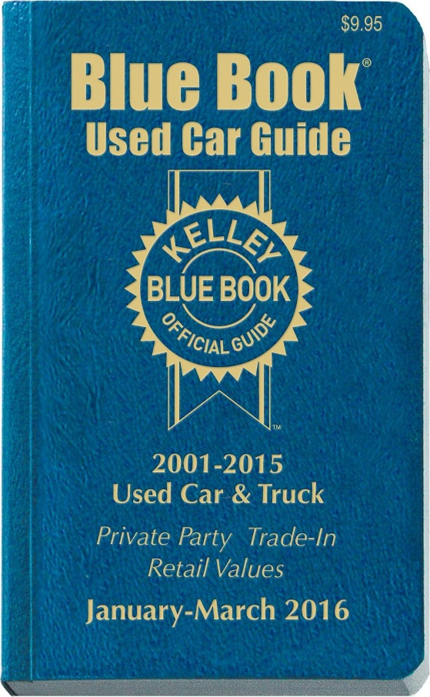
A damaged car
A “fair” price.
How about the book value of the car?
The dealer offered me $1000 below book value.
The cost is $1000 (less for him).
So we’re even.

Slide 23
A damaged car
A “fair” price.
How about the book value of the car?
The dealer offered me $1000 below book value.
The cost is $1000 (less for him).
So we’re even.
What does “fair” mean?
The price (fair or not) is part of our agreement.
There was no fraud or deception.
If I don’t like the price, I can renegotiate.

Slide 24
A damaged car
Scorecard.
Generalization test: fail
Utilitarian test: pass
Autonomy test: not applied
I have to pass all the tests.

Slide 25
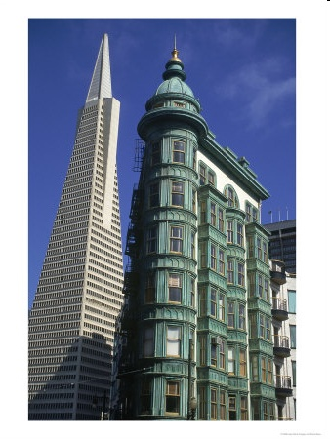
Boss’s expense account
My boss asked me to accompany him on a trip to San Francisco.
I booked my flight through the company travel service.
I asked the agent to charge the trip to my boss’s account.
The agent remarked that a 3rd party was going at company expense.
I recognized the name of my boss’s wife (different surname than my boss).
What to do?

Slide 26
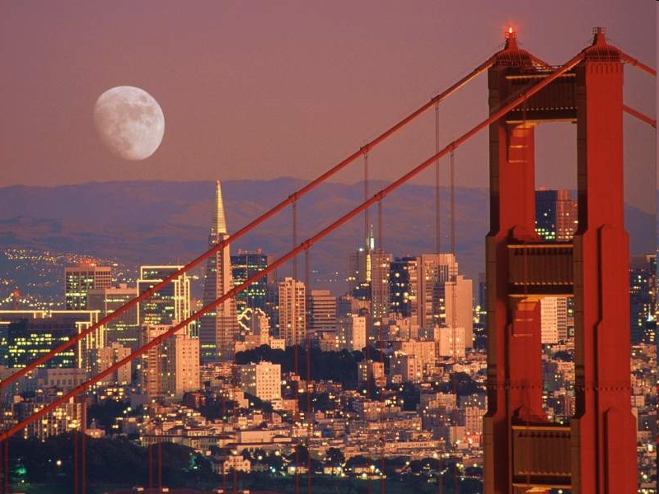
Boss’s expense account
Two issues:
Is my boss’s conduct unethical?.
If so, should I report it to the company?

Slide 27
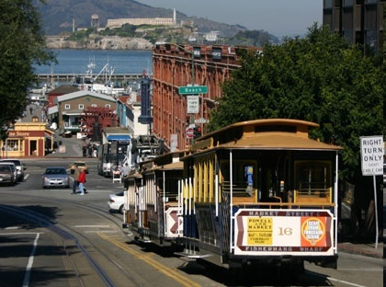
Boss’s expense account
Is my boss’s conduct unethical?
He deceived the company.
He represented his wife’s expenses as a legitimate business expense.
Deception merely for convenience is not generalizable.

Slide 28
Boss’s expense account
Is my boss’s conduct unethical?
He deceived the company.
He represented his wife’s expenses as a legitimate business expense.
Deception merely for convenience is not generalizable.
He broke an agreement to follow company rules.
Also ungeneralizable.

Slide 29
Boss’s expense account
Is it OK if I keep quiet about this?
Utilitarian outcome is unclear.
Whistle-blowing cases can be very unclear.

Slide 30
Boss’s expense account
Is it OK if I keep quiet about this?
Utilitarian outcome is unclear.
Whistle-blowing cases can be very unclear.
Generalizable?
No, if I have oversight responsibilities (I don’t).
No, if reporting this is part of company code of conduct (it isn’t).
Yes, because small irregularities are frequently caught by control mechanisms. I could still accomplish my purpose if act is generalized.

Slide 31
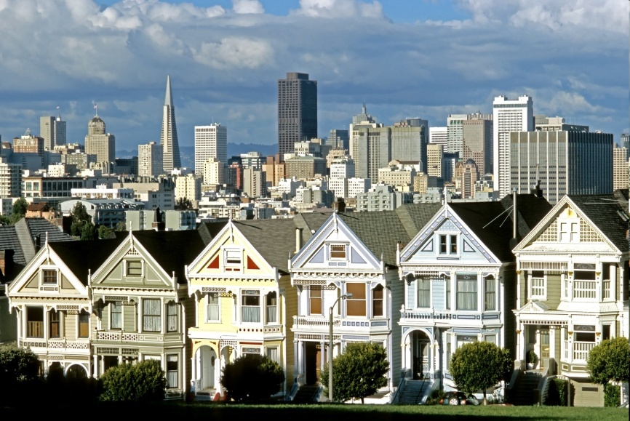
Boss’s expense account
Scorecard.
Generalization test: pass
Utilitarian test: pass (because outcome unpredictable)
Autonomy test: not applied
OK to keep quiet.
Reporting would also probably pass the tests.

Slide 32
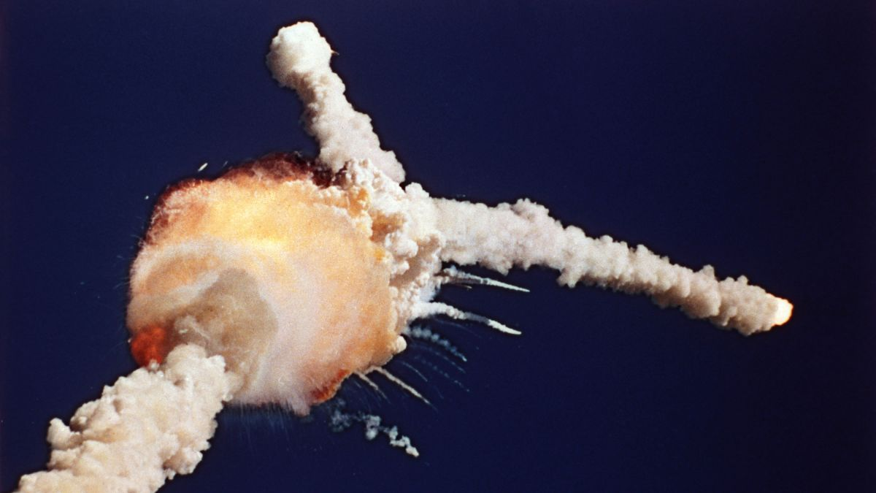
Whistle blowing
Can be internal or external.
In-house or public.
Whistle-blowing cases can be very unclear.
Substantial risk to whistle-blower.
Company may ignore it (e.g., Boeing 737 Max)
“Anonymous” hot line?
Retaliation possible.
External whistle-blower may suffer mental and physical health consequences.
E.g., Roger Boisjoly.

