Slide 1
Utilitarian Principle
A Course in Business Ethics
Module 7
John Hooker Carnegie Mellon University
May 2022

Slide 2
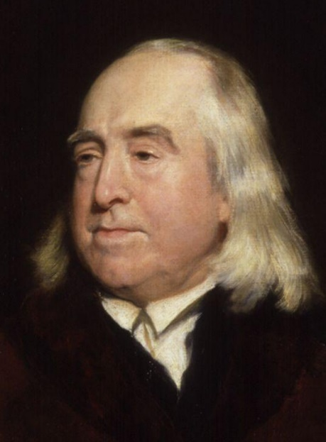
Importance of utility
The utilitarian principle is based on the idea that one should try to make things better.
Or as Jeremy Bentham put it, one’s actions should maximize utility
That is, create the greatest good for the greatest number “On the principle of utility” (1780)
Jeremy Bentham
Father of utilitarianism

Slide 3
Importance of utility
The utilitarian principle is based on the idea that one should try to make things better.
Or as Jeremy Bentham put it, one’s actions should maximize utility
That is, create the greatest good for the greatest number.
For example, Bentham believed that criminal penalties should be designed to reduce crime rather than exact retribution.
Jeremy Bentham
Father of utilitarianism

Slide 4
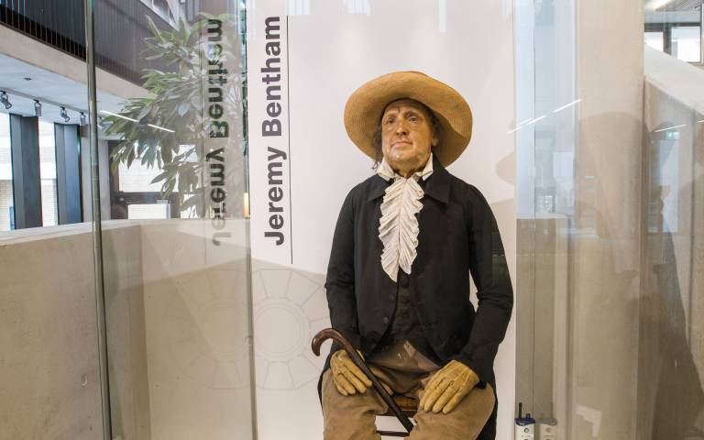
Bentham’s skeleton dressed in his clothes, with wax head, in student center of University College London

Slide 5
Importance of utility
For example, suppose I listen to loud TV in my hotel room at 2 am.
Keeping other guests awake.
Why is this unethical?
Let’s say it doesn’t violate hotel rules.
So it satisfies the generalization principle.

Slide 6
Importance of utility
For example, suppose I listen to loud TV in my hotel room at 2 am.
Keeping other guests awake.
Why is this unethical?
Let’s say it doesn’t violate hotel rules.
So it satisfies the generalization principle.
Problem: it reduces net utility.
Maybe it makes me a little happier.
But it substantially reduces utility of other guests.

Slide 7
Basic argument
Step 1: An action is often a means to an end.
You may want to achieve some goal.
Maybe your ultimate goal is happiness.
This was Bentham’s suggestion.
Whatever it is, let’s call it utility.
It’s what you regard as inherently valuable, as the end to which your actions are a means.

Slide 8
Basic argument
Step 2: If I regard something as inherently valuable...
I must regard it as inherently valuable for anyone (not just me).
…due to the universality of reason.

Slide 9
Basic argument
Step 3: My actions should take everyone’s happiness as seriously as my own.
Bentham thought this means maximizing total net utility.
This is adequate for most purposes.
We will go with it for now.

Slide 10
Utilitarian principle
An act is ethical only if I can rationally believe that no other act…
creates more net expected utility*…
and satisfies other ethical principles.
*counting everyone’s utility.

Slide 11
Utilitarian principle
Why consider only actions that satisfy other ethical principles?
Because behavior that doesn’t satisfy other ethical principles is not action.
And so is not a freely chosen option.
So utility can never “override” the other principles.

Slide 12
Utilitarian principle
Does the end justify the means?
Only an end can justify a means.
But only it can do so only if…
The means satisfies the generalization and autonomy principles.
The disutility of the means doesn’t offset the utility of the end.

Slide 13
Measuring utility
What if it’s hard to predict the outcome of a decision?
I am not required to have a crystal ball.
I need only make a rational determination, given the evidence.
If there is no way to tell, the utilitarian principle is satisfied by default.

Slide 14
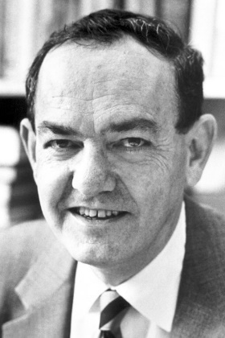
Measuring utility
But I must make a reasonable effort to research the issue.
The same effort I would invest in decisions that affect me.
For example, it is irrational to buy real estate without checking into it.
Find optimal tradeoff between research and need to act.
This is “satisficing,” a concept introduced by Herbert Simon.
Don’t waste time researching minor decisions.

Slide 15
Further reading
J. N. Hooker, Taking Ethics Seriously, Taylor & Francis (2018), Chapter 4
J. N. Hooker, Advanced Introduction to Business Ethics, Edward Elgar (2021), Chapter 3

