Slide 1
Facts and Values
A Course in Business Ethics
Module 5
John Hooker Carnegie Mellon University
May 2022

Slide 2
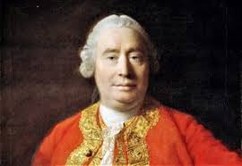
The Is-Ought Gap
Facts ≠ values
The distinction will factor into every issue we discuss.
Why?
Facts are important in ethical arguments, but…
One can’t deduce an ethical conclusion solely from facts.
This is the is-ought gap.
There must be an ethical premise at some point.
David Hume, Treatise
on Human Nature (1739)

Slide 3
The Is-Ought Gap
Conclusion doesn’t follow:
“Everyone” is cheating on their income taxes.
Therefore, it’s ethical to cheat on income taxes.

Slide 4
The Is-Ought Gap
Conclusion doesn’t follow:
“Everyone” is cheating on their income taxes.
Therefore, it’s ethical to cheat on income taxes.
Conclusion follows:
“Everyone” is cheating on their income taxes.
Something that everyone does is ethical.
Therefore, it’s ethical to cheat on the exam.
Ethical premise

Slide 5
The Is-Ought Gap
Conclusion doesn’t follow:
“Everyone” is cheating on their income taxes.
Therefore, it’s ethical to cheat on income taxes.
Conclusion follows:
“Everyone” is cheating on their income taxes.
Something that everyone does is ethical.
Therefore, it’s ethical to cheat on the exam.
…but are the premises true?
If not, the argument fails to establish its conclusion.
Ethical premise

Slide 6
The Is-Ought Gap
Conclusion doesn’t follow:
Nature is based on survival of the fittest.
Therefore, we should design a society based on survival of the fittest.
Pittsburgh, early 1900s

Slide 7
The Is-Ought Gap
Conclusion doesn’t follow:
Nature is based on survival of the fittest.
Therefore, we should design a society based on survival of the fittest.
This is social Darwinism, advanced by Herbert Spencer and endorsed by Andrew Carnegie.
Carnegie lost count of on-the-job fatalities.
Pittsburgh, early 1900s

Slide 8
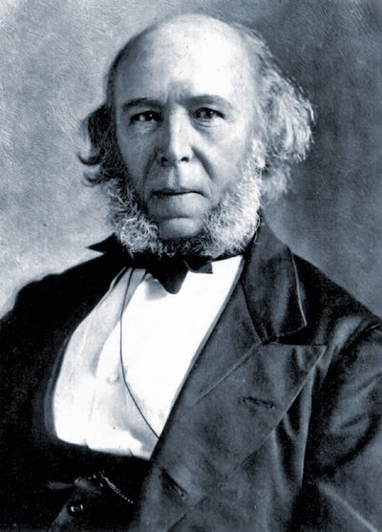
The Is-Ought Gap
Herbert Spencer 1820-1903
Conclusion doesn’t follow:
Nature is based on survival of the fittest.
Therefore, we should design a society based on survival of the fittest.
Conclusion follows:
Nature is based on survival of the fittest.
Human society should imitate nature.
Therefore, we should design a society based on survival of the fittest.
Ethical premise

Slide 9
The Is-Ought Gap
Herbert Spencer 1820-1903
Conclusion doesn’t follow:
Nature is based on survival of the fittest.
Therefore, we should design a society based on survival of the fittest.
Conclusion follows:
Nature is based on survival of the fittest.
Human society should imitate nature.
Therefore, we should design a society based on survival of the fittest.
But are the premises true?
Ethical premise

Slide 10
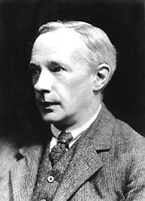
The Is-Ought Gap
Also known as the naturalistic fallacy.
G. E. Moore: Even when we know the facts, we can sensibly ask, “Is this ethical?”.
Bombing a train station kills innocent people.
Yet one can still ask if it is wrong.
Some terrorists insist it is ethical.
G. E. Moore 1873-1958

Slide 11
The Is-Ought Gap
Also known as the naturalistic fallacy.
G. E. Moore: Even when we know the facts, we can sensibly ask, “Is this ethical?”.
Bombing a train station kills innocent people.
Yet one can still ask if it is wrong.
Some terrorists insist it is ethical.
So, it’s a fallacy to draw ethical conclusions from facts alone.
G. E. Moore 1873-1958

Slide 12
The Is-Ought Gap
Also known as the naturalistic fallacy.
G. E. Moore: Even when we know the facts, we can sensibly ask, “Is this ethical?”.
Bombing a train station kills innocent people.
Yet one can still ask if it is wrong.
Some terrorists insist it is ethical.
So, it’s a fallacy to draw ethical conclusions from facts
Many controversies in ethics are over the facts.
G. E. Moore 1873-1958

Slide 13
The Is-Ought Gap
Recent example: Value alignment in AI
To be discussed.

Slide 14
The Is-Ought Gap
Ethics cannot tell us the facts.
We must go out and investigate, gather data.
No amount of talk will settle issues of fact.

Slide 15
The Is-Ought Gap
Ethics cannot tell us the facts.
We must go out and investigate, gather data.
No amount of talk will settle issues of fact.
Facts cannot tell us what is ethical.
We need ethical principles.
These are established by analysis.

Slide 16
The Is-Ought Gap
Ethics cannot tell us the facts.
We must go out and investigate, gather data.
No amount of talk will settle issues of fact.
Facts cannot tell us what is ethical.
We need ethical principles.
These are established by analysis.
Ethics tells us which facts matter.
This can save us a lot of effort.
Only chase down the facts that matter.

Slide 17
Further reading
Timothy Crews-Anderson, Critical Thinking and Informal Logic, 2007.
See this for a list of 71 logical fallacies!

