Slide 1
Corporations and Fiduciary Duty
A Course in Business Ethics
Module 4
John Hooker Carnegie Mellon University
May 2022

Slide 2
Role of Corporations
Many ethical issues involve corporations.
Fiduciary duty (discussed here)
Corporate social responsibility
Socially responsible investing
Insider trading
Worker ownership

Slide 3
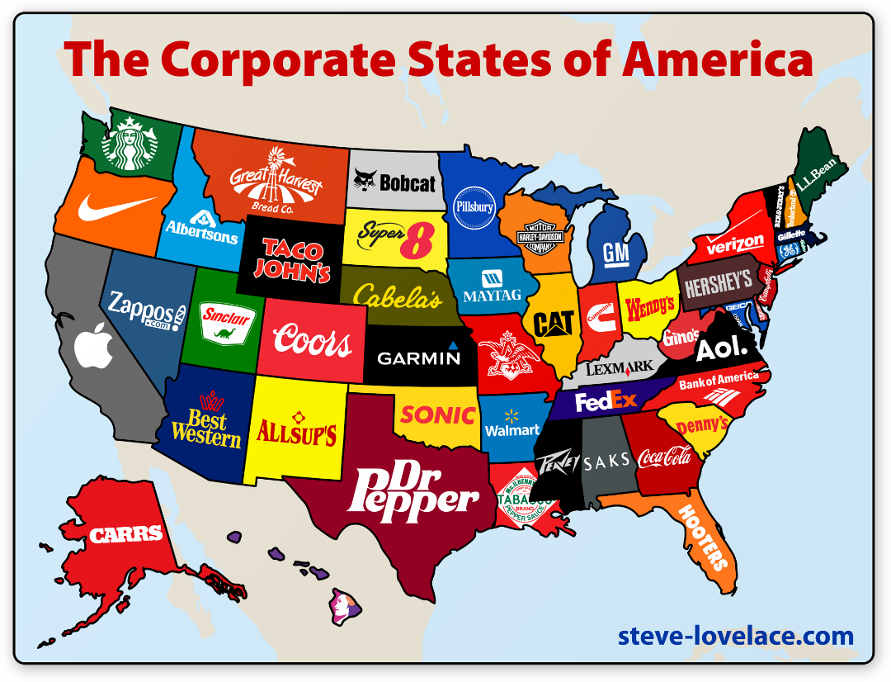
Role of Corporations
Some background on nature and purpose of corporations is necessary.

Slide 4
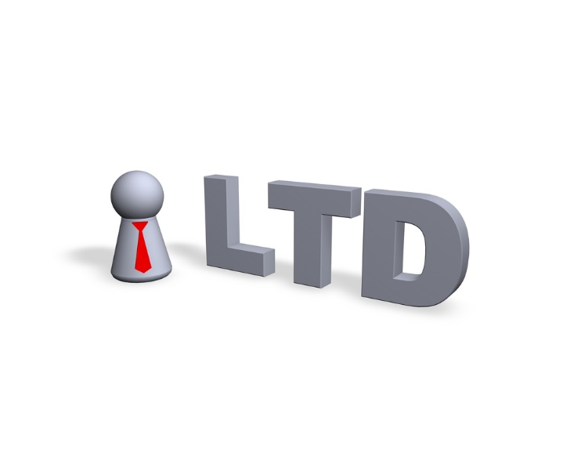
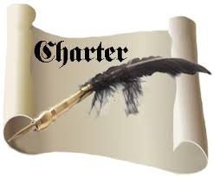
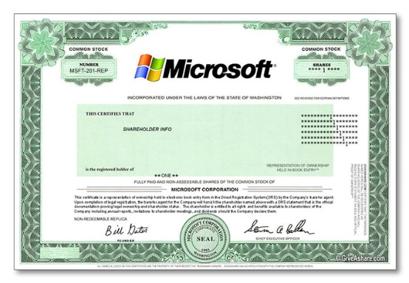
Role of Corporations
Convergence of 3 historical developments.
Government charters
Joint stock ownership
Limited liability

Slide 5
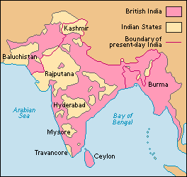
Role of Corporations
Chartered corporations - Mercantilism
Began to appear in Europe, 16th century
British East India Company, 1600
Dutch East India Company, 1602
Crown granted monopoly to favored companies.
Allowed some regulation of commerce.
British EIC had its own army, ruled India until1858.

Slide 6
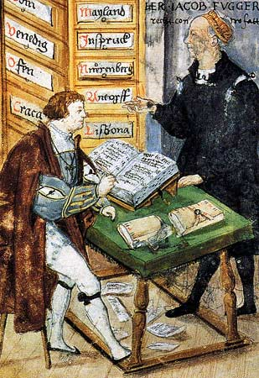
Origin of Corporations
Joint stock ownership
Means of private capital accumulation.
Precursors in 7th c. China
Fugger family: Augsburg, 1494.
Investors were primarily family members, but their rights protected by law.

Slide 7
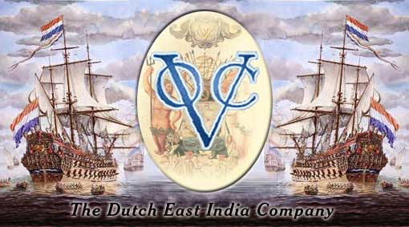
Origin of Corporations
Dutch East India Company (VOC), 1602.
Sold shares to the public in first stock exchange, Amsterdam
Paid 18% annual dividend for 200 years
“First modern corporation”

Slide 8
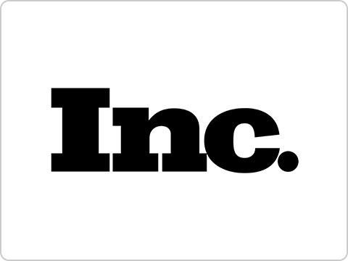
Origin of Corporations
Limited liability
Equally long history.
Granted by VOC and other Dutch companies
Established by law 1811 (NY state), 1855 (England)
Investors can lose only the money they invest.
In exchange for this public subsidy, corporations normally pay corporate income tax (“double taxation”)
Multiple taxation is a regular feature of tax systems.

Slide 9
Types of Corporations
Public
Stock traded on public exchange
Regulated, reporting requirements
Privately-held
Stock (if any) bought and sold privately
Non-stock
Voting members rather than stockholders
Includes not-for profit (e.g., most universities)

Slide 10
Types of Corporations
Country | Private corporation | Public corporation
U.S. | Inc., LLC Privately-held corp, Limited liability co. | Inc. Public corporation
U.K. | Ltd. Private limited company | PLC Public limited company
Germany | GmbH Gesellschaft mit beschränkter Haftung | AG Aktiengesellschaft
Japan | Mochibun kaisha | Kabushiki kaisha

Slide 11
Types of Corporations
Country | Private corporation | Public corporation
Spain | SL Sociedad limitada | SA Sociedad anónima
Italy | SRL Società a responsabilità limitata | SpA Società per azioni
Brazil | Ltda Sociedade Limitada | SA Sociedade anônima
France | SAS Société par actions simplifiées | SA Société anonyme

Slide 12
Types of Corporations
U.S. corporations
Chartered by individual States.
Registered with Secretary of State
Most chartered in Delaware, due to historic tax and legal advantages.
Al Schmidt, PA Sec. of State

Slide 13
Types of Corporations
Benefit corporation (U.S.)
For-profit corporation with public benefit as one of the purposes stated in the charter.
Legal protection for balancing financial and non-financial interests.
Recognized in 37 U.S. states, including Pennsylvania and Delaware.

Slide 14
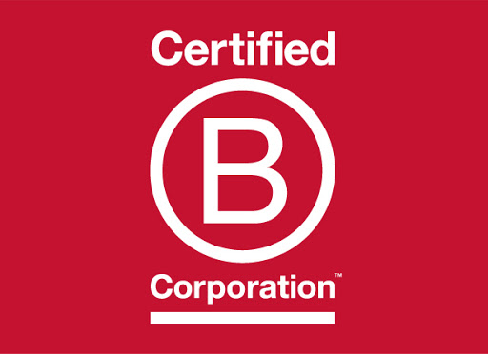
Types of Corporations
B-corp
Not the same as a Benefit Corporation.
Any for-profit company can be certified by B Lab, a private organization that partners with UN.
No legal status
Meets social & environmental sustainability criteria.

Slide 15
Types of Corporations
Distinctions in U.S. tax law
S-corp (Subchapter S, Internal Revenue Code)
Limited liability without corporate taxes
At most 100 shareholders, who pay taxes on profits/losses.
C-corp (subject to corporate tax)

Slide 16
Types of Corporations
Distinctions in U.S. tax law
S-corp (Subchapter S, Internal Revenue Code)
Limited liability without corporate taxes
At most 100 shareholders, who pay taxes on profits/losses.
C-corp (subject to corporate tax)
Of course, many companies are not corporations.
Sole proprietorship
Partnership
GmbH & Co KG (Germany)

Slide 17
Role of Corporations
Conclusion: primary role of corporations is private capital accumulation
As opposed to accumulation by community, government, royalty, influential families, or religious organizations.
Capital accumulation is a precondition for civilization.
Incentivized by limited liability
With at least the potential of public oversight due to government chartering.

Slide 18
Role of Corporations
This results in a separation of capital and labor.
Except in worker-owned corporations
Profound historical consequences
Two key issues:
Corporate governance
Who runs the company? Investors, managers, workers?
Fiduciary duty
What are the responsibilities of those running the firm to owners/investors?

Slide 19
Corporate Governance
Anglo-American sphere
Board of directors (trustees, fiduciaries)
Elected by stockholders, votes proportional to shares
Continental Europe
Two-tiered structure
Supervisory Board, Management Board
Often debt financed, banks represented on Board

Slide 20
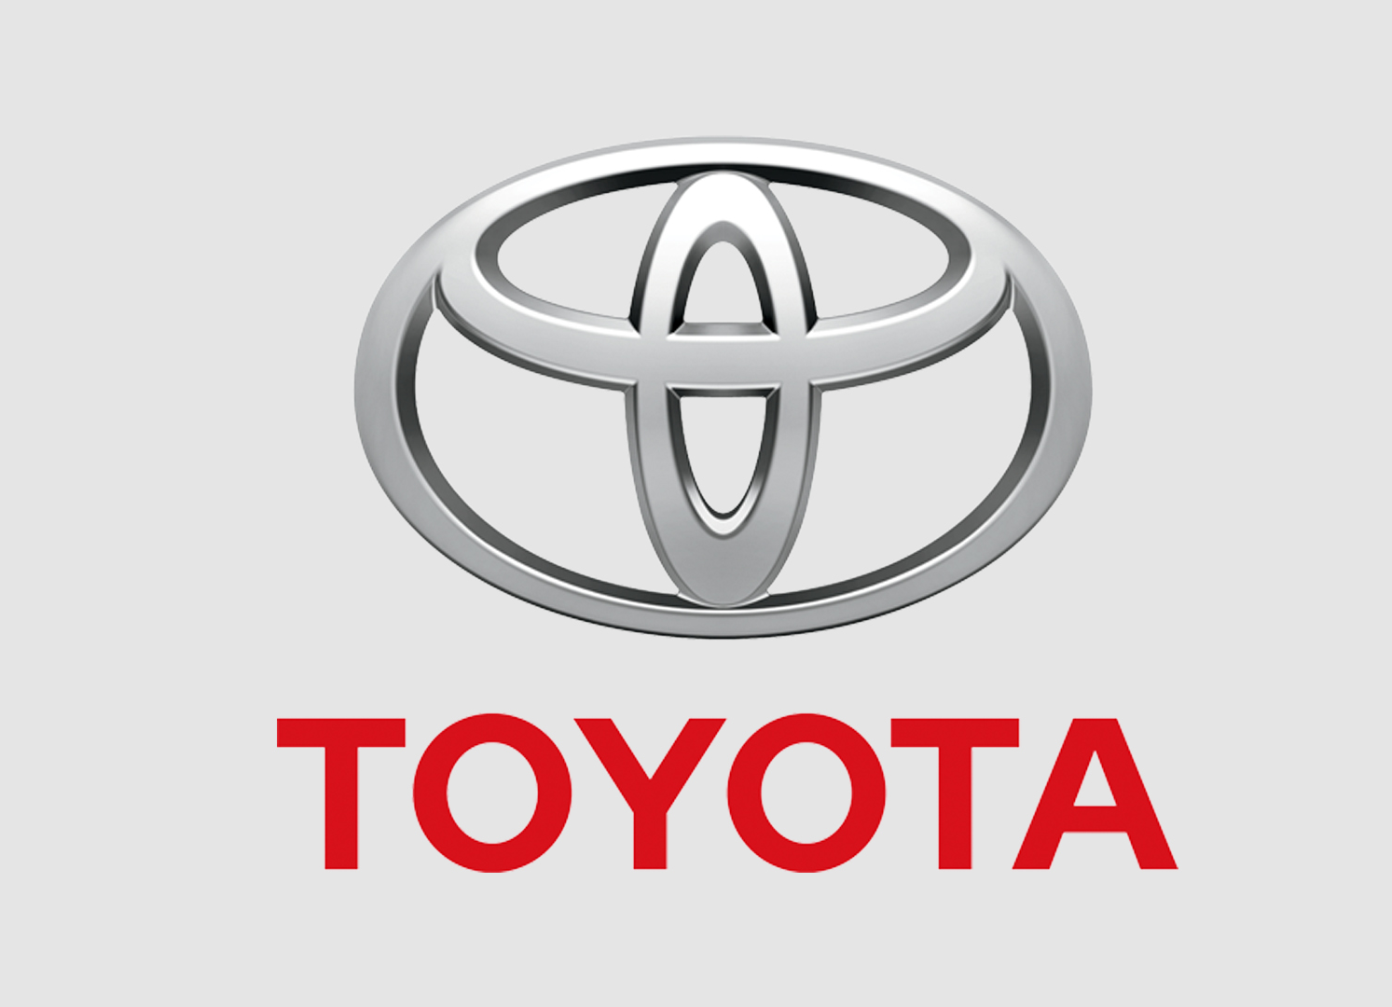
Corporate Governance
Japan
Single, large governing board
Relationships with banks, other firms (horizontal keiretsu)
Tightly integrated with supply chain (vertical keiretsu)
Much of Asia
Several Models
China: Board of Supervisors, which oversees Board of Directors
Company often controlled by wealthy individual or family

Slide 21
Fiduciary Duty
Duty to represent financial interests of shareholders and/or investors.
Fiduciary = Latin for loyalty
Based on agency agreement
Company directors/managers act on behalf of owners
…in exchange for salary/bonuses.
21

Slide 22
Fiduciary Duty
Duty applies to Board members
In existing models of corporate governance.
And by extension, to executives
Since Board hires them to act on its behalf.
…not to employees
Employees are bound by employment contract, not agency agreement.
Employees could be legally obligated to act against company’s financial interest, if so instructed by managers.
22

Slide 23
Fiduciary Duty
Legal duties of the Board
Represent only the financial interests of owners/investors.
Prevents investors from meddling and frivolous lawsuits.
Make a good faith effort.
Courts rarely second-guess business decisions.
Shareholder lawsuits are usually based on negligence, conflicts of interest, illegal activities, self-dealing.
23

Slide 24
Fiduciary Duty
Popular view
Business ethics is all about fiduciary duty.
Maximizing shareholder value.
24

Slide 25
Fiduciary Duty
Popular view
Business ethics is all about fiduciary duty.
Maximizing shareholder value.
Huh?
Suppose you run your own business (no shareholders).
Does this mean there is no business ethics?
Where did this idea come from?
25

Slide 26
Fiduciary Duty
It came from academics!
…not from the business world.
It dates to an influential 1976 academic article.
Michael C. Jensen and William H. Meckling, “Theory of the Firm: Managerial Behavior, Agency Costs and Ownership Structure,” Journal of Financial Economics 3 (1976) 305-360.
26

Slide 27
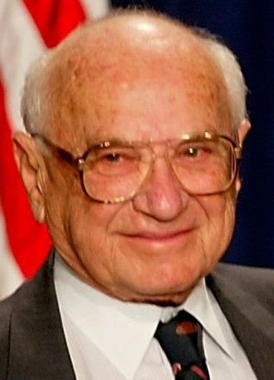
Fiduciary Duty
…also economist Milton Friedman’s much-cited article.
“The Social Responsibility of Business is to Increase its Profits.” New York Times Magazine, 13 Sep 1970.
27

Slide 28
Fiduciary Duty
…also economist Milton Friedman’s much-cited article.
“The Social Responsibility of Business is to Increase its Profits.” New York Times Magazine, 13 Sep 1970.
What did Friedman actually say?
Managers should “make as much money as possible” for shareholders “while conforming to their basic rules of the society, both those embodied in law and those embodied in ethical custom.”
28

Slide 29
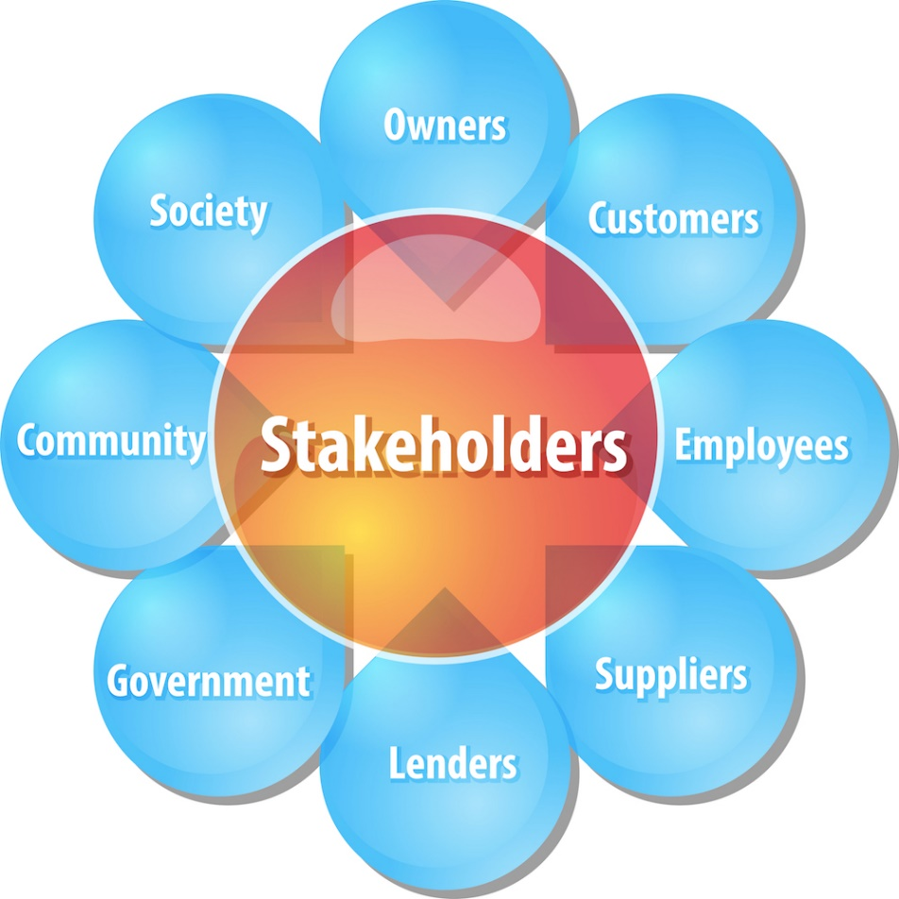
Fiduciary Duty
Before the 1970s, business managers generally accepted the view that a company should serve multiple stakeholders.
Although some did not live up to this obligation.
29

Slide 30
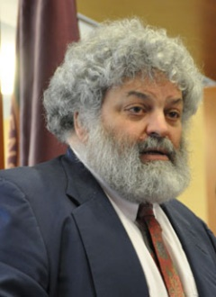
Stakeholder Theory
This gave rise to stakeholder theory
Beginning in 1980s
Credited to Ian Mitloff, R. Edward Freeman.
A business has duties to multiple stakeholders
30

Slide 31
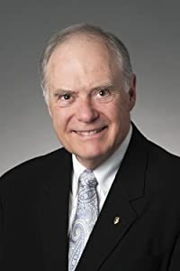
Fiduciary Duty
This poses the stakeholder paradox.
Kenneth Goodpaster, “Business Ethics and Stakeholder Analysis,” Business Ethics Quarterly 1 (1991), 53-73.
Business without ethics
We only care about maximizing profit.
…or ethics without business
Business is a social welfare agency.
31

Slide 32
Fiduciary Duty
Fundamental questions remain unanswered.
How to balance stockholder and stakeholder interests?
Exactly what obligations do fiduciaries have to stockholders?
32

Slide 33
Fiduciary Duty
Resolution of the paradox.
Since fiduciaries act as agents for owners…
Fiduciaries are obligated to do on behalf of owners only what is ethical for the owners to do
…if running the firm themselves.
Rather than ask how to balance stockholder and stakeholder interests,
Ask what obligations stockholders have to other stakeholders.
33

Slide 34
In Conclusion…
The primary task of business ethics:
Determine what is ethical for the owners!
Fiduciary duty exists but is a secondary concern.
It arises only if there are stockholders, and only after we have determined what actions are ethical for them.
34

Slide 35
In Conclusion…
The primary task of business ethics:
Determine what is ethical for the owners!
Fiduciary duty exists but is a secondary concern.
It arises only if there are stockholders, and only after we have determined what actions are ethical for them.
How to know what is ethical for the owners?
That’s what this course is about!
35

Slide 36
Further reading
Michael C. Jensen and William H. Meckling, “Theory of the firm: Managerial behavior, agency costs and ownership Structure,” Journal of Financial Economics 3 (1976) 305-360.
K. E. Goodpaster, "Business ethics and stakeholder analysis,“ Business Ethics Quarterly 1 (1991) 53-73.

