Slide 1
Moral Development and Leadership
A Course in Business Ethics
Module 3
John Hooker Carnegie Mellon University
May 2022

Slide 2
Moral Development
Studied by Kohlberg and others.
Robert Kegan, Carol Gilligan, Martin Hoffman, John Gibbs, James Fowler, Sharon Parks.
Parallel development
Cognitive, social, and moral development are mutually dependent
Should develop in parallel.

Slide 3
Moral Development
Several accounts of “stages” in the literature.
A 3-stage account will serve our purposes.
Heteronomy, Ideology, Autonomy.

Slide 4
Moral Development
Stage 1 – Heteronomy.
“Governed by others”
Intellectual development
Dependent on some authority for our views.
Social development
Rely on others for support – family, peer group
Moral development
Adopt values handed down by others – family, peers, school, company, legal structure.

Slide 5
Moral Development
Stage 2 – Ideology
Intellectual development
Learn to think independently, but buy into an ideology.
Marxism, religious fundamentalism, laissez-faire capitalism
Social development
Break way from family, but associate with like-minded peers.

Slide 6
Moral Development
Stage 2 – Ideology
Moral development
Values are chosen but must come in a neat package.
Relativism (ethics is a matter of opinion).
Simplistic maxims (“Don’t do anything you wouldn’t want your mother to know about”).
Psychological egoism.
Values based on ideology.

Slide 7
Moral Development
Stage 3 – Autonomy
“Self-governing”
Cognitive development
Tolerate uncertainty and ambiguity, see both sides of the argument.
But persist in the quest for a reasonable solution, refuse to embrace relativism.

Slide 8
Moral Development
Stage 3 – Autonomy
“Self-governing”
Social development
Can relate to people of widely different views and background.
Moral development
Recognize that issues are complex, and there is some truth in different views.
But continue to work with others toward rational consensus.

Slide 9
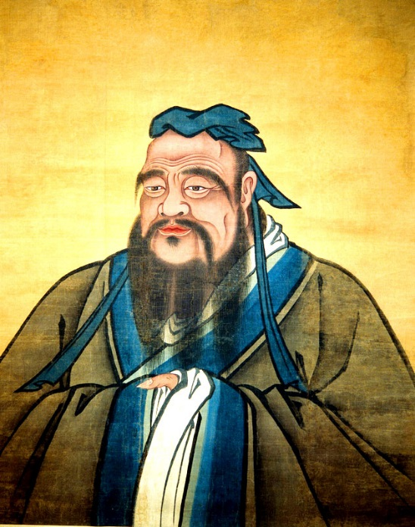
Leadership
Some research suggests that more advanced ethical skills enhance leadership effectiveness.
Not surprising, since ethics and leadership have the same aim – reaching consensus.
The idea goes back at least to Confucius.

Slide 10
Leadership
Leaders tend to occupy the highest stage more often than others.
Studied by Iordanis Kavathatzopoulos et al.
For example, I. Kavathatzopoulos and G. Rigas, “A Measurement Model for Ethical Competence in Business,” Journal of Business Ethics Education, 2006.

Slide 11
Leadership
Method:
Present 7 ethical dilemmas to 408 study participants.
Include high-level executives, mid-level managers, lower-level employees.
Ask them to select 2 from a list of several factors that may be relevant to the decision.
No “right” or “wrong” answer.
Some factors represent heteronymous decision making, some autonomous.
Give participants 0-3 points based on degree of autonomy.

Slide 12
Leadership
Hypothesis:
Higher rank in the company is associated with higher moral development score.

Slide 13
Leadership
1. Integrity. You are the CEO of a construction company, and it has come to your knowledge that some of the workers smoke cannabis. You know that your present customer, a major paper producer, has a hard policy against drugs. They regularly test their employees and dismiss all that use illegal drugs. You are considering having your own personnel tested.

Slide 14
Leadership
2. Cover-up. You are the CEO of a major bank, and you have discovered that one of the oldest and most trusted employees in the organization systematically uses a computer routine to transfer client capital to accounts of his own. He is a high-ranking executive and is seen as one of the bank’s well-known profiles with the public. Will you press charges or discreetly settle the matter with him?

Slide 15
Leadership
3. Public relations. You are the CEO of a chemical corporation planning a large investment in an area that suffers from unemployment. Environmental activists demand that the factory be stopped due to inevitable chemical outlets, while others welcome the opportunity for new jobs.

Slide 16
Leadership
4. Discrimination. You are the manager of one of your bank’s offices. You have recently received an application for a personal account from a mentally retarded person. It is to be used by him to pay his bills. The bank’s policy is against it, and you know yourself that such accounts are not profitable, due to the low turnaround.

Slide 17
Leadership
5. Whistle-blowing. You live in a small town, dominated by a large arms-industry where you also work. You discover evidence that proves that the company exports large quantities of arms to dictatorships, which is prohibited by law. Further investigation on your behalf shows that this is true beyond a shadow of doubt, even though management denies the fact. You are unsure if you should report this to the appropriate authorities and media.

Slide 18
Leadership
6. Fraud. You are the CEO of a company developing a new shampoo that prevents baldness. Tests have been conducted, but studies have taken longer time than
expected. Despite the tests, scientists still debate whether there are any side effects or not. You could continue the tests, but the company has already surpassed its budget excessively. Many members of the board therefore push for starting to market the product.

Slide 19
Leadership
7. Promise keeping. You are the CEO of a chain of grocery stores, having received a tempting offer to be bought up by a larger organization in the same business. You have, however, had a close and mutually rewarding cooperation with another big company. You have also repeatedly promised them to give them the offer first if you should ever decide to sell your company.

Slide 20
Leadership
Scores, summed over 7 items.
(408 participants)
Group | n | μ | σ
Higher-level officers | 43 | 11.05 | 2.36
Mid-level managers | 45 | 9.67 | 2.76
Lower-level employees | 69 | 8.30 | 2.38
Others* | 251 | 8.18 | 3.10
*Primarily university students (204)

Slide 21
Leadership
Type of issue | High-level μ (σ) | Mid-level μ (σ) | Lower-level μ (σ) | F test p level
Integrity | 1.70 (.96) | 1.73 (.91) | 1.35 (.92) | .051
Cover-up | 1.37 (.66) | 1.31 (.73) | 1.14 (.49) | .129
Public relations | 2.14 (.83) | 1.62 (.86) | 1.13 (.80) | .001
Discrimination | 1.19 (.70) | 0.91 (.70) | 0.93 (.52) | .065
Whistle blowing | 1.14 (.83) | 1.29 (.69) | 1.09 (.51) | .279
Fraud | 1.51 (.77) | 1.09 (.70) | 1.00 (.69) | .001
Promise keeping | 2.00 (.87) | 1.71 (.99) | 1.67 (.97) | .176

Slide 22
Moral Development
Relevance to leadership…
Ethical reasoning and leadership have the same goal: build consensus. Ethical competence may therefore enhance leadership.

Slide 23
Moral Development
Relevance to leadership…
Ethical reasoning and leadership have the same goal: build consensus. Ethical competence may therefore enhance leadership.
Autonomous ethical reasoning recognizes the value of disparate viewpoints, a valuable skill in leadership.

Slide 24
Moral Development
Relevance to leadership…
Ethical reasoning and leadership have the same goal: build consensus. Ethical competence may therefore enhance leadership.
Autonomous ethical reasoning recognizes the value of disparate viewpoints, a valuable skill in leadership.
Persons in this stage can be tapped and groomed for responsible leadership.

Slide 25
Moral Development
Employees in different stages requires a different style of leadership.
Heteronomous stage – Make company values very clear and tie them to incentives.

Slide 26
Moral Development
Employees in different stages requires a different style of leadership.
Heteronomous stage – Make company values very clear and tie them to incentives.
Ideological stage – Emphasize alternate points of view. Beware that persons in this stage can be convincing and charismatic.
…but tend to crash and burn eventually.

Slide 27
Moral Development
Employees in different stages requires a different style of leadership.
Heteronomous stage – Make company values very clear and tie them to incentives.
Ideological stage – Emphasize alternate points of view. Beware that persons in this stage can be convincing and charismatic.
…but tend to crash and burn eventually.
Autonomous stage – Work with these persons to formulate ethical policy and give them opportunities for leadership.

Slide 28
Further reading
Blog post at Leadership Excellence.
I. Kavathatzopoulos and G. Rigas, “A measurement model for ethical competence in business,” Journal of Business Ethics Education 3 (2006) 55-74.
Discussion of Defining Issues Test: J. Rest et al., "A neo-Kohlbergian approach to morality research," Journal of Moral Education 29 (2000) 381-395.
Original work: Lawrence Kohlberg, The Philosophy of Moral Development: Moral Stages and the Idea of Justice (1981)
John C. Gibbs, Moral Development and Reality Beyond the Theories of Kohlberg and Hoffman (2003).

