Slide 1
Myths and Misconceptions
A Course in Business Ethics
Module 2
John Hooker Carnegie Mellon University
May 2022

Slide 2
Myths and Misconceptions
Myth 1. The purpose of ethics is to judge who is good and bad.
…and nobody wants to be told they are bad.
2

Slide 3
Myths and Misconceptions
Wrong
Ethics is a negotiation tool for working out how we are going to live and work together.
It provides the basis for the social infrastructure we rely on.
3

Slide 4
Myths and Misconceptions
Myth 2. Society relies primarily on legal enforcement, not ethics.
4

Slide 5
Myths and Misconceptions
Wrong
Suppose everyone starts running red lights tomorrow morning.
There is no way the police can stop it.
We rely on voluntary compliance with rules on which we agree. Ethics provides the agreement.
Laws and regulations cannot keep up with a complex and fast-moving world.
5

Slide 6
Myths and Misconceptions
Myth 3. We all know what’s right. It’s just a matter of doing it.

Slide 7
Myths and Misconceptions
Myth 3. We all know what’s right. It’s just a matter of doing it.
Then why do we disagree all the time?

Slide 8
Myths and Misconceptions
Myth 4. Ethics is simple.
Just don’t do anything you wouldn’t want to appear on the first page of the newspaper.
Or you wouldn’t want to go viral on Facebook, etc.

Slide 9
Myths and Misconceptions
Wrong.
Suppose you must lay off most of your employees due to lack of sales.
They have families and end up homeless.
Yet otherwise you would go into bankruptcy and lay off everyone.
You wouldn’t want this on the back page of the newspaper.

Slide 10
Myths and Misconceptions
Myth 5.
Ethics is based on religion.
Therefore, we can never think about it rationally.

Slide 11
Myths and Misconceptions
This much is true…
Religions have made fundamental contributions to ethics.

Slide 12
Myths and Misconceptions
This much is true…
Religions have made fundamental contributions to ethics.
But…
Religions have a long tradition of rational discourse on ethics and other subjects.
Judaism: Talmudic scholarship
Islam: Ulema (community of scholars)
Christianity: Thomist philosophy
Religions gave us mathematics!
Anyway, ethical reasoning can be done independently of religious assumptions.
Isaiah 8th c. BCE

Slide 13
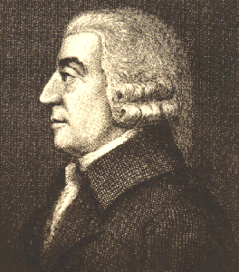
Myths and Misconceptions
Myth 6. People end up acting in their self-interest.
So ethics is irrelevant.
This is psychological egoism.
Adam Smith agrees.
“It is not from the benevolence of the butcher, the brewer or the baker that we expect our dinner, but from their regard to their own self-interest.”
Self-interest runs society like an “invisible hand” that benefits everyone.
13

Slide 14
Myths and Misconceptions
Wrong.
Smith is quoted grossly out of context.
He emphasized that human behavior is based on empathy as well as self-interest.
Theory of Moral Sentiments (1759), beginning with very first sentence.
The quote about the butcher, brewer and the baker explains how specialization of labor leads to trade.
The “invisible hand” refers to self-regulation of international trade.
Which he preferred to mercantilism.
14

Slide 15
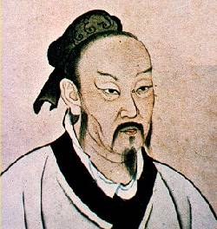
Psychological egoism?
An even older idea…
Mencius (Mèng Zĭ), 372-289 BCE
Human beings are altruistic by nature.
Example – child in danger
15

Slide 16
Psychological egoism?
An even older idea…
Mencius (Mèng Zĭ), 372-289 BCE
Human beings are altruistic by nature.
Example – child in danger
But we must cultivate this trait.
Education is key.
Mèng mŭ sān qiān (“Mencius’s mother, three moves”).
16

Slide 17
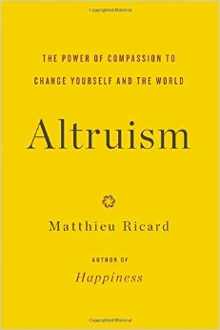
Psychological egoism?
800 pages of recent evidence for human altruism.
17

Slide 18
Myths and Misconceptions
Myth 7. We learn our ethics as little kids, not as adults.
For adults, it’s too late to study ethics.

Slide 19
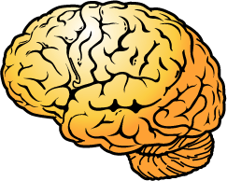
Myths and Misconceptions
Myth 7. We learn our ethics as little kids, not as adults.
For adults, it’s too late to study ethics.
Wrong. Ethical maturity grows with cognitive and social maturity.
We learn how to think about our actions and their consequences.
A lifelong process.

Slide 20
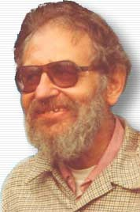
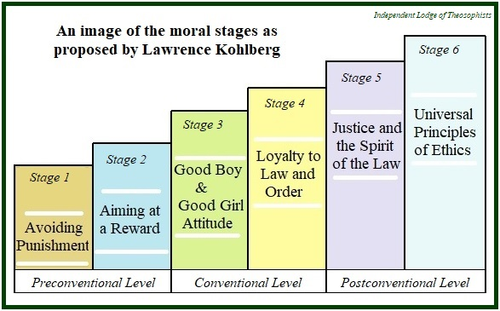
Myths and Misconceptions
Myths and Misconceptions
Lawrence Kohlberg’s developmental stages
He identified 6 stages of moral development.
Ethical reasoning skills improve in later stages.
Final stage reached only in the 60s, if at all.

Slide 21
Myths and Misconceptions
Myth 9. Ethics is just a matter of opinion.
There are no objective standards.
Only personal values.

Slide 22
Myths and Misconceptions
Myth 9. Ethics is just a matter of opinion.
There are no objective standards.
Only personal values.
Try to remember this the next time you are mugged.

Slide 23
Myths and Misconceptions
Some say ethics shouldn’t be objective!
We shouldn’t “impose our values on others.”
Ethics should therefore be a matter of personal values.

Slide 24
Myths and Misconceptions
Ethics does not “impose values on others.”
Just the opposite!
It seeks consensus on values!
This is the whole point!
Ethics can’t do its job if it’s purely about personal values.
It must be about interpersonal values.

Slide 25
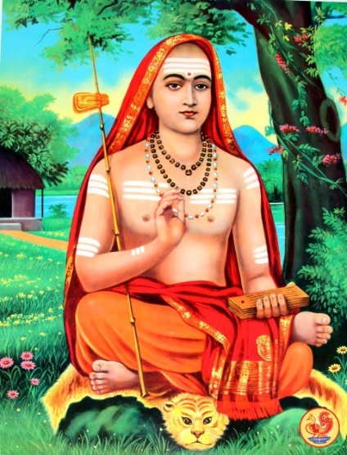
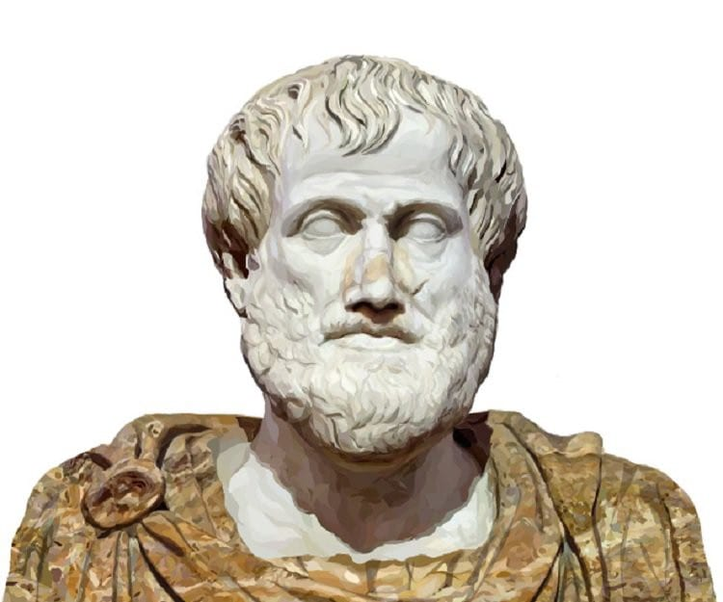
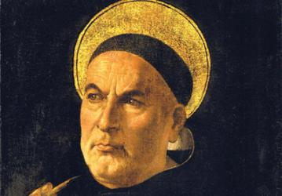
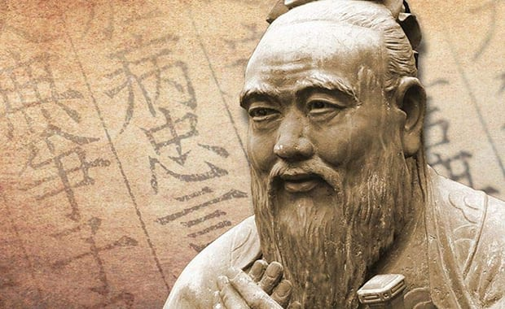
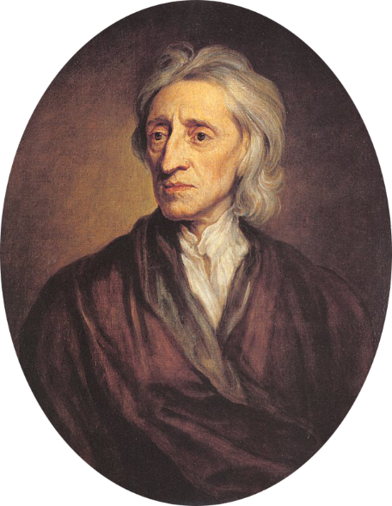
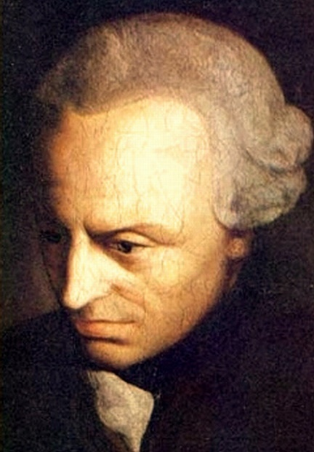
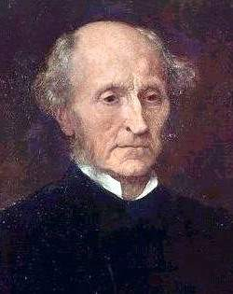
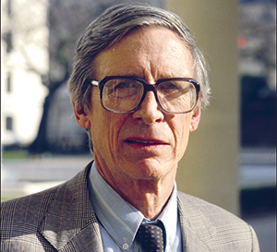
Myths and Misconceptions
Is rational analysis possible in ethics?
It is hard, but people have been doing it for centuries.
Including some of the smartest people who ever lived.
We can distill the best ideas from their thought.

Slide 26
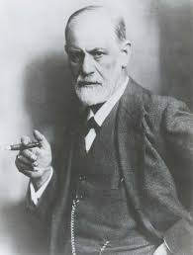
Myths and Misconceptions
Myth 10. Humans are driven by emotion, not reason.
The idea that we act rationally is false consciousness.
So ethical reasoning has no influence on behavior.
At best, it only justifies what we already want to do.
Sigmund Freud 1856-1939

Slide 27
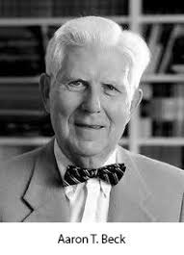
Myths and Misconceptions
Wrong. This is, at best, warmed-over Freud.
Cognitive psychology recognizes that reason is a co-equal partner with emotion.
Cognitive therapy is used to treat depression, phobias, PTSD, even schizophrenia.
Aaron T. Beck 1921-2021 (!)

Slide 28
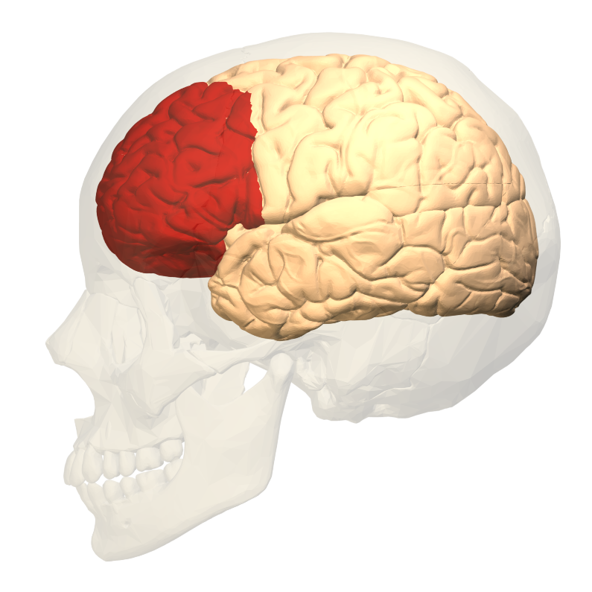
Myths and Misconceptions
We are rational creatures.
It’s why we are called homo sapiens.
It’s how we survived > 200,000 years.
The prefrontal cortex evolved for its survival value…
…in the rapidly changing climate of the African savannah.
It was necessary to solve problems as they arose, rather than rely on instinct.
The prefrontal cortex interacts with limbic system, is not governed by it.

Slide 29
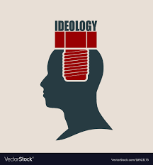
Myths and Misconceptions
Our brain demands a rationale for our actions.
Our thinking influences our emotions and actions, as well as vice-versa.
This is why so much effort is invested in political ideology and talking points.

Slide 30
Myths and Misconceptions
Our brain demands a rationale for our actions.
Our thinking influences our emotions and actions, as well as vice-versa.
This is why so much effort is invested in political ideology and talking points.
If you doubt that thought influences emotions and actions, imagine that you read a lab report that indicates terminal cancer.

Slide 31
Myths and Misconceptions
But people believe crazy conspiracy theories…
This proves the point!
The brain demands a rationale for our behavior.
…often supplied by talk radio, TV commentators, social media, extreme web sites.

Slide 32
Myths and Misconceptions
Issues are complicated and abstract in our postmodern world.
Very different from those facing our prehistoric ancestors.
We must learn how to think about them.
This requires education in abstract reasoning.
Similar situation in business.

Slide 33
Further reading
Lawrence Kohlberg, The Philosophy of Moral Development: Moral Stages and the Idea of Justice (1981)
John C. Gibbs, Moral Development and Reality Beyond the Theories of Kohlberg and Hoffman (2003).

