Slide 1
Why Ethics?
A Course in Business Ethics
Module 1
John Hooker Carnegie Mellon University
May 2022

Slide 2
Why ethics?
Just as engineering underlies the physical infrastructure on which business relies...
2

Slide 3
Why ethics?
…ethics underlies social infrastructure that is necessary for business – and civilization.
3

Slide 4
Why ethics?
Since the social infrastructure consists of human beings,
We must agree on the ground rules that allow the system to operate.
4

Slide 5
Why ethics?
Two essential points:
Ethics is hard, much like engineering.
When organizations go astray ethically, it is usually because we don’t know how to think about the issues
…not because we are bad people.
5

Slide 6
Why ethics?
Two essential points:
Ethics is hard, much like engineering.
When organizations go astray ethically, it is usually because we don’t know how to think about the issues
…not because we are bad people.
This is evident in 2 case studies.
Ford Pinto (1972)
Guidant Corporation (2014)
6

Slide 7
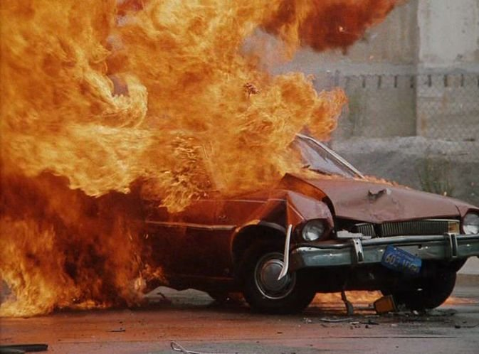
Ford Pinto
Early 1970s: Exploding gas tank in Ford Pinto
in low-speed collisions.

Slide 8
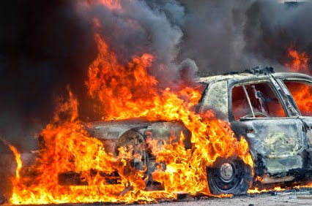
Ford Pinto
The company knew of the danger.
Decided not to fix the defect.
Would have cost $11 per car.
To fix bolts that punctured the gas tank on collision.

Slide 9
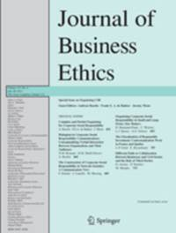
Ford Pinto
Dennis Gioia tells the inside story in an article.

Slide 10
Ford Pinto
Gioia held engineering and MBA degrees.
He wanted to make a positive contribution and saw business as an opportunity to do so.
So he joined Ford as Field Recall Coordinator.

Slide 11
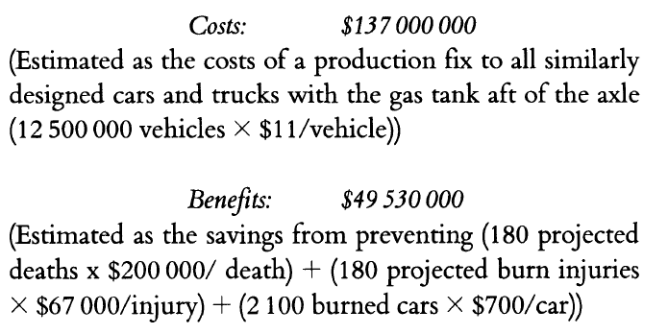
Ford Pinto
Cost-benefit analysis showed that the defect should not be fixed.

Slide 12
Ford Pinto
1978: Ford executives prosecuted for reckless homicide.
After 3 teenage girls were killed by exploding gas tank in Indiana.
Ford executives acquitted due to lack of evidence.

Slide 13
Ford Pinto
Gioia later began using the Pinto case in his classes.
Then and for years afterward, he believed he had made the right decision at Ford, given the evidence at hand.
Then he changed his mind.
Why?

Slide 14
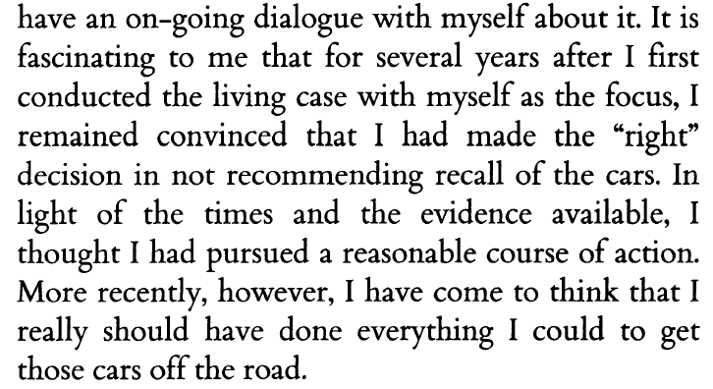
Ford Pinto

Slide 15
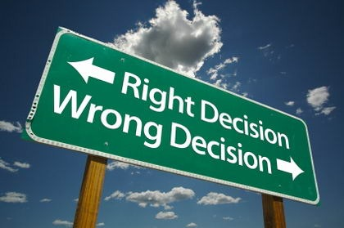
Ford Pinto
What is the rational basis for his views?
Either for his decision at Ford…
Or for changing his mind later?

Slide 16
Ford Pinto
Ford’s reasoning was flawed
But not because they put a value on human life.
This is necessary and routine in policy work.
If a city puts infinite value of life, it will spend its entire budget on traffic safety and none on schools.

Slide 17
Ford Pinto
Ford’s reasoning was flawed
But not because they put a value on human life.
This is necessary and routine in policy work.
If a city puts infinite value of life, it will spend its entire budget on traffic safety and none on schools.
We put a monetary value on our own lives.
Suppose you can buy a car with an additional safety option that reduces the chance of a fatal crash by 1/1000.
How much are you willing to pay for the option?

Slide 18
Ford Pinto
Ford’s reasoning was flawed
But not because they put a value on human life.
This is necessary and routine in policy work.
If a city puts infinite value of life, it will spend its entire budget on traffic safety and none on schools.
We put a monetary value on our own lives.
Suppose you can buy a car with an additional safety option that reduces the chance of a fatal crash by 1/1000.
How much are you willing to pay for the option?
Multiply by 1000. This is the value of your life.

Slide 19
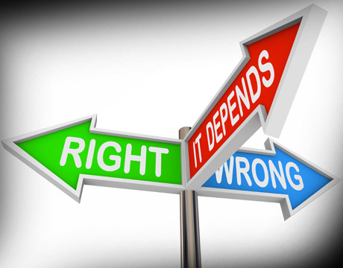
Ford Pinto
Lesson: We often make the wrong decision because we don’t know what is right.
Not because we are bad people.
We don’t have the conceptual equipment to analyze the issue.

Slide 20
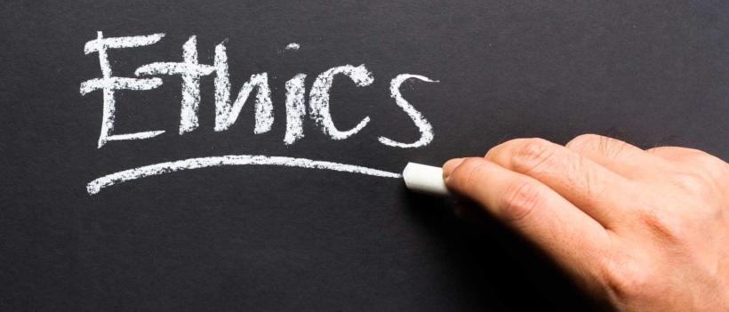
Ford Pinto
We can rationalize almost anything.
Even terrorists defend their actions on moral grounds.
How do we distinguish mere rationalization from correct analysis?
This is why we have ethics.
It provides the conceptual equipment we need.

Slide 21
Guidant Corporation
The Pinto case may seem easy to you.
But try this one:
The case of Guidant Corporation defibrillators
Based on Martin E. Sandbu, “Dicing with death? A case study of Guidant Corporation's implantable defibrillator,” in M. W. Hoffman et al., Readings and Cases in Corporate Morality, 5th ed. (2014).
Later part of Boston Scientific

Slide 22
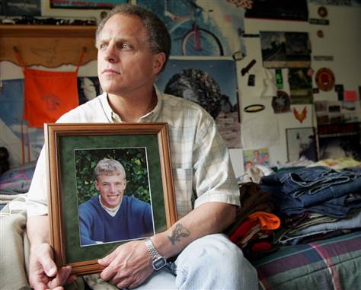
Guidant Corporation
A tragic malfunction.
Joshua Oukrop died of heart failure on a cycling trip.
His implanted defibrillator malfunctioned.
Guidant had known of defect for some time.
Lee Oukrop with photo of his deceased son, Joshua

Slide 23
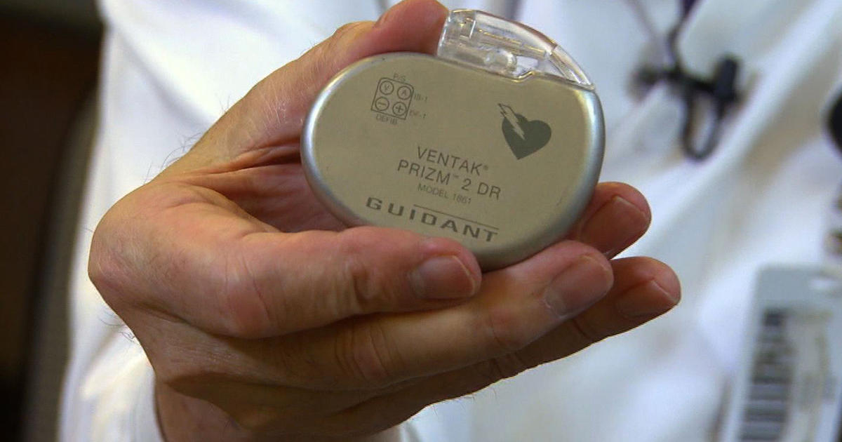
Guidant Corporation
Guidant did not notify doctors or patients.
Although it notified the FDA as required by law.
Joshua’s doctors were furious.
They said they would have replaced the device.

Slide 24
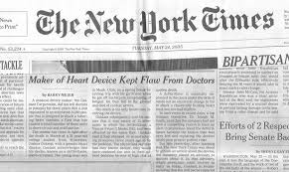
Guidant Corporation
Conflict of interest?
Guidant was also negotiating a buyout by Johnson & Johnson.
Publicity of defect would have resulted in a smaller offer.
Guidant did notify doctors & patients when the story broke in NYT.
J&J reduced its offer, deal fell through.

Slide 25
Guidant Corporation
Guidant’s argument
Lethal risk of leaving device in place: 0.10-0.24%.
Risk of replacing it: 0.42%
Doctors & patients would want to replace it (as did Joshua’s doctors).
This is why FDA doesn’t require public notice of defect.
Better not to notify.
Dr. Joseph M. Smith Guidant executive at the time

Slide 26
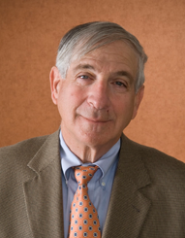
Guidant Corporation
Argument from Joshua’s doctors
Dr. Maron: “It is a statistical argument that has little to do with real people”
People have a “right” to know.
Joshua’s father: “Whoever made this decision at Guidant, I pray he doesn't have a son who this happens to.”
Barry J. Maron One of Joshua’s doctors

Slide 27
Ultimatum game
Illustrates why we have ethics.
…and how ethics is based on rationality.

Slide 28
Ultimatum game
How it is played:
Half of group randomly selected to receive $100 each.
Each is given the opportunity to donate any portion of the $100 (including zero) to an anonymous recipient in the other half of the group.
If the recipient accepts the donation, donor and recipient split the money accordingly.
If the recipient rejects the donation, both forfeit the money.

Slide 29
Ultimatum game
The “rational” donor would give $1.
And the “rational” recipient would accept it.
…if “rational” means “rational self-interest.”
Yet this is not what happens.
Average donation (in U.S.) is $30-35.
Many give $50.
Many refuse donations up to $20 or so.

Slide 30
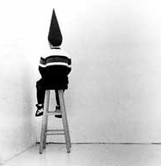
Ultimatum game
One interpretation
Most people are irrational (indeed, idiots).
They should take an economics course to learn rational self-interest.

Slide 31
Ultimatum game
Another interpretation
Most people use a more comprehensive form of rationality than rational self-interest.
We follow ground rules on which we can agree.
What policy would we agree on for this game?

Slide 32
Ultimatum game
Another interpretation
Most people use a more comprehensive form of rationality than rational self-interest.
We follow ground rules on which we can agree.
What policy would we agree on for this game?
Maybe split 50-50 between donor and recipient?
This close to what people do!

Slide 33
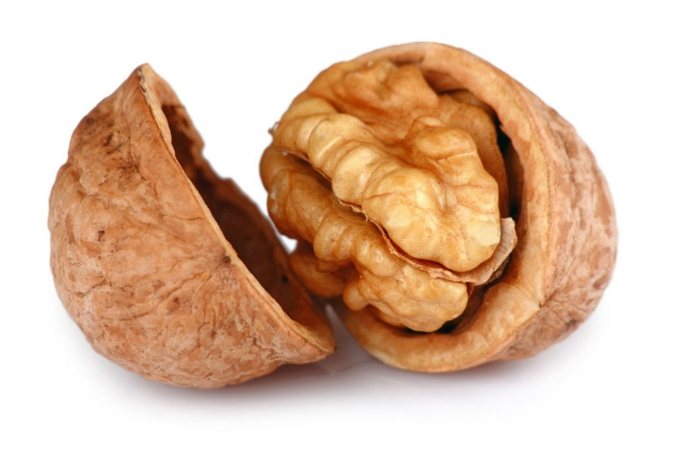
Ethics in a nutshell
We should all play by the same rules.
Ethics is how we agree on the rules.
Nobody says this is easy.
Why should we expect ethics to be easy, especially in a complicated world?

Slide 34
Intellectual Basis
Deontological tradition in ethics.
Deontology = “what is required”
Ethical principles are derived from necessary conditions for the possibility of freely chosen action.
Distilled from 200+ years of thought, right up to the present day.

Slide 35
Further reading
Dennis A. Gioia, “Pinto fires and personal ethics: A script analysis of missed opportunities,” Journal of Business Ethics 11 (1992).
Martin E. Sandbu, “Dicing with death? A case study of Guidant Corporation's implantable defibrillator business.” In M. W. Hoffman et al., Readings and Cases in Corporate Morality, 5th ed. (2014).

